Slide 1
Lecture- 27
Diffusion and Adoption of Innovations

Slide 2
What is diffusion?
•The process by which an innovation is communicated through certain channels over time among the members of a social system.
•Diffusion is a special type of communication in which the messages are about a new idea.
•The newness of the idea gives diffusion its special character –it ensures that a degree of uncertainty is involved in diffusion.
•Uncertainty –the degree to which a range of alternatives are perceived with regard to the occurrence of an event. Uncertainty implies lack of predictability and therefore of information.
•Thus information becomes a means of reducing uncertainty.
•Any technological innovation embodies information and thus reduces uncertainty about cause-effect relationships in problem solving.

Slide 3
Four Elements in Diffusion of Innovations:
•An innovation
•Is communicated through certain channels
•Over time
•Among members of a social system.
The Innovation-
•An idea, practice or object that is perceived as new by an individual or other unit of adoption.

Slide 4
Characteristics of Innovation-
•Relative Advantage
•Compatibility
•Complexity
•Trialability
•Observability
Relative Advantage –over existing technologies -can be perceived, may be measured in economic terms, social prestige, convenience and satisfaction.
•Compatibility –with existing values, past experiences, needs of potential adopters (and their social system)
•Complexity -degree to which an innovation is perceived as difficult to understand and use.

Slide 5
ADOPTER CATEGORIES There are different categories of farmers. According to Rogers (1971), the farmers based on their innovativeness can be classified as 1. Innovators (Venturesome) 2. Early adopters (Respectable) 3. Early majority (Deliberate) 4. Late majority (Skeptical)

Slide 6
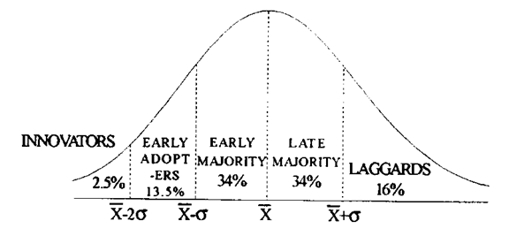
The adoption of innovation means an innovation has ceased to be “innovative.” It means that a method, technology, or approach to a problem has moved from the experimental edges of an organization to the core of its work: no longer a novelty, but something normal and institutionalized.

Slide 7
1.The distribution of adopters over time closely approaches normality, and may be explained by the statistical concept of normal curve. The distribution of the adopters may be partitioned into five adopter categories by using the mean (x) and standard deviation. The area lying to the left of the mean time of adoption minus two standard deviations includes 2.5 per cent of the individuals who are the first to adopt an innovation and are known as innovators.
2. This interest leads them out of a local circle of peers and into more cosmopolite social relationships. Communication patterns and friendships among a clique of innovators are common, eventhough the geographical distance between the innovators may be great. Being an innovator has several prerequisites. These include control of substantial financial resources to absorb the understand and apply complex technical knowledge.

Slide 8
Early Adopter: Respectable- Early adopters are a more integrated part of the local social system than are innovators. Whereas innovators are cosmopolites, early adopters are localities. This adopter’s category, more than any other, has the greatest degree of opinion leadership in most social systems. Potential adopters look to early adopters for advice and information about the innovation.
Early Majority: Deliberate (Local Adoption Leaders)- The early majority adopt new ideas just before the average member of a social system. The early majority interact frequently with their peers, but leadership position; are rarely held by them. The early majority's unique position; between the very early and relatively late to adopt make; them an important link in the diffusion process.

Slide 9
Late Majority: Skeptical- The late majority adopt new ideas just after the average member of a social system. Adoption may be both an economic necessity and the answer to increasing social pressures. Innovations are approached with a skeptical and cautions air, and the late majority do not adopt until most other in their social system have done so. The weight of system norms must definitely favour the innovation before the late majority are convinced. They can be persuaded of the utility of new ideas, but the pressure of peers is necessary to motivate adoption.
Laggards: Traditional- Laggards are the last to adopt an innovation. They possess almost no opinion leadership. They are the most localite in their outlook of all adopter categories, many are near isolates. The point of reference for the laggard is the past. Decisions are usually made in terms of what has been done in previous generations.

