Slide 1
Nutrient Acquisition
Lecture 28 : xylem and phloem mobility;
Nutrient transport to grains at maturity;
Strategies to acquire and transport minerals under deficient levels

Slide 2
Plants have tissues to transport water, nutrients and minerals. Xylem and Phloem are two different types of vascular tissues, which are mainly involved in the transportation process.
Xylem transports water and mineral salts from the roots up to other parts of the plant, while phloem transports sucrose and amino acids from the leaves to other parts of the plant.
Xylem moves water from roots to the leaves (Transpiration stream), and phloem moves food from the leaves to the rest of the plant (Translocation).
The movement of xylem is unidirectional, while the movement of phloem is bidirectional.

Slide 3
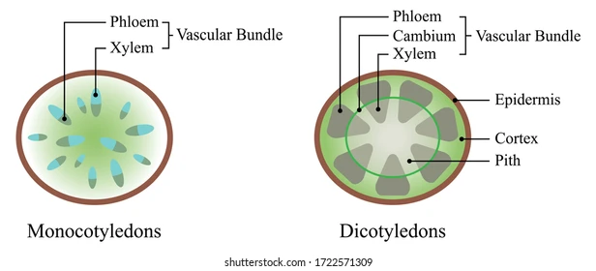
Fig. Xylem and Phloem

Slide 4
Cells scavenge compounds present in low to high abundance from their environments and accumulate them intracellularly.
There are two distinct types of nutrient uptake:
Passive transport. Passive transport does not require cell energy input. It occurs either by the passive diffusion of a molecule across the cell membrane, or by the facilitated diffusion of the molecule aided by a specialized membrane protein.
Active transport. Active transport of a nutrient requires a dedicated solute transport system and input of cell energy. There are several types of systems that are differentiated by the mechanism of molecule uptake, the energy source, and the types of proteins present. Examples include the ABC-type transporters, symporters, antiporters, and group translocation transporters.
Solute transport systems are also used to maintain intracellular ion levels, and to export cell waste materials and toxins.

Slide 5
Strategies to acquire and transport minerals under deficient levels
These strategies include
Alterations in root morphology and architecture
Acidification of root rhizosphere
Secretion of acid phosphatases and organic acids from roots
Induction of high-affinity P transport systems
Changes in carbohydrate metabolism
Formation of symbiotic association with mycorrhizal fungi

Slide 6
THANK YOU

