Slide 1
Nutrient Acquisition
Lecture 29 : Role of mycorrhiza, Root Exudates and PGPRs in plant nutrient acquisition

Slide 2
Role of mycorrhiza
Mycorrhizae are essential in areas where soils are deficient in water and certain nutrients - conditions that are found in the desert
Mycorrhizae permits the plant to obtain additional moisture and nutrients.
This is particularly important in uptake of phosphorus, one of the major nutrients required by plants.

Slide 3
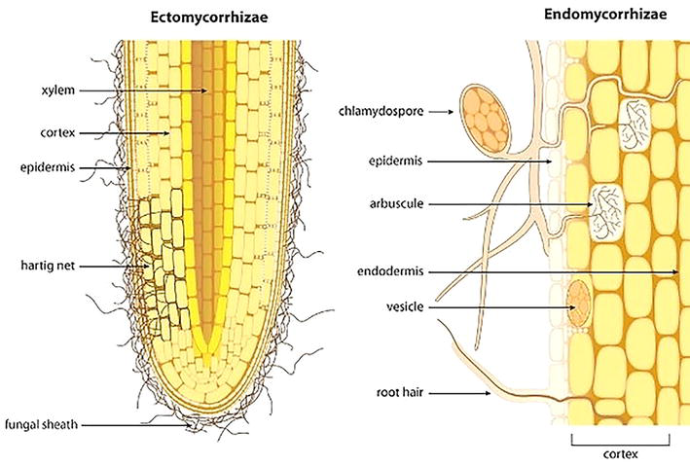
In Ecto mycorrhizae (external), the fungus produces a sheath around the root.
This sheath then produces hyphae that grow into the root and out into the soil
In Endo mycorrhizae (internal) do not produce a sheath; the hyphae grow within the cells and out into the soil.
These are far more common than the ecto mycorrhizae

Slide 4
Root Exudates
A suite of substances in the rhizosphere that are secreted by the roots of living plants and microbially modified products of these substances.
They consist of low-molecular-weight organic compounds that are freely and passively released root-cell material and mucilage associated with roots.

Slide 5
PGPRs in plant nutrient acquisition
PGPR promote plant growth through several modes of action, be it directly or indirectly.
The benefits provided by these bacteria can include
Increased nutrient availability
Phytohormone production
Shoot and root development
Protection against several phytopathogens
Reduced diseases

Slide 6
THANK YOU

