Slide 1
Concept of Foliar Nutrition
Lecture 30 : Foliar nutrition;
Significance and factors affecting total uptake of minerals

Slide 2
Foliar nutrition of mineral nutrients by means of sprays offers methods of supplying nutrients to higher plants more rapidly than methods involving root application.
Foliar nutrition consists of spraying dilute nutrient solutions on foliage in order to feed the plants with required nutrients in short time.

Slide 3
Physio-biochemical factors
Concentration
The concentration of a nutrient present in a foliar spray will always be significantly higher than the concentration found within the plant organ.
concentration gradient will be established when a nutrient solution is applied onto the plant surface and this will potentially lead to the diffusion of the nutrient across the surface.
Solubility
Water solubility of the applied substance is a key factor for foliar uptake, since absorption will occur only when the applied compound is dissolved in a liquid phase on the plant surface that will subsequently diffuse into the plant organs.

Slide 4
Molecular weight
The size of the nutrient molecule in solution will affect the rate of penetration of a foliar fertilizer as a consequence of the mechanism of cuticular absorption.
Foliar uptake pathway is less size selective than would be predicted by the cuticular penetration route of entry which may indicate that there is a stomatal pathway.
Solution pH
Since plant cuticles are poly-electrolytes, their ion exchange capacity will be altered with pH fluctuations.
Frequently foliar spray salts dissolved in pure water will alter spray solution pH and some formulations may have extreme pH values and hence will affect the uptake process of by the foliage.

Slide 5
Point of deliquescence
The point of deliquescence is defined as the relative humidity value at which the salt becomes a solute.
Lower the point of deliquescence of a salt is, the sooner it will dissolve upon exposure to ambient relative humidity.
When ambient relative humidity is higher than the point of deliquescence of the foliar applied compound, the substance will dissolve and will be available for absorption by the leaf.

Slide 6
Environmental factors
Relative humidity
At high relative humidity permeability may be increased due to cuticular hydration and the delayed drying of the salt deposited onto the plant surface following the application of a foliar spray • Salts with points of deliquescence above the prevailing relative humidity in the phyllo sphere will theoretically remain as solutes and leaf penetration will be prolonged.
Temperature
Increasing temperature range (e.g. from 0 to 40°C)
• solubility of the active ingredients, adjuvants ↑
• viscosity, surface tension and point of deliquescence↓
• high temperatures will speed the rate of evaporation from the spray solutions deposited onto the foliage reducing the time until solution dryness occurs when leaf penetration can no longer occur.
Light intensity
Thickness of cuticle and amount of cuticular waxes increases under high light intensity.

Slide 7
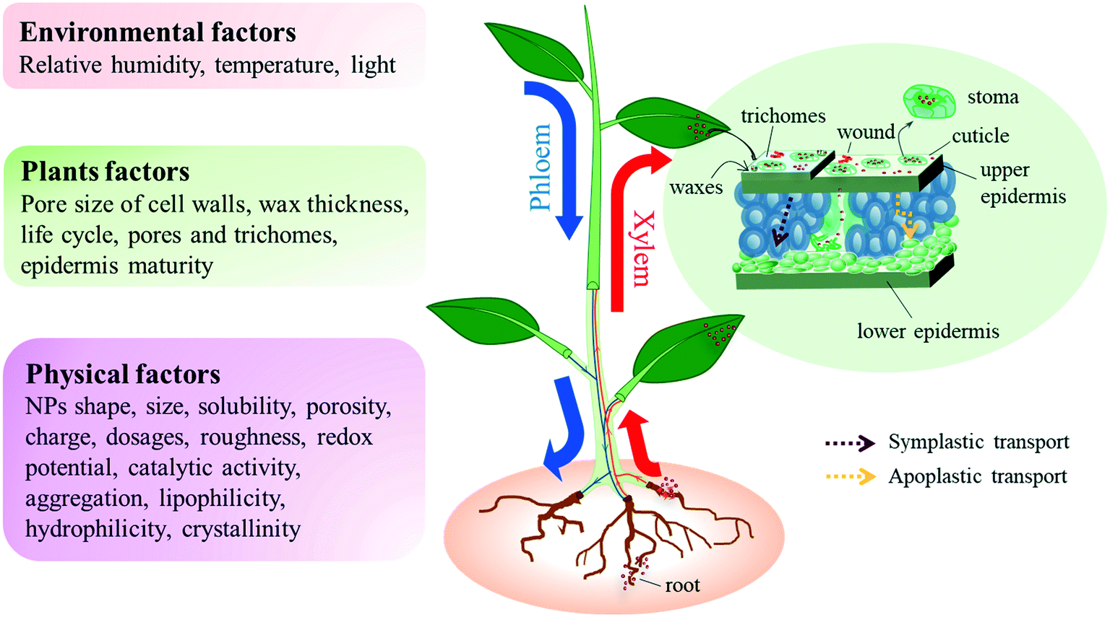

Slide 8
THANK YOU

