Slide 1
Lecture 4
Extension Programme Planning

Slide 2
Elements of a Program Plan
Situation
Objectives
Audience
Strategy
Tactics
Calendar/ Timetable
Budget
Evaluation

Slide 3
Situation-
•Understanding the situation leads to the conclusion that:–Is there a problem or negative situation that needs to be addressed?
Ex: Production/marketing –Needed to reinforce an ongoing effort and introduction of new technology?
Ex: variety, practice
2. Objectives
•What is the desired outcome?
•Does it really address the situation?
•Is it realistic and achievable?
•Can success be measured in meaningful terms?
3. Audience-
•Extension programs should be directed toward specific and defined target communities
•Use research to identify demographics as age, income, social strata, education, existing enterprise, resource use behaviour etc.

Slide 4
Strategy-
•How, in concept, is an objective going to be achieved?
•Key themes and message that should be part of programme
•Plan should contain changes to be achieved in target communities.
5. Tactics-
•Are “nuts and bolts” of plan that describe, in sequence, the specific activities that put strategies into operation and help achieve the stated objectives
•Tactics involve using the tools of communication to reach primary and secondary target communities with extension inputs.
6. Calendar/Timetable
•Determining the proper sequence of activities
•Compiling a list of steps that must be completed to produce a desirable change in target communities.

Slide 5
7. Budget-
•No program plan is complete without a budget
•Part of strategy to ensure flow of finance as per the programme
•The anticipated outcomes/outputs are directly related to financial input
8. Evaluation-
•Objectives must be measurable in some way to show program accomplished its purpose
•Types of evaluation : Ex-ante, concurrent and Expost facto

Slide 6
STEPS IN EXENSION PROGRAMME PLANNING
Review of progress and projection of plans
Analysis of Situation
Identification of problems
Finding solutions to problems
Selecting problems and determining priorities
Preparing a plan of action or Annual plan of work
Carrying out the plan
Continuous checking and evaluation of result

Slide 7
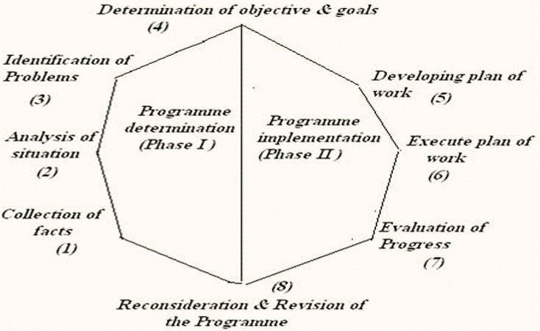

Slide 8
Types of planning
•Nature–Strategic–Tactical–Operational–Contingency •Managerial level –Top level–Middle level–Lower level
•Time–Long term–Intermediate term–Short term
•Use –Single use–Standing plan Based on Nature
•Strategic Plan:formulated by top level management for a long period of time of five years or more. They decide the major goals and policies to achieve
•Tactical Plan:concerned with integration of various organizational units. Involves resource utilization to achieve the strategic goals
•Operational Plan:Formulated by lower management for short term period. Concerned with the day to day operations of the organization. It is detailed and specific.
•Contingency Planning: Made when something unexpected happens or when something needs to be changed

Slide 9
On the basis of time
•Long Term Plan: Determines the path for research and development institutions to reach their goals. It also reinforces and makes corrections to the goals as the plan progresses
•Intermediate Plan: Covers 6 months to 2 years. It outlines how the strategic plan will be pursued.
•Short-term Plan: Involves pans for a few weeks or at most a year. Allocates resources for the day-today activities and management within the strategic plan.

Slide 10
On the basis of use
•Single Plan: Connected with some special problems. These plans end the moment problem is solved. They are further re-created whenever required
•Standing Plan: Formulated once and they are repeatedly used. Continuously guide the extension professionals. Include mission, policies, objective, rules and strategy

Slide 11
Conclusion
In practice the steps provide us insight regarding planning the programme and programme planning •Appropriate planning involving holistic approach leads to overall development

