Slide 1
Lecture no. 3: Henri Fayol 14 Principle of Management, Classification of functions of management, Levels of Management

Slide 2
Henri Fayol 14 Principle of management
Henry Fayol, also known as the ‘father of modern management theory’ gave a new perception of the concept of management. He introduced a general theory that can be applied to all levels of management and every department. The Fayol theory is practiced by the managers to organize and regulate the internal activities of an organization. He concentrated on accomplishing managerial efficiency.

Slide 3
Henri Fayol 14 Principle of management
14 principle are:
1. Division of work 11. Equity
2. Authority and responsibility 12. Stability
3. Discipline 13. Initiative
4. Unity of command 14. Esprit de corps
5. Unity of direction
6. Subordination of Individual Interest
7. Remuneration
8. Centralization
9. Scalar chain
10. Order

Slide 4
1. Division of Work-
Henri believed that segregating work in the workforce amongst the worker will enhance the quality of the product. Similarly, he also concluded that the division of work improves the productivity, efficiency, accuracy and speed of the workers. This principle is appropriate for both the managerial as well as a technical work level.
2. Authority and Responsibility-
These are the two key aspects of management. Authority facilitates the management to work efficiently, and responsibility makes them responsible for the work done under their guidance or leadership.

Slide 5
3. Discipline-
Without discipline, nothing can be accomplished. It is the core value for any project or any management. Good performance and sensible interrelation make the management job easy and comprehensive. Employees good behaviour also helps them smoothly build and progress in their professional careers.
4. Unity of Command-
This means an employee should have only one boss and follow his command. If an employee has to follow more than one boss, there begins a conflict of interest and can create confusion.
5. Unity of Direction-
Whoever is engaged in the same activity should have a unified goal. This means all the person working in a company should have one goal and motive which will make the work easier and achieve the set goal easily.

Slide 6
6. Subordination of Individual Interest-
This indicates a company should work unitedly towards the interest of a company rather than personal interest. Be subordinate to the purposes of an organization. This refers to the whole chain of command in a company.
7. Remuneration-
This plays an important role in motivating the workers of a company. Remuneration can be monetary or non-monetary. However, it should be according to an individual’s efforts they have made.

Slide 7
8. Centralization-
In any company, the management or any authority responsible for the decision-making process should be neutral. However, this depends on the size of an organization. Henri Fayol stressed on the point that there should be a balance between the hierarchy and division of power.
9. Scalar Chain-
Fayol on this principle highlights that the hierarchy steps should be from the top to the lowest. This is necessary so that every employee knows their immediate senior also they should be able to contact any, if needed.
10. Order-
A company should maintain a well-defined work order to have a favorable work culture. The positive atmosphere in the workplace will boost more positive productivity.

Slide 8
11. Equity-
All employees should be treated equally and respectfully. It’s the responsibility of a manager that no employees face discrimination.
12. Stability-
An employee delivers the best if they feel secure in their job. It is the duty of the management to offer job security to their employees.
13. Initiative-
The management should support and encourage the employees to take initiatives in an organization. It will help them to increase their interest and make then worth.

Slide 9
14. Esprit de Corps-
It is the responsibility of the management to motivate their employees and be supportive of each other regularly. Developing trust and mutual understanding will lead to a positive outcome and work environment.

Slide 10
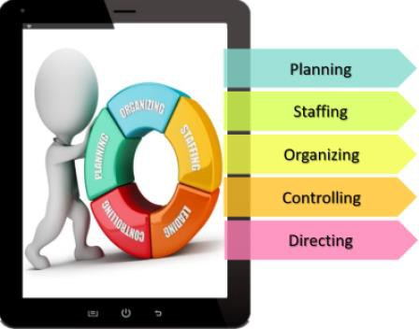
Classifications of functions of management

Slide 11
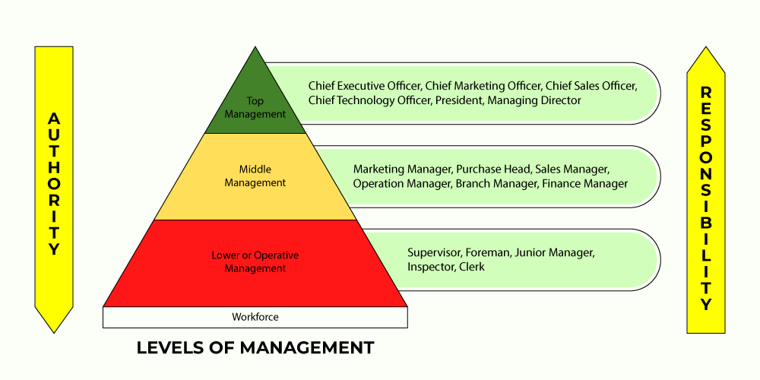

Slide 12
Levels of Management:
Administrative, Managerial, or Top Level of Management: This level of management consists of an organization’s board of directors and the chief executive or managing director.
Executive or Middle Level of Management: The branch and departmental managers form this middle management level. These people are directly accountable to top management for the functioning of their respective departments, devoting more time to organizational and directional functions.
Supervisory, Operative, or Lower Level of Management: This level of management consists of supervisors, foremen, section officers, superintendents, and all other executives whose work must do largely with HR oversight and the direction of operative employees.

