Slide 1
EMERGENCY DRUGS

Slide 2
ADRENALINE
LIDOCANE
AMIODARONE
CALCIUM GLUCONATE
FRUSEMIDE
ATROINE
DOPAMINE
NORADRENALINE
ADENOSINE
METEPROLOL
DOBUTAMINE
CHLORPHENARAMINE
DEXAMETHASONE
HYDROCORTISONE
MIDAZOLAM
TRAMADOL
SODIUM BICARBONATE

Slide 3
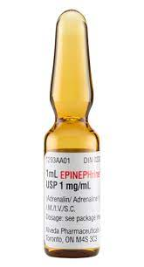
Adrenaline :
Mechanism of action :
1. α – adrenergic – vasoconstriction
2. β2 – adrenergic – bronchial relaxation
Dose :
1ml – 1mg
onset : 3- 5 min
cardiac arrest – every 3-5 min
DS – 10ml+ 40ml ns
Indication :
cardiac arrest
anaphylaxis

Slide 4
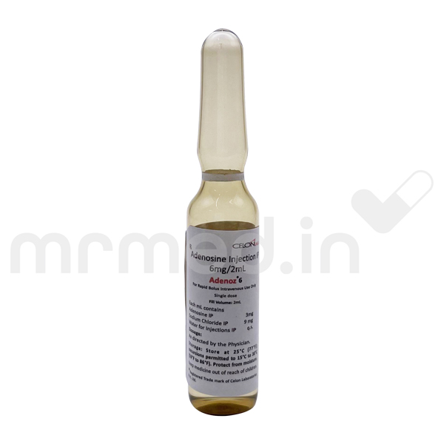
ADENOSINE :
Mechanism of action :
1. anti arrhythmic
2. slows condition time through the av node can interrupt
the re-entry of pathways through the av node , and can
restore normal sinus rhythm in patients with paroxysmal
supraventricular tachycardia
Dose :
2ml- 6mg
onset – 20-30 sec
max dose 12mg

Slide 5
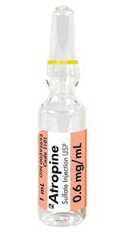
Atropine :
Mechanism of action :
1. anti arrhythmic , anticholinergic .
2. these actions increase cardiac output and heart rate ,
decrease by blocking vagal stimulation in heart .
3. blocks the acetylcholine receptors to dries the secreations .
Dose:
1ml – 0.6mg
onset immediately
max dose : 3mg
if op poisoning : 4mg or more

Slide 6
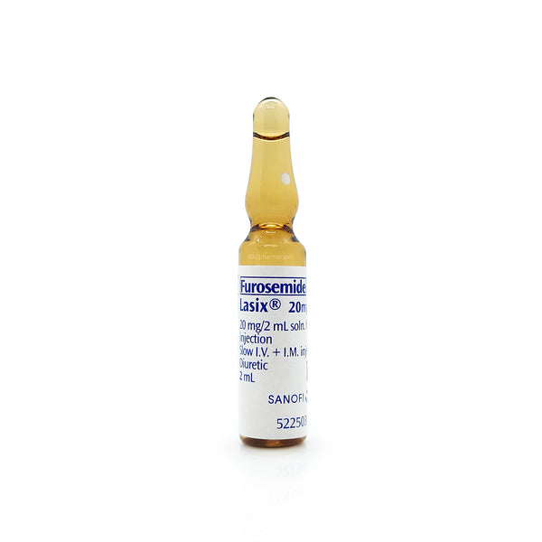
Furosemide :
Mechanism of action :
1. inhibit reabsorption of sodium and chloride at proximal
and distal tubule and in loop of henle
Dose :
1ml – 10 mg
first dose – 20 – 80 mg
second dose after 6th hour of 1st dose
onset : 2-3 min
max dose : 600-800 mg

Slide 7
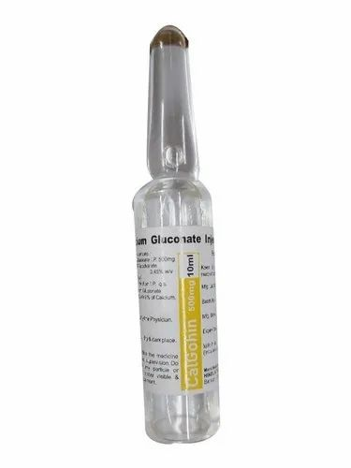
Calcium gluconate :
Mechanism of action :
1. calcium needed for maintenance of nervous
muscular , skeletal functions
2. mainly cardiac contractibility
Dose :
10ml- 10%
ensure 10:10:10
max dose : 3 gram
Slow iv

Slide 8
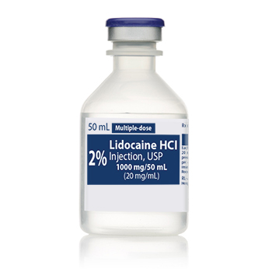
2% lidocaine :
Mechanism of action :
1. type 1 antiarrythmic : decrease diastolic depolarization decreasing automaticity of ventricular cells .
Dose :
1ml – 20mg
50 – 100mg { 25 – 50mg/min }
repeat q3-5min
max dose : 300mg/hr

Slide 9
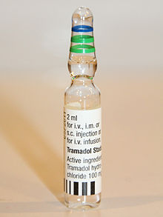
Tramadol :
Mechanism of action :
binds to opioid receptors inhibit reuptake of norepinephrine , serotonin , weak opioid analgesics
Dose :
1ml-50mg
1ml diluted with 9ml ns
max dose : 400mg/day

Slide 10
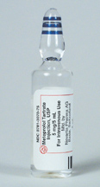
Metoprolol :
Mechanism of action :
anti hyertensive lowers BP by beta blocking effects
Dose :
1ml-1mg
max dose : 400mg / day
slow IV

Slide 11
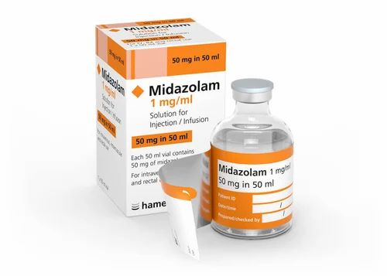
midazolam :
Mechanism of action:
1. sedative , anti anxiety , hypnotic
2. depress subcortical levels in CNS
Dose :
1ml-1mg
max dose : 15mg/day

Slide 12
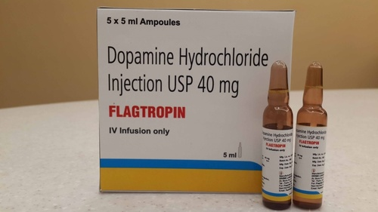
Dopamine :
Mechanism of action :
1. adrenergic agent
2. vasoconstrictor and inotropic effect causes increased
cardiac output ,renal flood flow and sodium excretion
Dose:
1ml-40mg
5ml- 200mg
Ss-5ml+45ml ns
ds-10ml +40ml ns

Slide 13
Nor adrenaline:
Mechanism of action :
1. adrenergic agent
2. vasoconstrictor
3. BP ,heart rate , cardiac output increases
Dose :
1ml-1mg
ss -4ml+46ml 5D
ds-8ml+42ml 5D

Slide 14
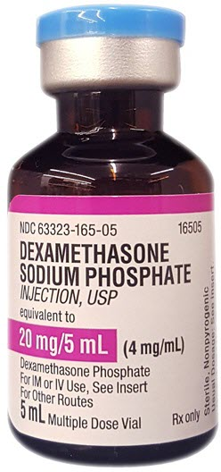
DEXAMETHASONE:
Mechanism of action:
1. corticosteroid , anti inflammatory, immuno suppressant
2. decrease inflammation by suppression of poly morpho nuclear leucocytes
Dose :
1ml-4mg
initially 0.5-20mg

Slide 15
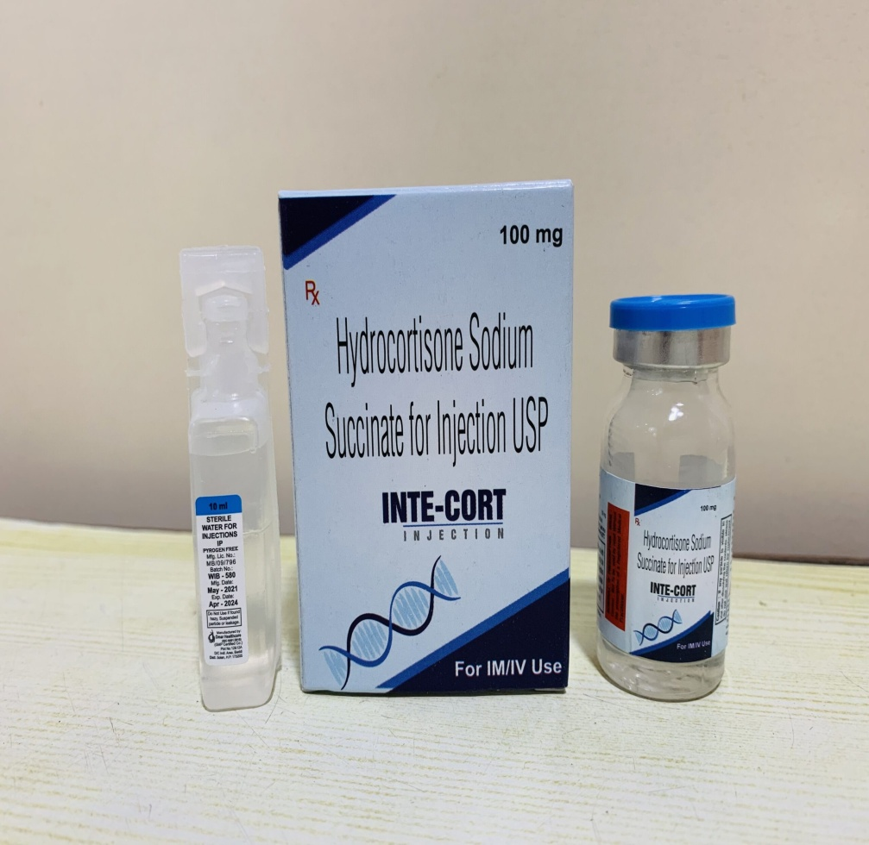
Hydrocortisone :
Mechanism of action :
1. corticosteroid
2. anti inflammatory
3. immunosuppressive and salt retaining
Dose:
100 – 500 mg
3-4 times in 24 hours

Slide 16
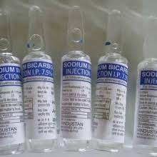
Sodium bicarbonate :
Mechanism of action :
1. alkanilizer
2. reverse acidosis
Dose:
10ml-7.5%
if severe acidosis , 50 ordered means 5 ampoules
have to administer

