Slide 1
Decision Making
SESSION 23
Dr. Chitrasena Padhy
Associate Professor
Agricultural Extension

Slide 2
About Decision-making
A decision is a choice made between two or more available alternatives.
Decision-making is the process of choosing the best alternative for reaching objectives.
Decision-making is the process of making choices by identifying a decision, gathering information, and assessing alternative resolutions.
Common examples include deciding for whom to vote, what to eat or buy, and which college to attend.

Slide 3
Types of decision
The basic decision or strategic decision
Administrative decision
Organizational or Personal decision
Policy of decision
Individual and group decision
Routine decision
Adaptive decision

Slide 4
Basic decision or strategic decision
1. Basic decision
A basic decision is a choice that is made between two or more options.
Example:- It can be a simple decision, such as deciding what to eat for breakfast, or a more complex decision, such as deciding which college to attend or which job to take.
2. Strategic decision
Strategic decisions are those that have a long-term impact on an organization or a situation. They involve making choices that will shape the direction of the organization and help it achieve its goals.
Examples:- How to decide to enter a new market, acquire a company, launch a new product, or change the organization's business model.

Slide 5
Administrative decision
Herbert Simon classified the decision in two classes
1. Programmed decision
It involves organization which and develop a specific process for handling this decision.
Examples:- standing operating procedures and policies.
2. Non-programmed decision.
They relate to the general problem-solving process. They involve judgment intuition and creativity.
This type of decision are taken mostly by high-level management.
Examples:-
Whether a company must acquire another organization or not.
Whether a new technology must be adopted or not.

Slide 6
Organizational or personal decision
Organizational decisions reflect company policy.
They can be delegated or transferred to others.
Strategic:-
Decide entrance or exit from the market
Approve capital budget
Managerial:-
Design a marketing plan
Develop a new operational procedure
Operational:-
Involve in marketing
Store inventory control
Strategic
Managerial
Operational
While personal decisions referred to those made by a manager as an individual and this can’t be dedicated.

Slide 7
Individual and group decisions
The decisions taken by an individual in an organization are known as individual decisions.
Group decisions refer it’s the decisions which are taken by a group of organizational members (board directors, and a committer of experts)

Slide 8
Routine decisions
The type of decisions made when problems are relatively well defined and common and when established rules, policies and procedures can be used to solve them
Adaptive decisions
Adaptive decision-making can be particularly useful in complex or uncertain situations where it may not be possible to predict all the variables or outcomes in advance..

Slide 9
Decision-making process
Specific objectives
Identification of problems
Search for alternatives
Evaluation of alternatives
Choice of alternatives
Action
Results

Slide 10
Specific objectives
The need for decision-making arises in order to achieve certain specific objectives.
The starting point in any analysis of decision-making involves the determination of whether a decision needs to be made.
This may not be considered truly the first step of the decision process but provides a framework for further decisions.
Identification of problem
A problem is a gap between the present and desired state of affairs on the subject matter of the decision.
In management, a problem exists whenever one faces a question whose answers involve doubt and uncertainty.

Slide 11
Search for alternatives
The problem can be solved in several ways, however, all the ways are not equally satisfying. Therefore, that is the decision maker must try to find out the various alternatives available in order to get the most satisfactory result of a decision.

Slide 12
Evaluation of alternatives
For evolution 2 approaches can be followed:
Constraint on alternatives
That the decision maker develops a list of limits that must be met by a satisfactory solution.
He may treat these limits as constant, that is, he may check proposed alternatives against limits, and if an alternative does not meet them, he can discard it.
2. Grouping of alternatives of similar nature
In this approach, the various alternatives can be grouped into classes on some specific criteria important to decision-making.

Slide 13
Choice of alternative
The choice aspect of decision-making is related to deciding the most acceptable alternative which fits with the organizational objectives.
In choosing an alternative, we can follow 3 approaches:
Experience
Experimentation
Research and analysis.

Slide 14
Action
Once the alternative is selected, it is put into action and implementation of a decision.
Results
When the decision is put into action, it brings certain results.
Results provide an indication of whether decision-making and its implementation are proper.

Slide 15
Techniques of decision making
Brainstorming
Nominal group technique
Delphi technique
Multi - voting
Electronic meeting

Slide 16
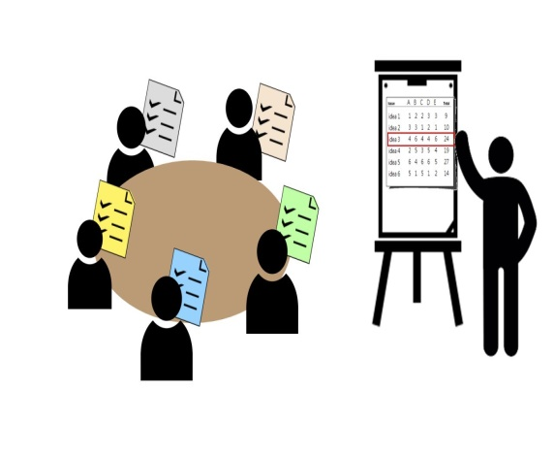
Brainstorming
A group problem-solving technique that involves the spontaneous contribution of ideas from all members of the group.
Nominal group technique
In a nominal group technique, the team divides itself into smaller groups and generates ideas.
Team members then discuss and vote on the best possible choice.
The choice that receives the maximum votes is accepted as the group decision.

Slide 17
Delphi method
In the Delphi technique of decision-making, members do not have face-to-face interaction for group decisions.
The decision was arrived at through written communication in the form of filling up questionnaires often through the mail and submitting their ideas.
The facilitator then collects all the information from others for modifying or improving them.
This process continues until a final decision is made.

Slide 18
Multi - voting
It starts with a round of voting where an individual casts his vote for the shortlisted options.
Each individual can cast one vote at a time.
The persons with the maximum number of votes are carried to the next round.
This process is repeated until a clear winning is obtained.
The strategy that receives the maximum number of votes is considered final.
Electronic meeting
Here, the decision-making process takes place virtually with the help of technology.

Slide 19
Principles of decision making
Principle of alternatives
Distinguish between real options and false options.
Differentiate between risk and uncertainty.
Draw up your ideal criteria before looking at available options.
Participation of employees.

Slide 20
Models of decisions making
There are many different models of decision-making that have been proposed in the fields of psychology, economics, and management.
Rational choice theory
This model assumes that people make decisions based on a cost-benefit analysis, choosing the option that maximizes their expected utility.
2. Prospect theory
This model proposes that people make decisions based on the potential gains and losses they expect to incur, rather than the final outcomes of their choices.

Slide 21
3. Heuristics and biases
This model suggests that people often rely on mental shortcuts or rules of thumb (heuristics) when making decisions, which can lead to systematic biases in their judgment.
4. Normative models
These models describe how people ought to make decisions, based on principles of rationality or utility maximization.
5. Descriptive models
These models describe how people actually make decisions, based on observations of real-world behaviour.

Slide 22
Difficulties in Decision-making
Incomplete Information
Un-supporting environment
Non-acceptance by subordinates
Ineffective Communication
Incorrect timing

Slide 23
THANK YOU

