Slide 1
Social Judgement
SESSION 28
Dr. Chitrasena Padhy
Associate Professor
Agricultural Extension

Slide 2
Contents
About Social Judgement Theory
What is it???
Why is it important???
Principles of SJT
Social Judgement Process
Social Judgement Examples
SJT aka Ego-involvement theory

Slide 3
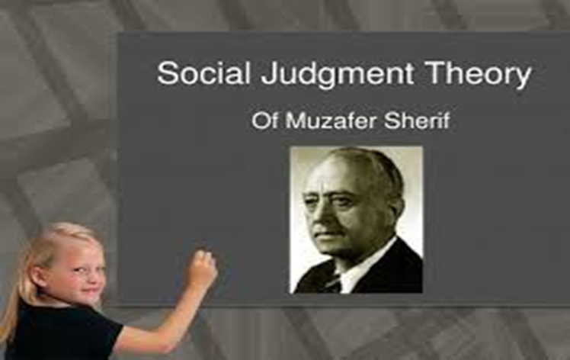
About Social Judgement theory
Social Judgement theory states that you have a statement or message and you accept it or reject it based on your cognitive map. You accept or reject a message based on one's own ego involvement and if it falls within your latitude of acceptance. Theorists: Muzaffar Sherif, Carolyn Sherif, Carl Hovland

Slide 4
What is it???
Social Judgement Theory suggests that when people are presented with an idea or any kind of persuasive perposal , their natural reaction is to immediately seek a way to sort the information subconsciously and react to it.
We evaluate the information and compare it with the attitude we already have , which is called the initial attitude or anchor point.

Slide 5
Why is it important???
Social Judgment Theory is important because it is involved in every aspect of life. It is the reason people say, belief, and do the things they do.

Slide 6
Principles of Social Judgement Theory (SJT)
We have categories of judgment by which we evaluate persuasive arguments.
When we receive persuasive information we use our categories of judgment to assess it.
Our level of ego involvement affects the size of our latitudes.
We generally distort incoming information to fit our categories of judgement.

Slide 8
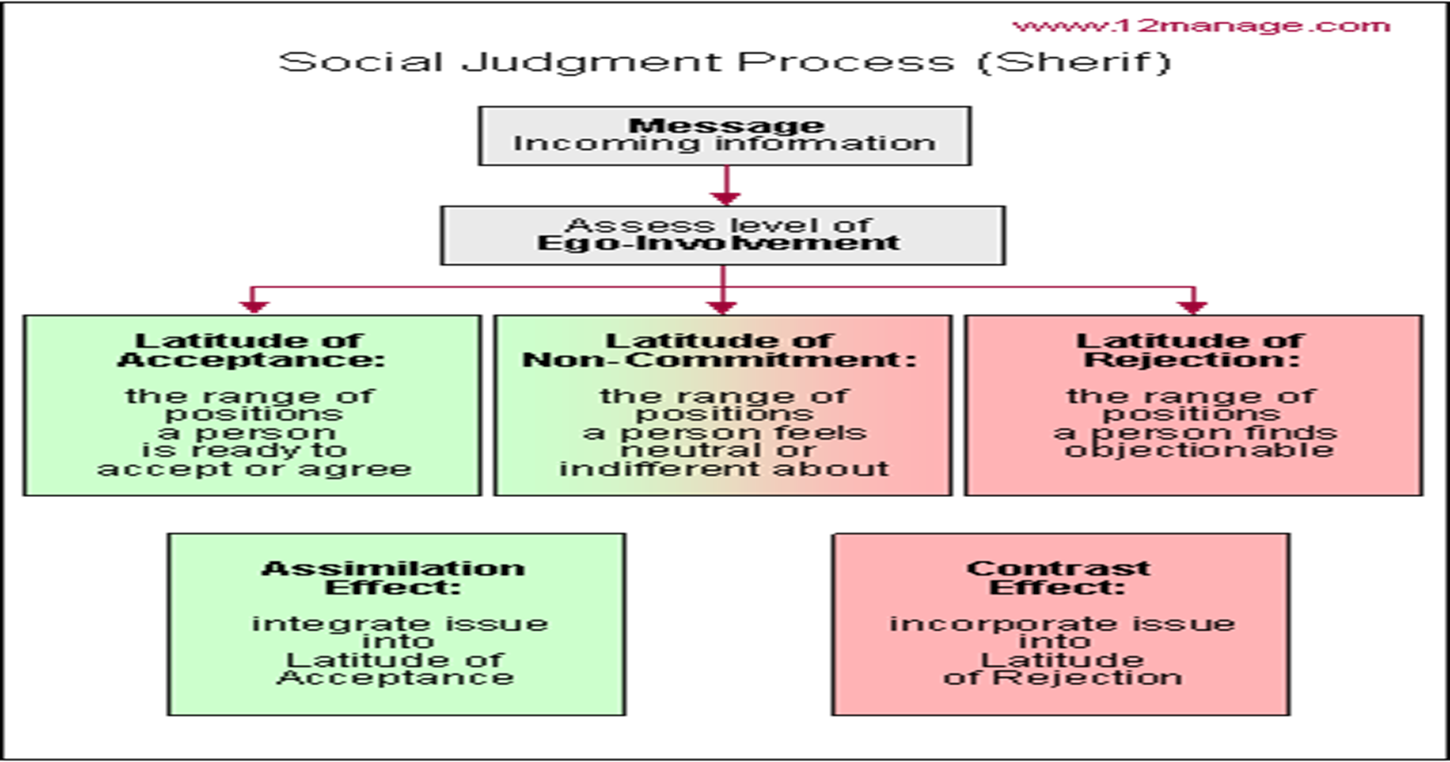

Slide 10
SJT aka Ego-involvement theory.
Basically, the more ego-involved one is with a situation, usually the more knowledgeable in the subject…therefore making the person much harder to persuade

Slide 12
Conclusion
Social judgment theory suggests that the way we form opinions and thoughts on certain issues depends on three main factors: our anchor, other alternatives, and ego-involvement. These all mean different things to each of us and makes our viewpoint unique.

Slide 13
THANK YOU

