Slide 1
Theories of Motivation
SESSION 7
Dr. Chitrasena Padhy
Associate Professor
Agricultural Extension

Slide 2
Introduction
The term motivation comes from the Latin word movere, referring to the movement of activity. Motivation has as many faces as there are human desires.
Motivation is a psychological term that means it cannot be forced on a person. It comes automatically from inside the person as it is the willingness to do the work.
://www.verywellmind.com/what-is-motivation-2795378

Slide 3
Definition of motivation
"Motivation is the driving force behind the energy required to complete a task, a lack of motivation will give rise to a lack of driving power behind completing a certain task."
https://psychologydictionary.org/motivation/

Slide 4
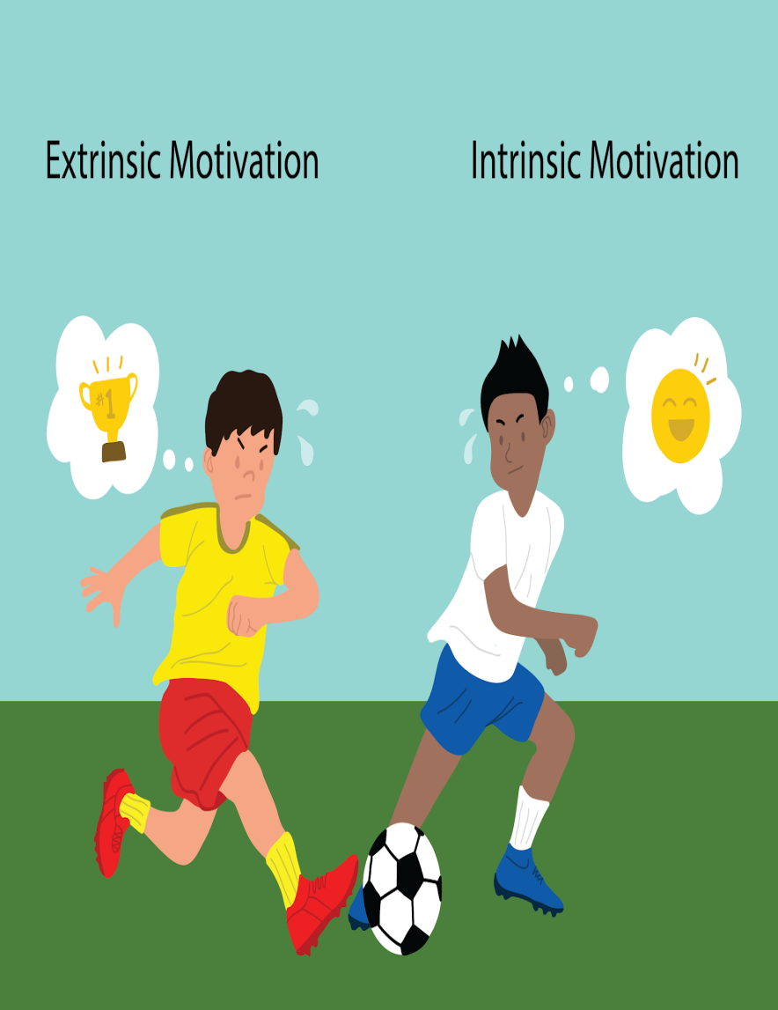
Types of motivation
Extrinsic
When an individual performs an action or behavior because the individual is affected by the eternal factors such as rewards or punishments
Intrinsic
The act of being motivated by internal factors to perform certain actions and behavior
://www.verywellmind.com/what-is-motivation-2795378

Slide 5
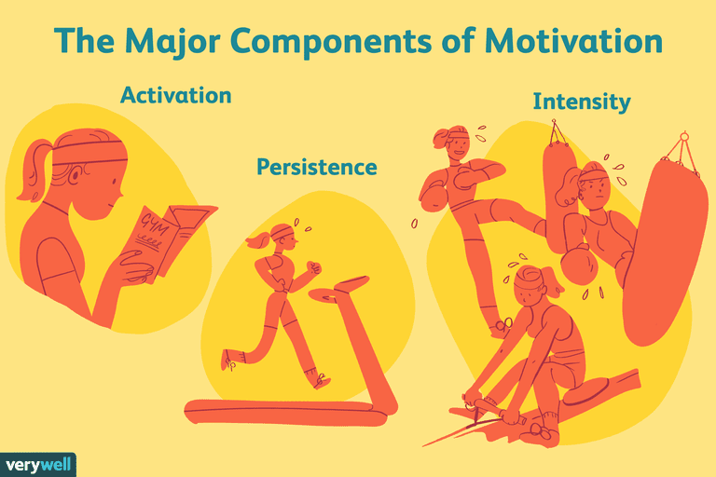
://www.verywellmind.com/what-is-motivation-2795378

Slide 6
Process of motivation

Slide 7
Theories of motivation
Motivation theories try to explain what motivates human behavior in the hopes of yielding insights that can help organizations to improve the productivity of their workers.
Maslow’s hierarchy of needs theory
McClelland’s learned needs theory
Alderfer’s ERG theory
Herzberg’s two-factor theory
McGregor’s Theory X and Theory Y
Vroom’s expectancy theory
Adam’s equity theory
Carrot and stick theory

Slide 8
Maslow’s hierarchy of needs theory
One of the most widely-known theories of motivation, it arranges human needs in a hierarchy. The lower a need in the hierarchy, the more dominant it is. When a lower-level need is satisfied, the next-level need emerges. The person keeps climbing up the pyramid to reach self-actualization
://byjus.com/biology/maslows-hierarchy-of-needs/

Slide 9
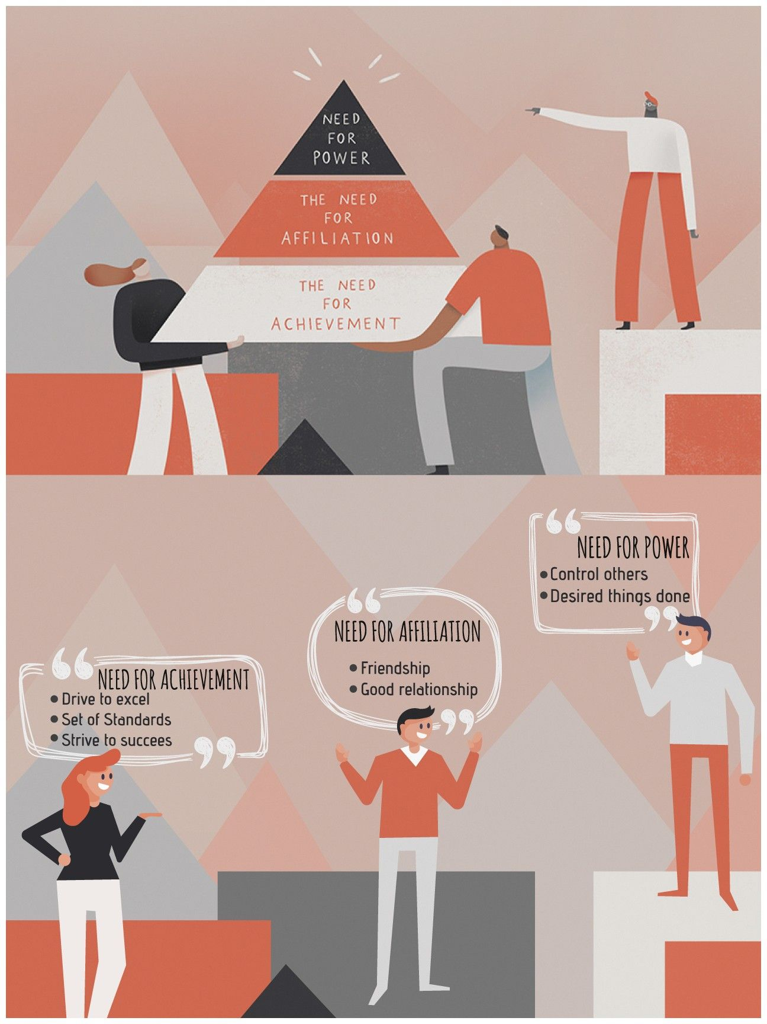
McClelland’s learned needs theory
This theory states that humans learn to desire power, achievement, and affiliation from their experiences and interactions with the world around them
://www.managementstudyhq.com/mcclellands-theory-of-needs-power-achievement-and-affiliation.html

Slide 10
Cont.
NEED FOR ACHIEVEMENT
People who have the drive to excel
They like competition and always like to stay at the top
They want to do something different from others
NEED FOR POWER
Desire to have an impact on others
They like to influence others
Concerned about their status and prestige
NEED FOR AFFILIATION
Wants to belong to a group
Wants to be liked by others
Favors collaboration over competition
://www.managementstudyhq.com/mcclellands-theory-of-needs-power-achievement-and-affiliation.html

Slide 11
Herzberg’s two-factor theory
Herzberg talks about two factors in his theory that influence motivation. These are motivation and hygiene/maintenance factors and the presence of motivation factors increases job satisfaction whereas the absence of hygiene factors leads to job dissatisfaction
://www.simplypsychology.org/herzbergs-two-factor-theory.html

Slide 12
McGregor’s Theory X and Theory Y
McGregor took a different approach while trying to explain what motivates workers. Instead of focusing on human needs like the previous theories did, he focused on the nature of workers and concluded that there are two types of workers
https://parsadi.com/mcgregors-x-and-y-theories/

Slide 13
Management techniques of theory x and y
MANAGEMENT TECHNIQUES | THEORY X | THEORY Y
Setting of objectives | Set by superior | Set by superior and workers jointly
Leadership style | Autocratic | Democratic
Motivational philosophy | Most people must be controlled, directed, or threatened with punishment to get them to put forth adequate effort towards the achievement | A system of positive incentives and rewards are required
https://parsadi.com/mcgregors-x-and-y-theories/

Slide 14
Alderfer’s ERG theory
Clayton Alderfer refined Maslow's hierarchy of needs by categorizing Maslow’s pyramid into a theory of Existence, Relatedness, and Growth, with a primary focus on esteem and job performance
worldofwork.io/2019/02/alderfers-erg-theory-of-motivation/

Slide 15
Vroom’s expectancy theory
Vroom’s expectancy theory of motivation says that individuals are motivated to do something by three things. They are motivated when they value the reward associated with an action, trust that they’ll receive the reward if they do a good job and believe that they have the ability to achieve their objectives by working hard.
Expectancy (Efforts):
This is about what employees expect from their own efforts (expected outcome) and the relation to good performance and outcomes (performance expectancy).
Instrumentality (Performance):
It refers to the belief and expectation of a person that his performance will lead to a particular desired reward.
Valence (Rewards):
It refers to the desire of a person with respect to a potential outcome or reward. The reward may be extrinsic or intrinsic.

Slide 16
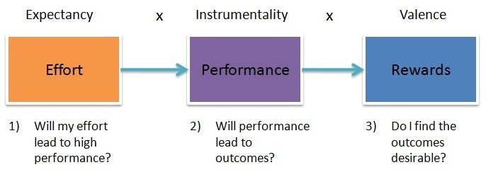
://www.toolshero.com/psychology/vrooms-expectancy-theory/

Slide 17
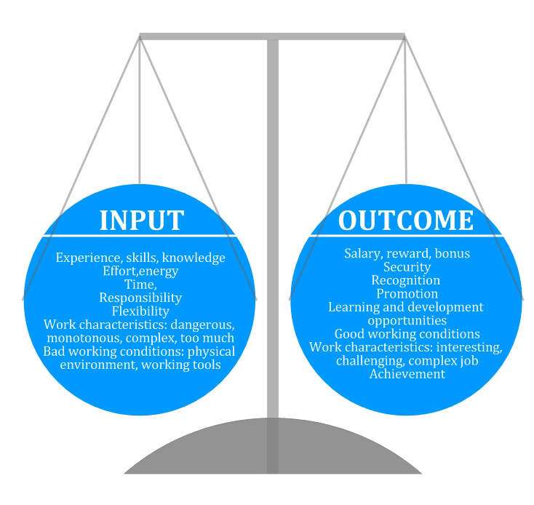
Adam’s Equity theory
According to this theory, motivation is not only influenced by one’s effort and how likely one thinks their efforts are going to lead to rewards, but also by how others are rewarded for their efforts.
People have a tendency to compare themselves with other.
://www.mindtools.com/azv3n0k/adams-equity-theory

Slide 18
When a person feels inequity then….
Change the input/put more efforts
Choose a different referent
Quit the job
Change the self-perception/re-evaluate others’ input
://www.mindtools.com/azv3n0k/adams-equity-theory

Slide 19
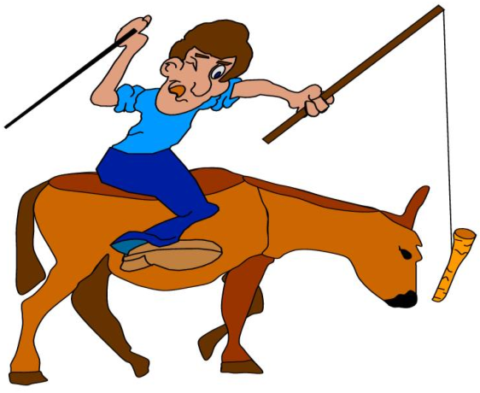
Bentham’s Carrot and Stick Approach of Motivation
This theory suggests a combination of both rewards and penalties for motivation. the rewards are given in the form of money, promotion, and any other financial or non-financial benefits and sometimes the punishments are exerted to push an individual towards the desired behavior.
://managementweekly.org/stick-and-carrot-theory/

Slide 20
How to Increase Motivation Levels
Set goals
Make sure to reward yourself every time you achieve your weekly goals
Overcome fears and obstacles
Have a rest after hard work
Get inspired

Slide 21
Thank you

