Slide 1
Operating principle of firearms
Ujaala Jain
Assistant Professor, SoFS

Slide 2
Cycle of Firing
Loading
Corking
Press the trigger
Push firing pin
Hit ammunition
Unload cartridge case
Fire

Slide 4
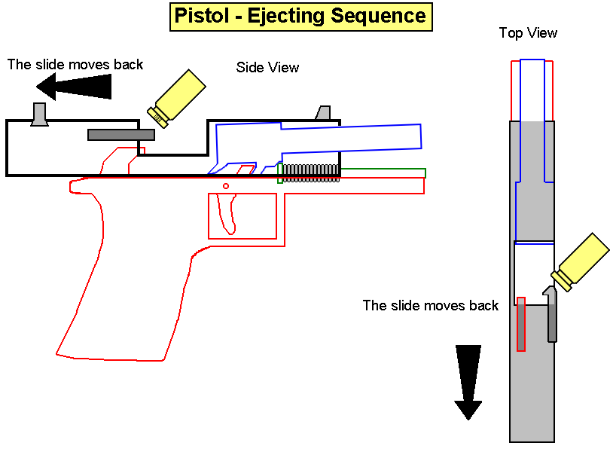
Cartridge Case Identification Cartridge Case ejection
barrel
Magazine
and magazine
spring
Louise Walzer, JPSO Crime Lab

Slide 5
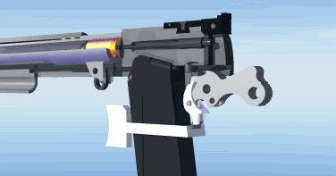

Slide 6
The firing pin is recessed
-
The firing pin strikes the primer, sending the bullet down the barrel.
The back of the primer is
slammed back onto
the breech.
Louise Walzer, JPSO Crime Lab

Slide 7
Firing Pin
Striking
Primer
Louise Walzer, JPSO Crime Lab

Slide 8
PRIMER
CUP
F C
ANVIL
FLASH HOLE
CONTACT EXPLOSIVES
Louise Walzer, JPSO Crime Lab

Slide 9
Rearward movement of Slide
after cartridge has been fired
Ejection port
Breech
Slide
Extractor
Ejection of
Fired Cartridge
Case

Slide 10
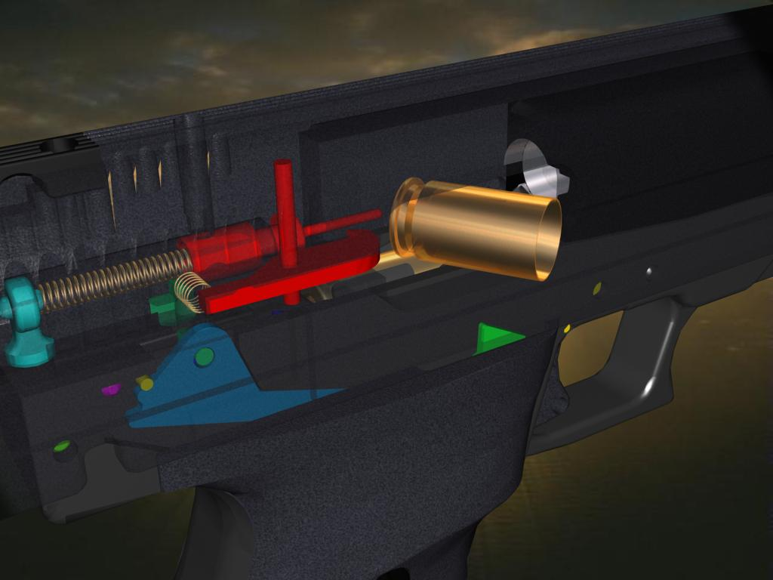
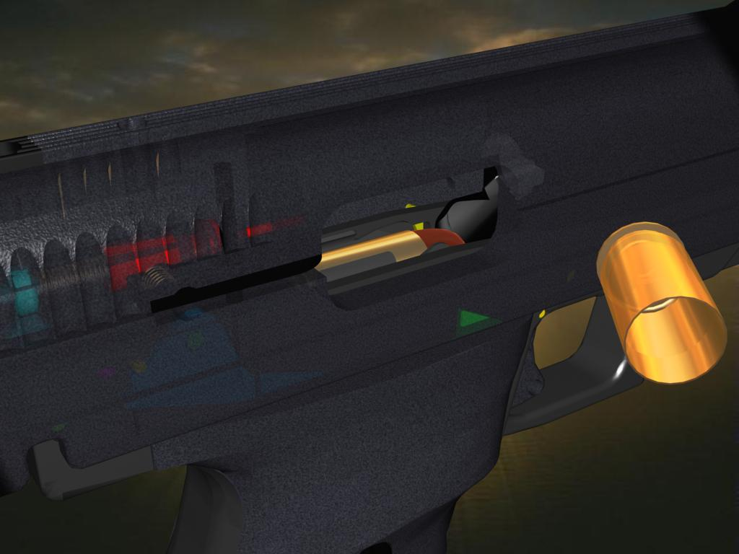

Slide 11
Action Mechanism
Automatic Action- Only one trigger press is needed and the entire process is done automatically.
Semi-automatic Action- The process is completed till unloading of the cartridge case and after that a new trigger press is required.
Manual- Everything has to be done manually by the operator.

Slide 12
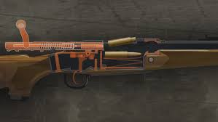
Loading and Unloading mechanism
Bolt Action
The mechanism combines the firing pin, a spring, and an extractor, all housed in a locking breechblock. The spring-loaded firing pin slide back and forth inside the bolt, which itself is the breechblock.

Slide 13
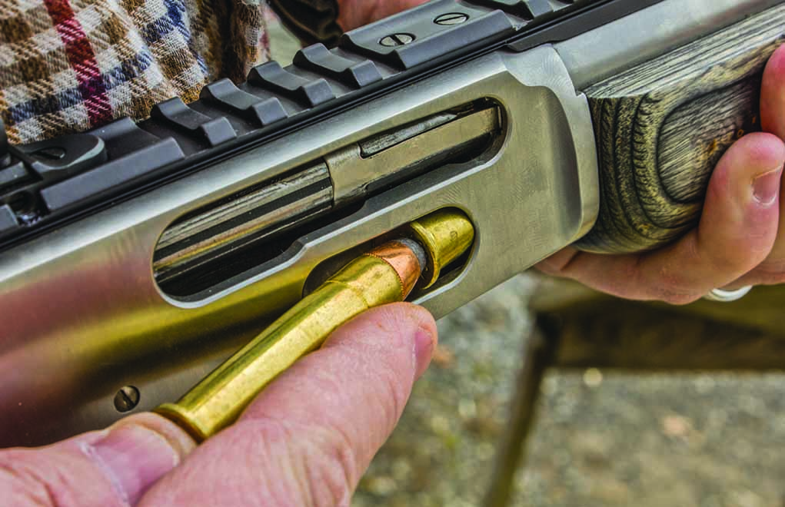
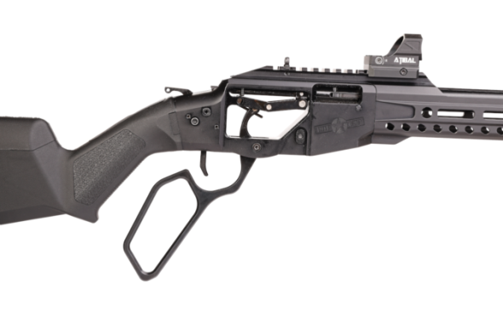
Loading and Unloading mechanism
Lever Action
It is a type of action for repeating firearms that uses a manually operated cocking handle located around the trigger guard area that pivots forward to move the slider via internal linkages, which will feed and extract cartridges into and out of the chamber, and cock the firing pin mechanism.

Slide 14
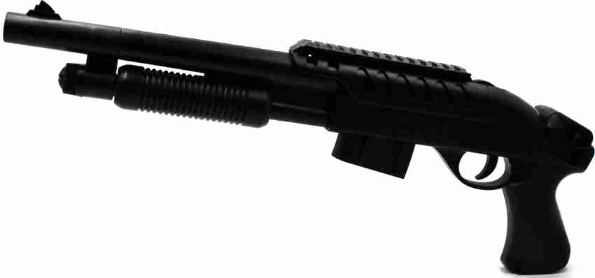
Loading and Unloading mechanism
Pump Action
Pump action is a type of manual firearm action that is operated by moving a sliding handguard on the gun's forestock. When shooting, the sliding forend is pulled rearward to eject any expended cartridge and typically to cock the hammer or striker, and then pushed forward to load a new cartridge into the chamber.

