Slide 1
Internal, External and Terminal Ballistics
Ujaala Jain
Assistant Professor, SoFS

Slide 2
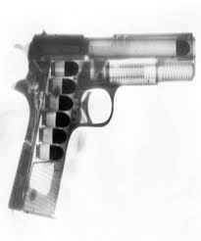
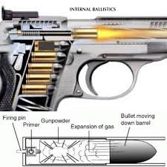
Internal Ballistics

Slide 3
External Ballistics

Slide 4
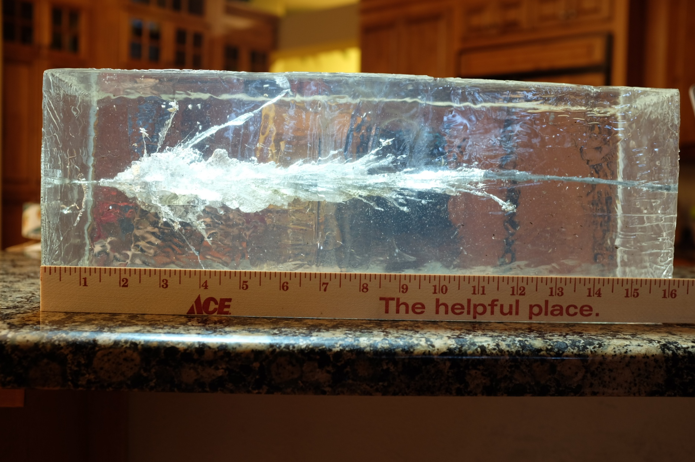
Terminal Ballistics

Slide 5
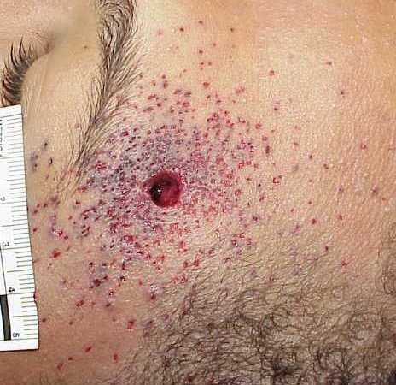
Wound Ballistics

Slide 6
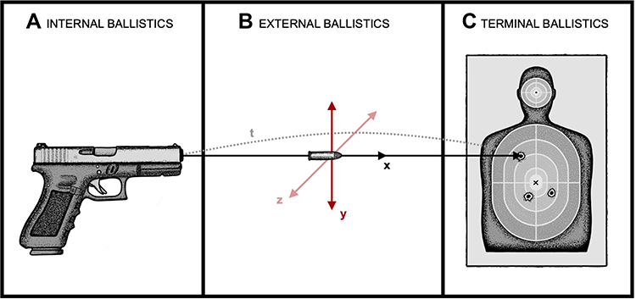
The Collective Role

