Slide 1
Comparison Microscope and Borescope
Ujaala Jain
Assistant Professor, SoFS

Slide 2
INSTRUMENTS FOR ANALYSIS
Stereomicroscope- Individual examination
Comparison Microscope- Side by Side, Superimposition
Borescope- Analysis of the Barrel
BDAS- Detection of projectile velocity
IBIS/ NIBIN- Database analysis

Slide 3
COMPARISON MICROSCOPE
EVIDENCE
FIRED
CARTRIDGE
CASE
REFERENCE
FIRED
CARTRIDGE
CASE
Louise Walzer, JPSO Crime Lab

Slide 4
EVIDENCE
FIRED CARTRIDGE CASE
REFERENCE
FIRED CARTRIDGE CASE
Louise Walzer, JPSO Crime Lab

Slide 5
EVIDENCE
REFERENCE
Louise Walzer, JPSO Crime Lab

Slide 6
Limitations of Comparison Microscope:
Manual, tedious and time consuming
Evidences compared piece by piece to vast inventory of crime/ test exhibits
Necessity of searching each piece manually
Severe stress and eyestrain slowed the process even more

Slide 7
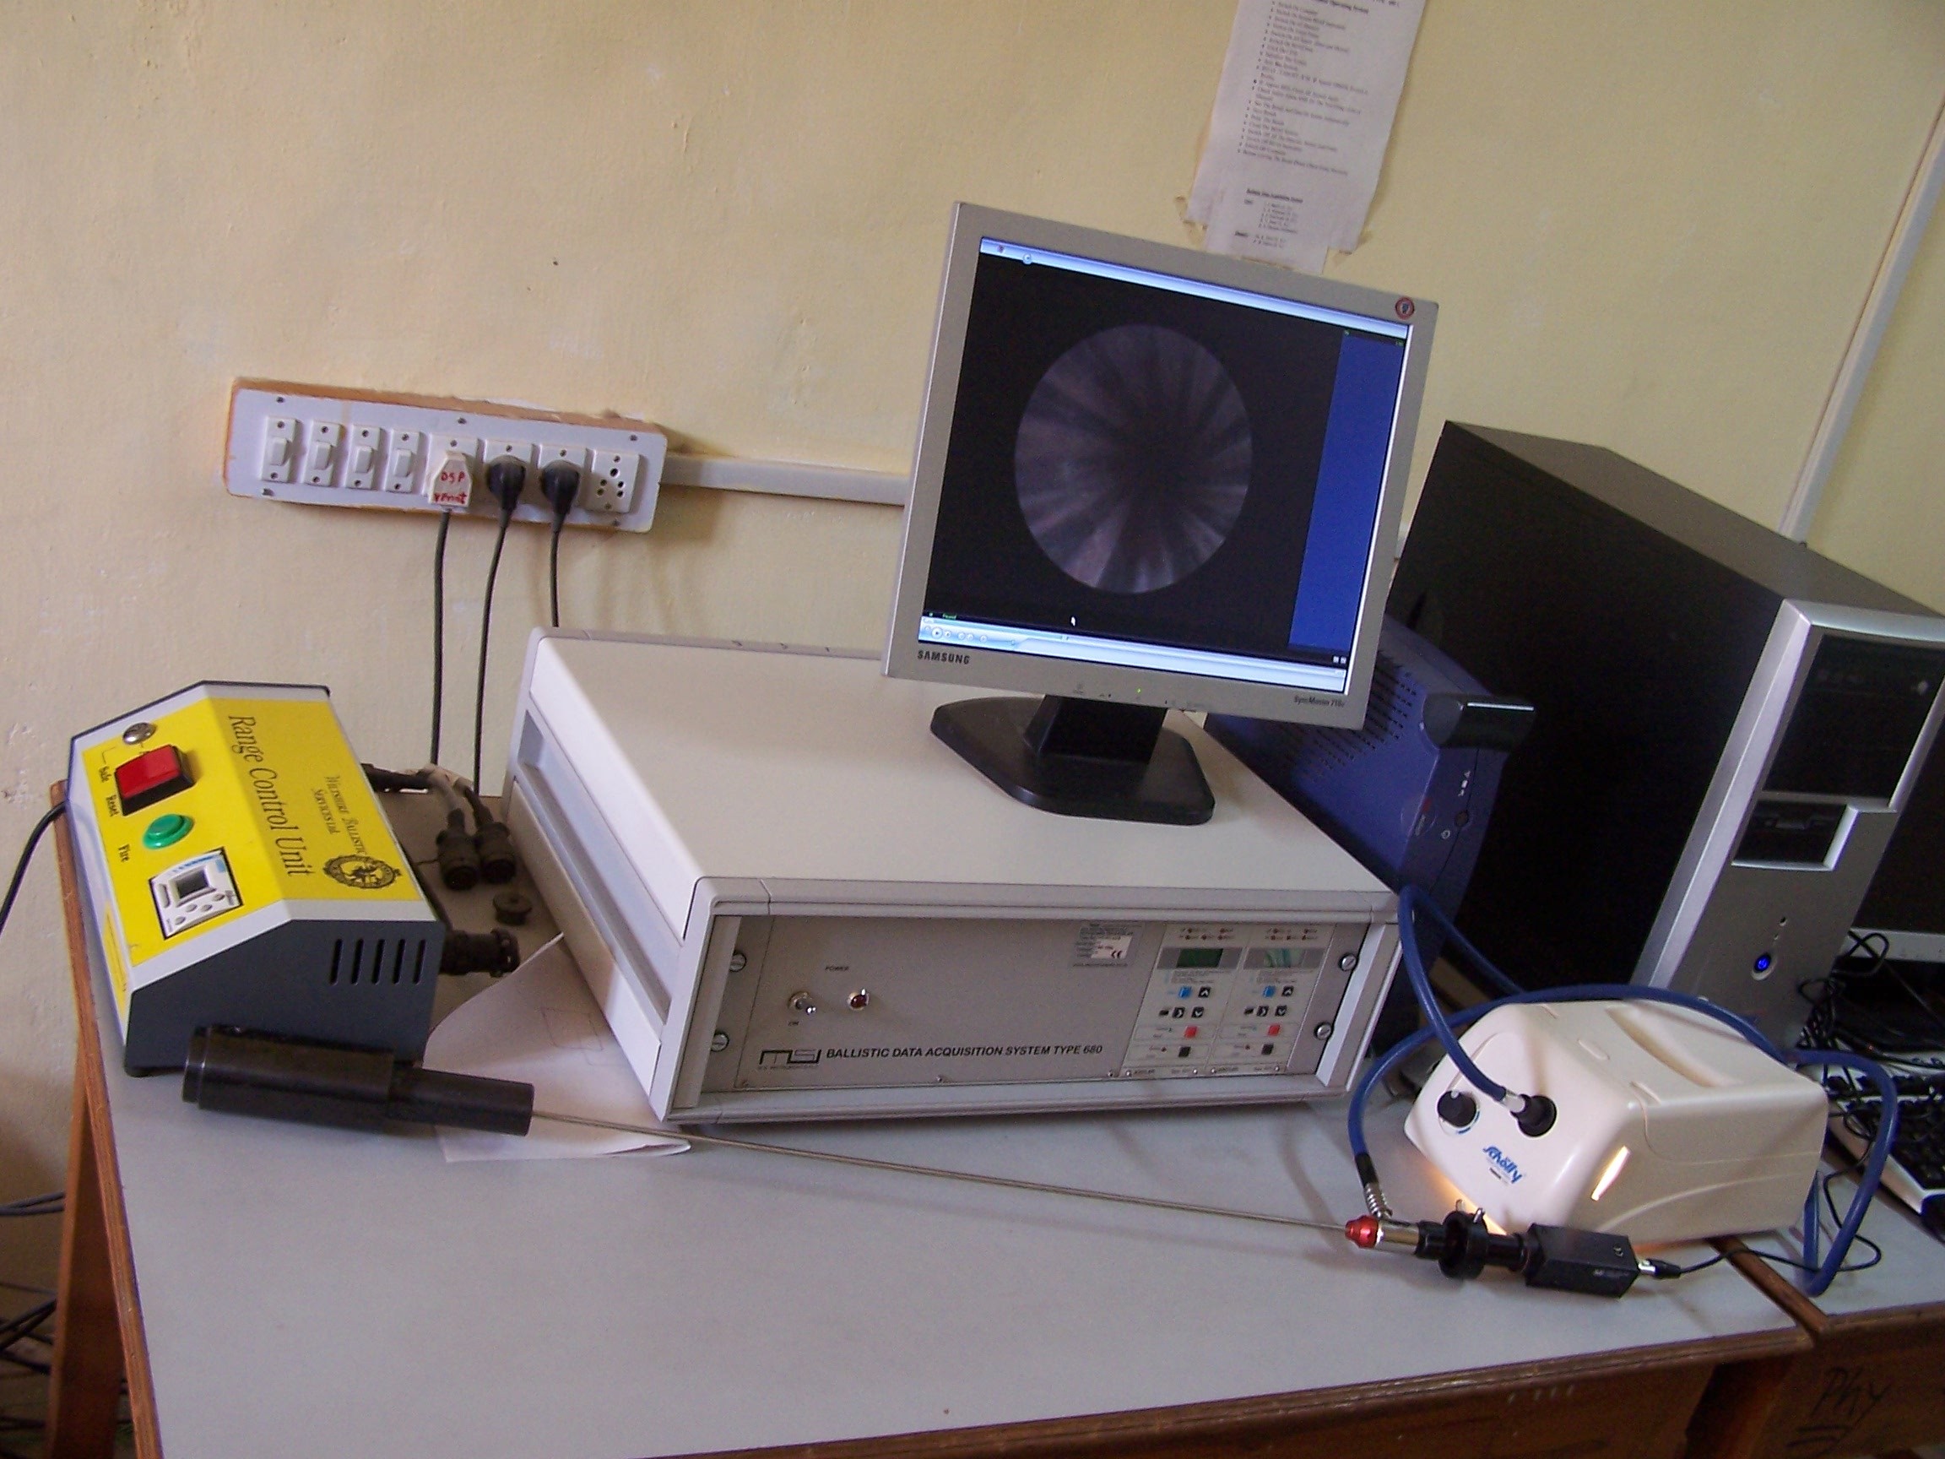
Borescope

Slide 8
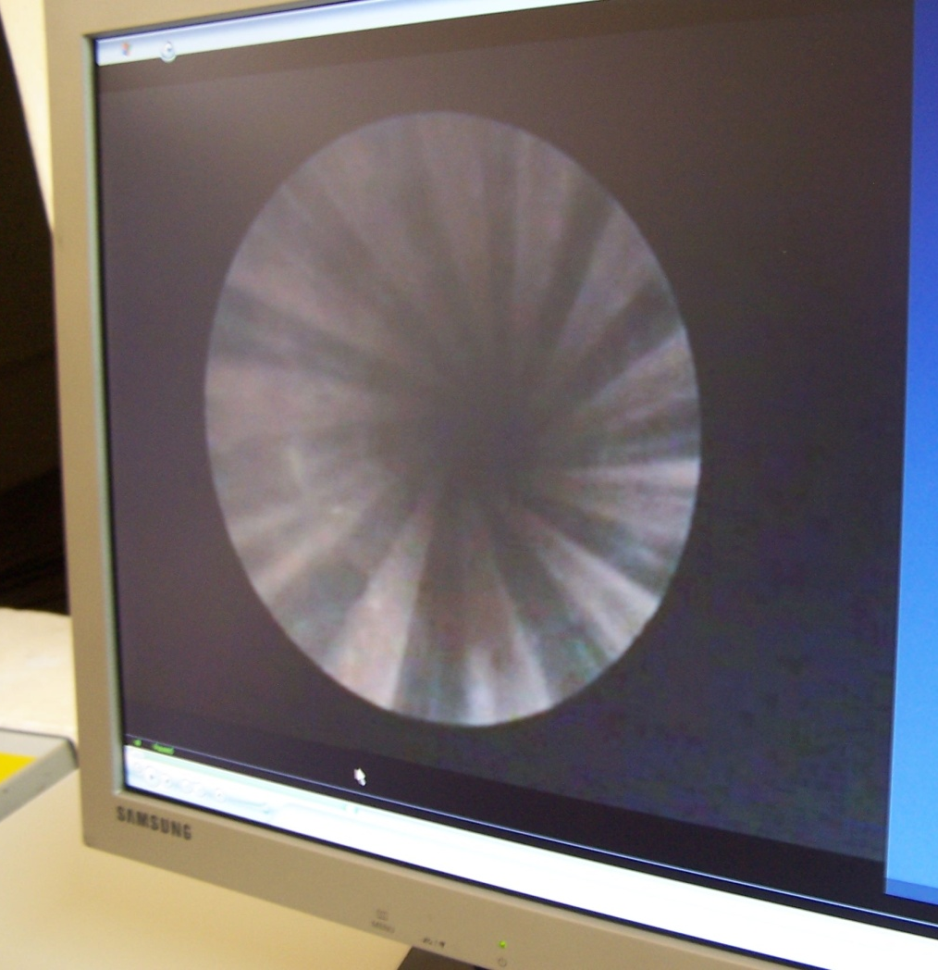
IMAGES OF THE BARREL
Side view of the barrel
Full view of the barrel

