Slide 1
BDAS ballistic data acquisition system
Ujaala Jain
Assistant Professor, SoFS

Slide 2
Ballistics Data Acquisition System
Universal Receiver
Automatic Firing Rest
Target Frames
Indoor Climate Monitor
Optical Detector
Flash Detector
Recovery Box

Slide 3
UNIVERSAL RECEIVER
LEFT VIEW

Slide 4
UNIVERSAL RECEIVER
BACK VIEW
Breech-open
Chamber
Firing Pin

Slide 5
FLASH DETECTOR

Slide 6
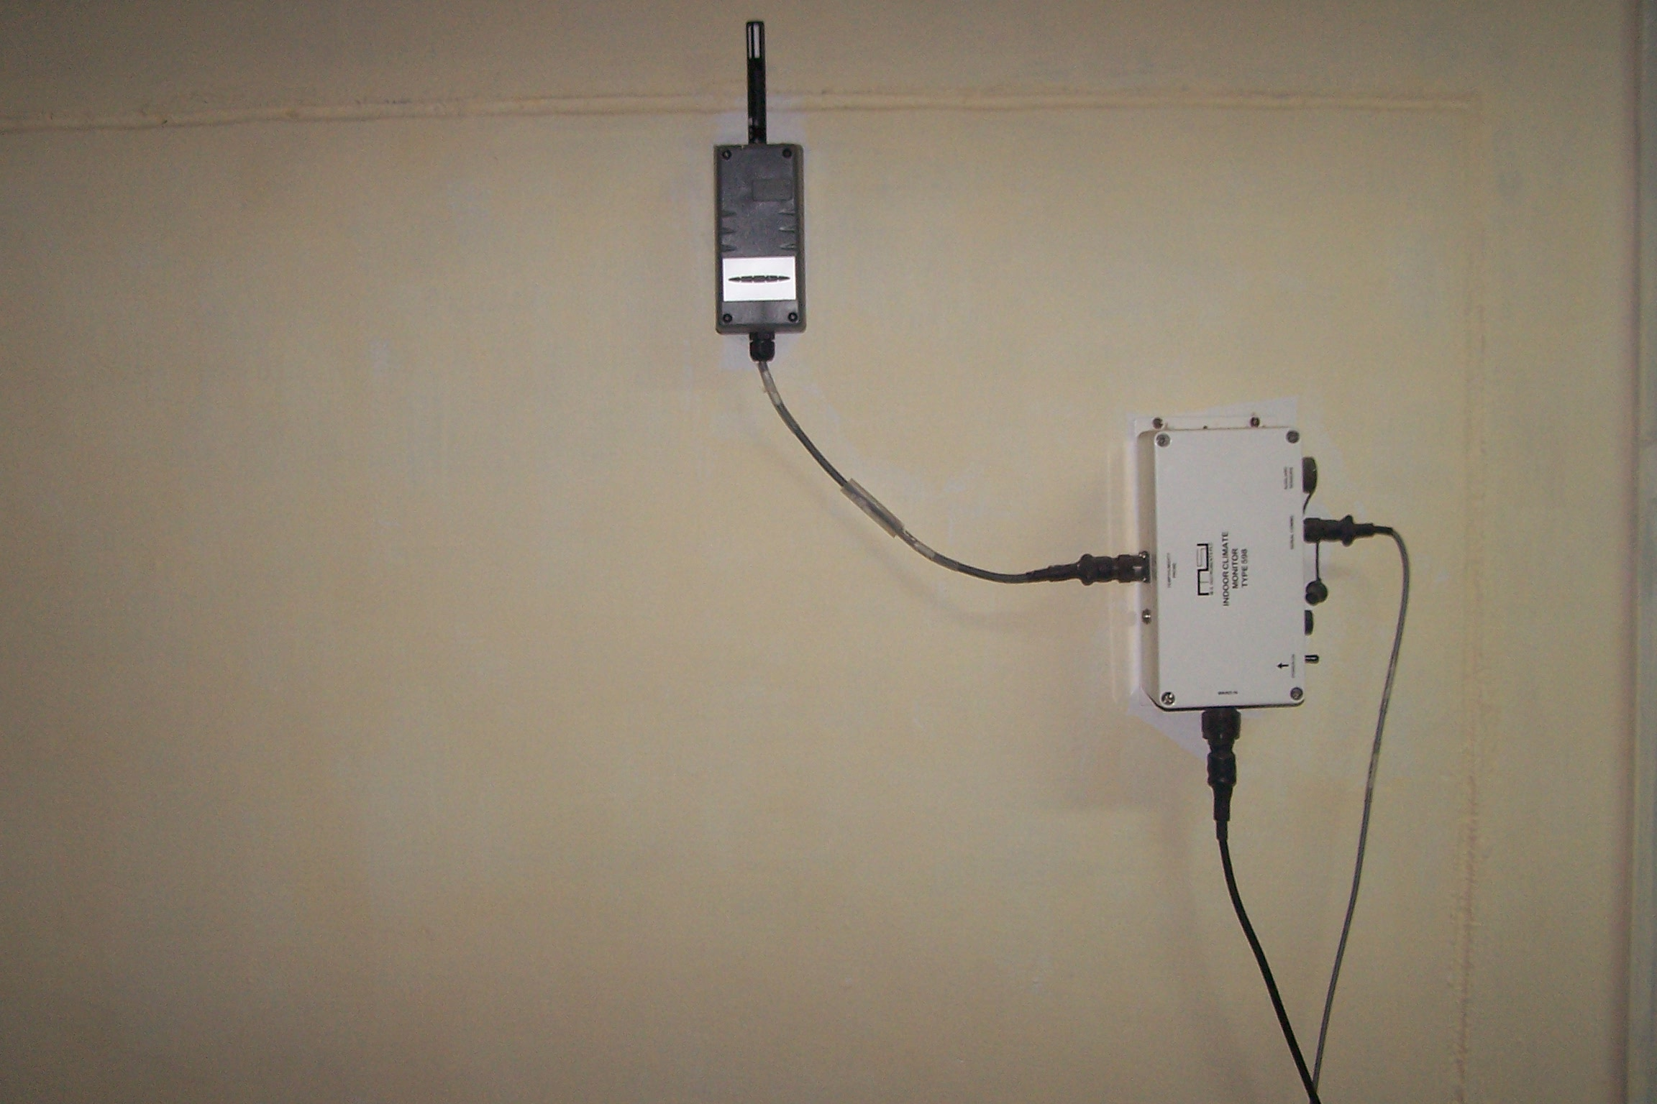
INDOOR CLIMATE MONITOR

Slide 7
FIRING RANGE
LIGHT SOURCE
OPTICAL
DETECTOR

Slide 8
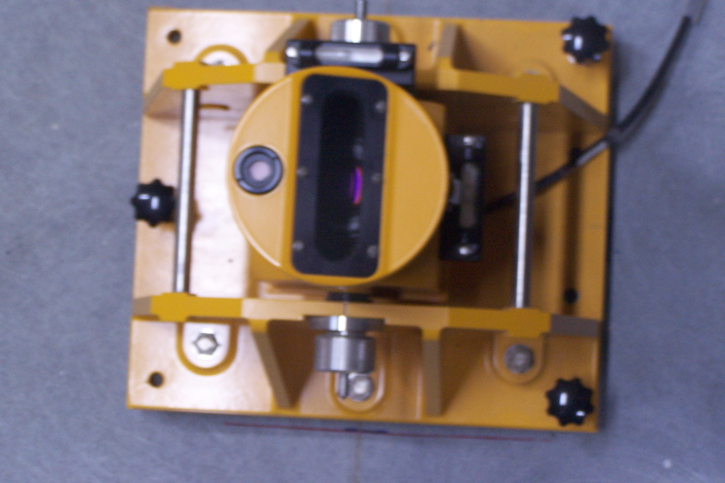
OPTICAL DETECTOR

Slide 9
LARGE AREA OPTICAL TARGET
Recovery
box

Slide 10
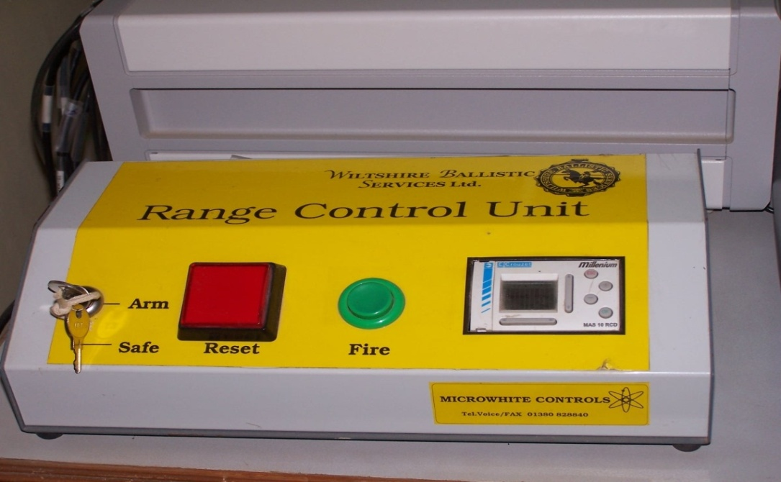
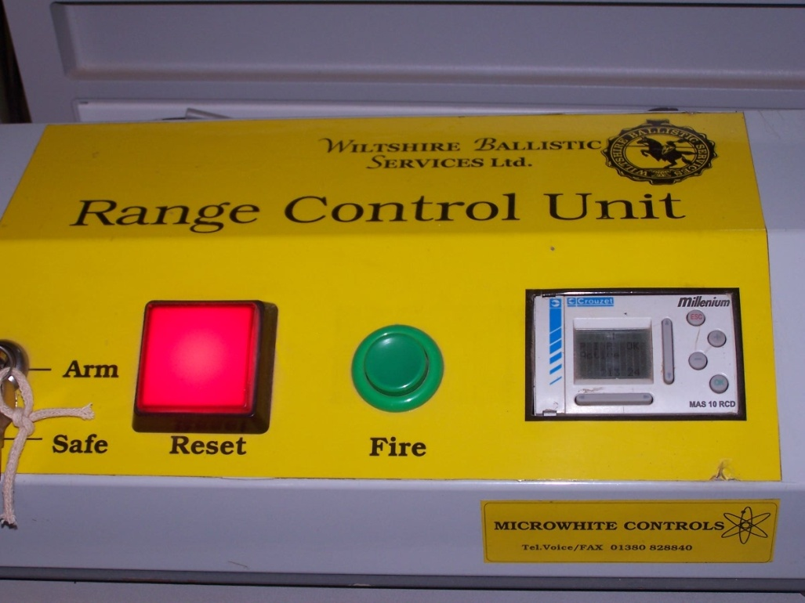
AUTO FIRING RANGE CONTROL UNIT
OFF
ON

Slide 11
RANGE CONTROL SOFTWARE

