Slide 1
Assembly and Disassembly of Firearms
Ujaala Jain
Assistant Professor, SoFS

Slide 2
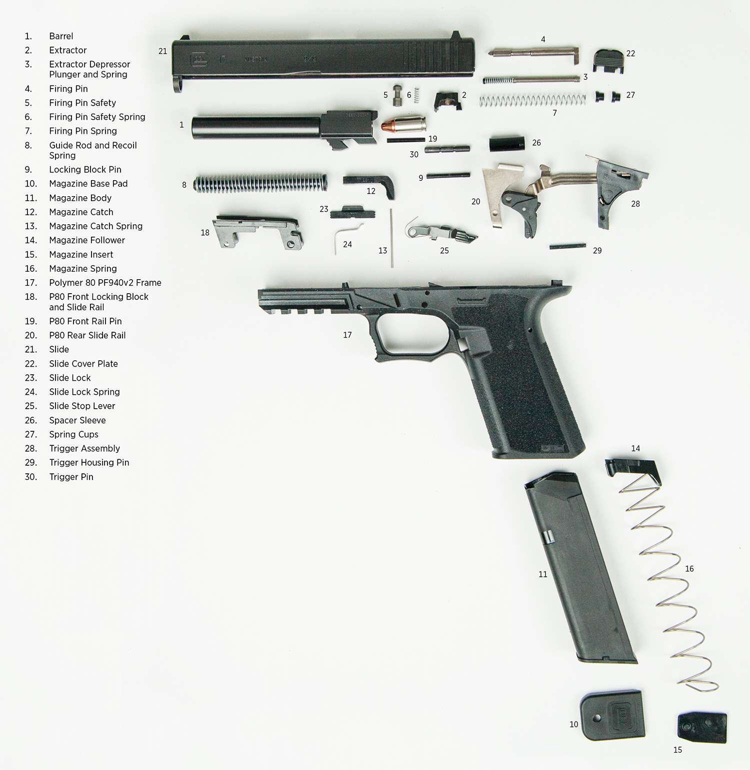

Slide 4
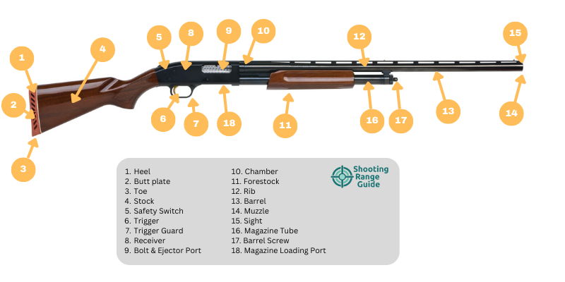

Slide 5
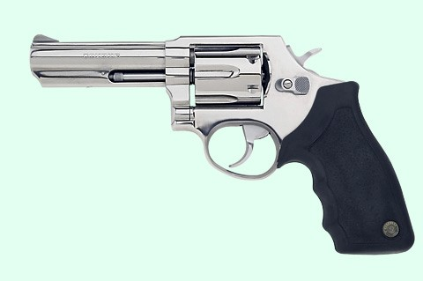
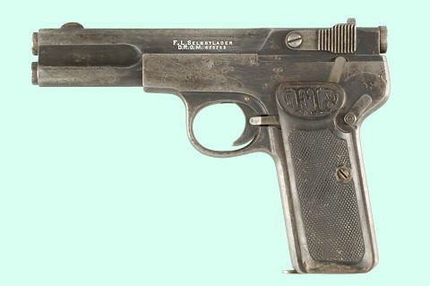
Identify the parts?

