Slide 1
IBIS
Integrated ballistic identification system
Ujaala Jain
Assistant Professor, SoFS

Slide 2
IBIS
IBIS introduced by forensic technology Inc. in 1991
Technology that solves firearm Crime:-
IBIS digitally captures the images of bullets & cartridge cases, stores them in a database, performs automatic computer based comparisons of the images & ranks them according to the likelihood of a match.

Slide 3
Aim of IBIS
Information Sharing Between States
Centralized Correlation
Restricted Data Replication
Links suspected projectile, cartridge case with other projectiles or firearms.
Database formulation
Notes:
Ability to Restrict the Replication of Cases to a Centralized Server:
An IBIS network can now be implement across several countries or
regions so that they can share information. A region is defined as a
country or group of countries depending on how the IBIS wide access
network (WAN) is set up. This international IBIS network has a
centralized server that includes all authorized data from participating
countries or regions. However, some countries may choose not to share
or restrict certain data, due to its sensitive or classified nature.
A Restricted check box has been added to the Case Maintenance dialog
box. Selecting the Restricted check box prevent the case and its exhibits
from being replicated to the centralized international server.
Enhanced Display Functionality of Multiviewer:
Previously when comparing Bullet images in the Multiviewer, if the test
bullet had more LEA images than the reference bullet, the additional
test bullet images where not shown.
Now all LEA images of the test bullet will be displayed. If a equivalent
LEA image does not exist for the reference bullet, a blank image will be
displayed.
Overview of 3.4.7:
The main purpose of this release is to resolve a number of client Issues with regards to the Correlation process architecture and some pressing needs of our international users. Current and future clients are looking to share information between agencies yet at the same time maintain autonomy in the correlation of their respective databases. The major changes requested for this version are in regards to modifications to the centralized and decentralized correlation process. Our current decentralized correlation process has some limitations for some customers and the requested changes will enable these customers to work more effectively in their current environments. These changes will allow networked agencies to function independently of one another yet at the same time share information in a cooperative and trusting environment. The software changes will help centralize correlations between agencies that are information dependent yet not have the cooperating agencies dependent on each other’s hardware for successful interaction.
Currently agencies share (Cross Replication) information between sites so as to keep a synchronized database and the ability to correlate against each others data on a regular basis. The current architecture distributes the correlation of all samples between the two servers even though both Servers contain the necessary Data to correlate the data on the local server. If one of the sites servers is offline or the network is down then correlation and data processing is negatively affected at both sites. Both sites are interdependent on each other even though they have independent equipment and databases. Version 3.4.7 modifies the correlation process so as to sever this artificial dependency in that both sites can function effectively without one another.

Slide 4
System
Brass Trax
Bullet Trax
Match Point
Digital Automated Server
Correlation Server
Signature Analysis Server
Storage
  From 60,000 Cartridge Cases to more than 250,000
  From 33,000 Bullets to more than 125,000

Slide 5
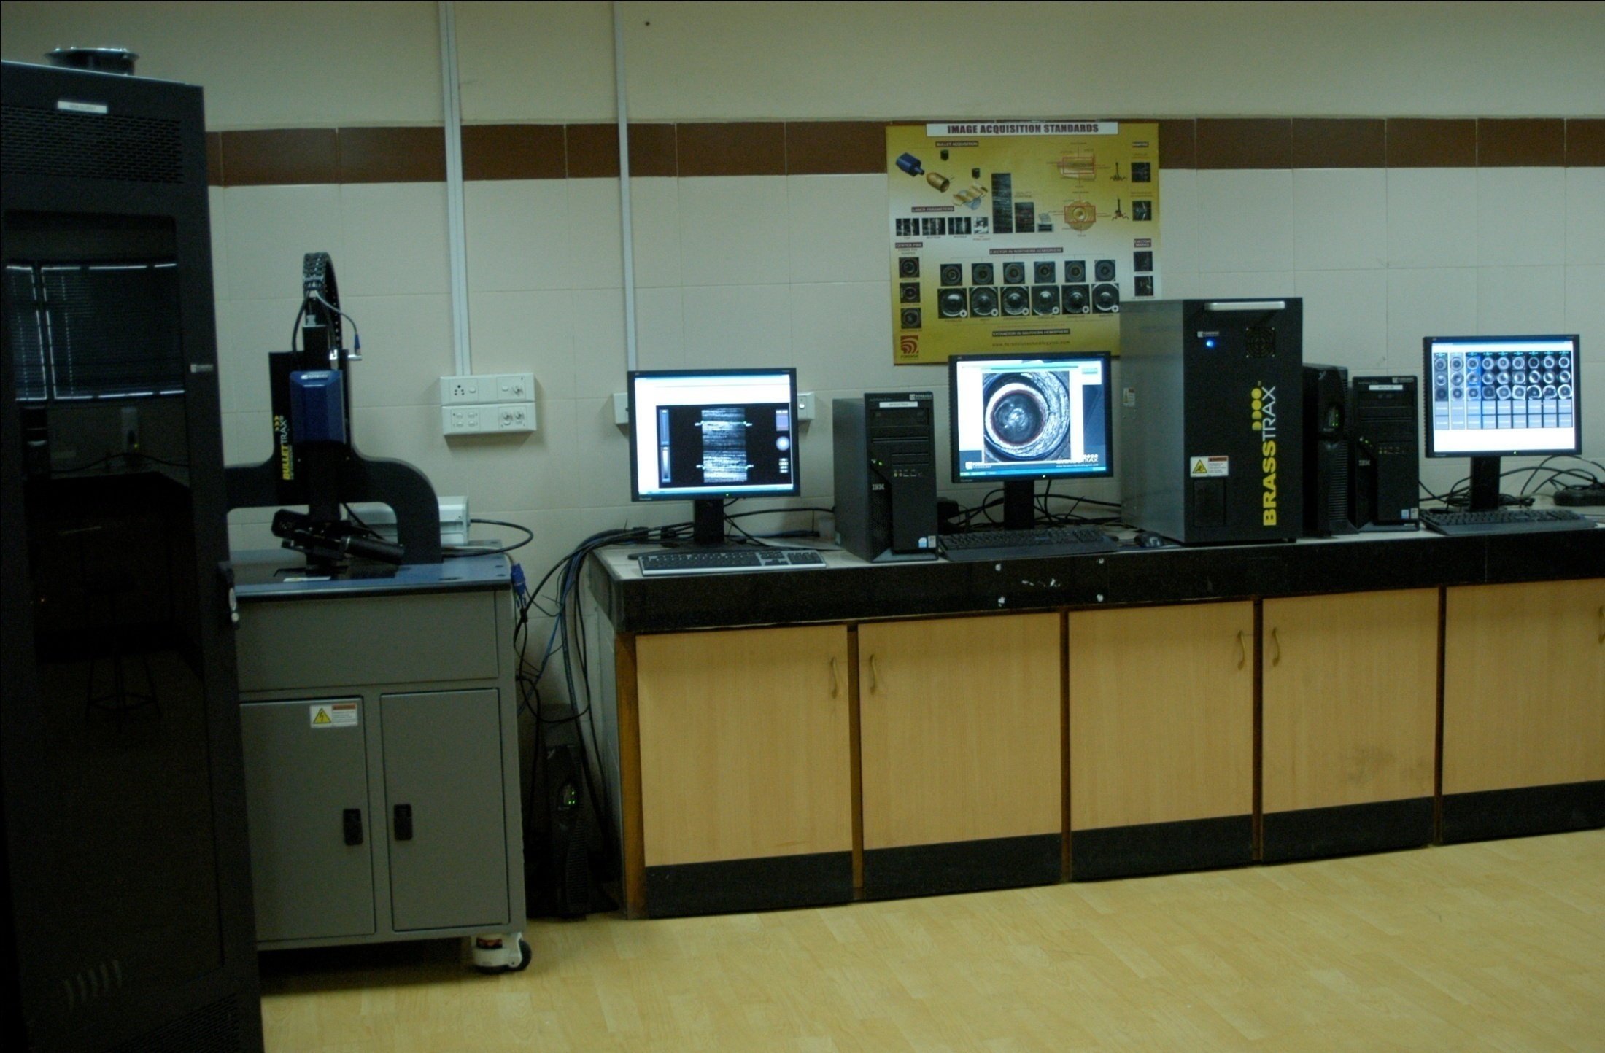
IBIS
IBIS-TRAX
BrassTRAX
MatchPoint +
BulletTRAX- 3D
Data Concentrator
Correlation Server

Slide 6
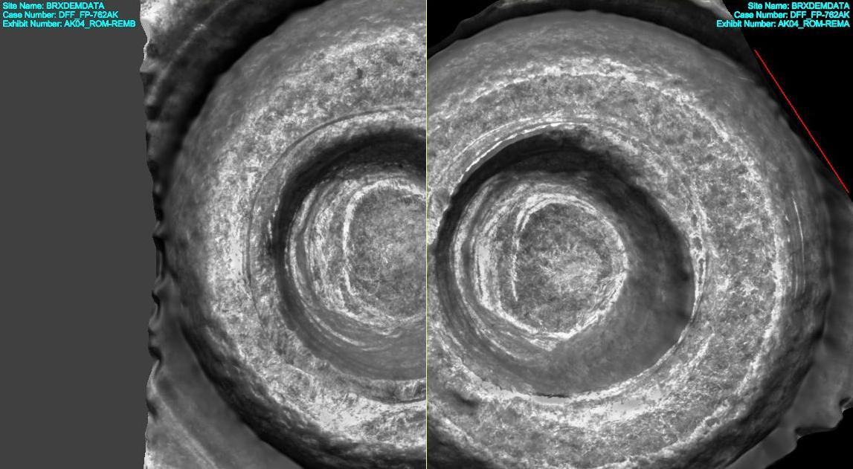
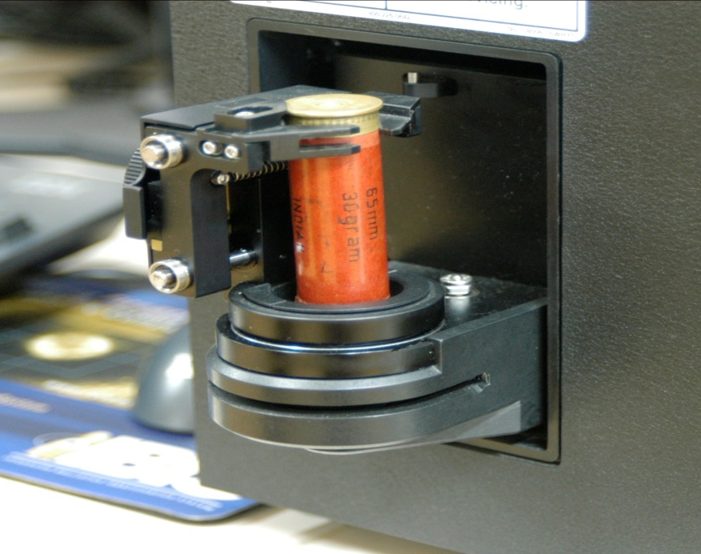
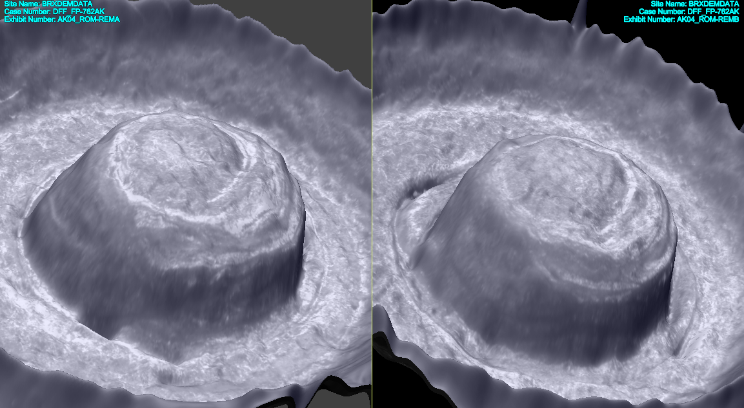

Slide 7
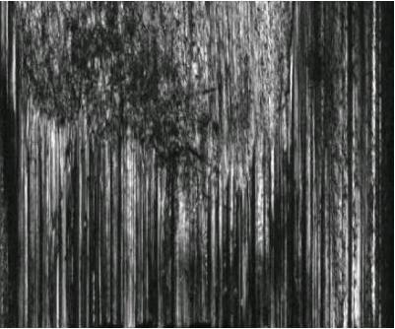
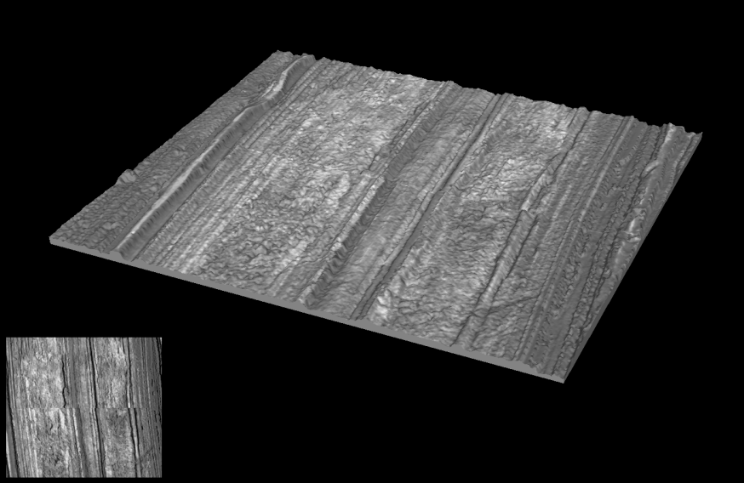
2D IBIS Bullet Image
3D Bullet Image from Bullet trax 3D

Slide 8
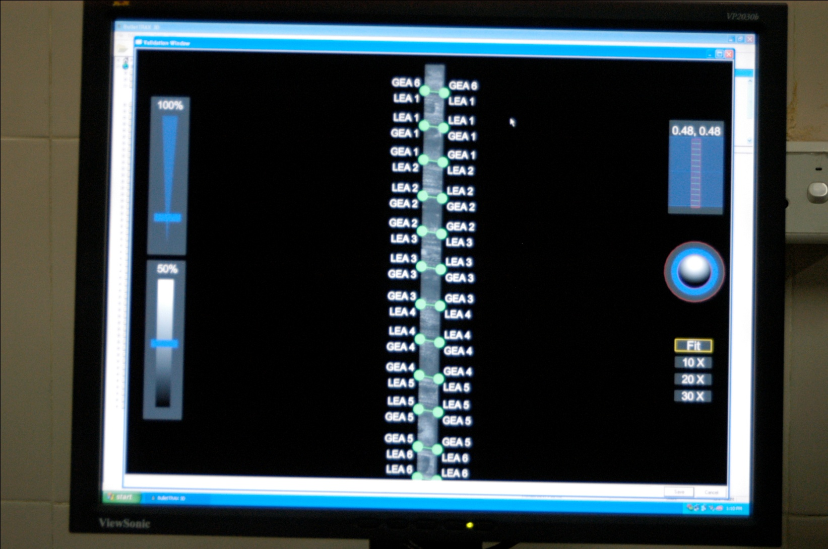
LEA & GEA MARKING
Notes:
MARKING LEA-land engraved
area (LEA, or land impression) and groove engraved area

Slide 9

Full Surface Scans of Bullets

Slide 10
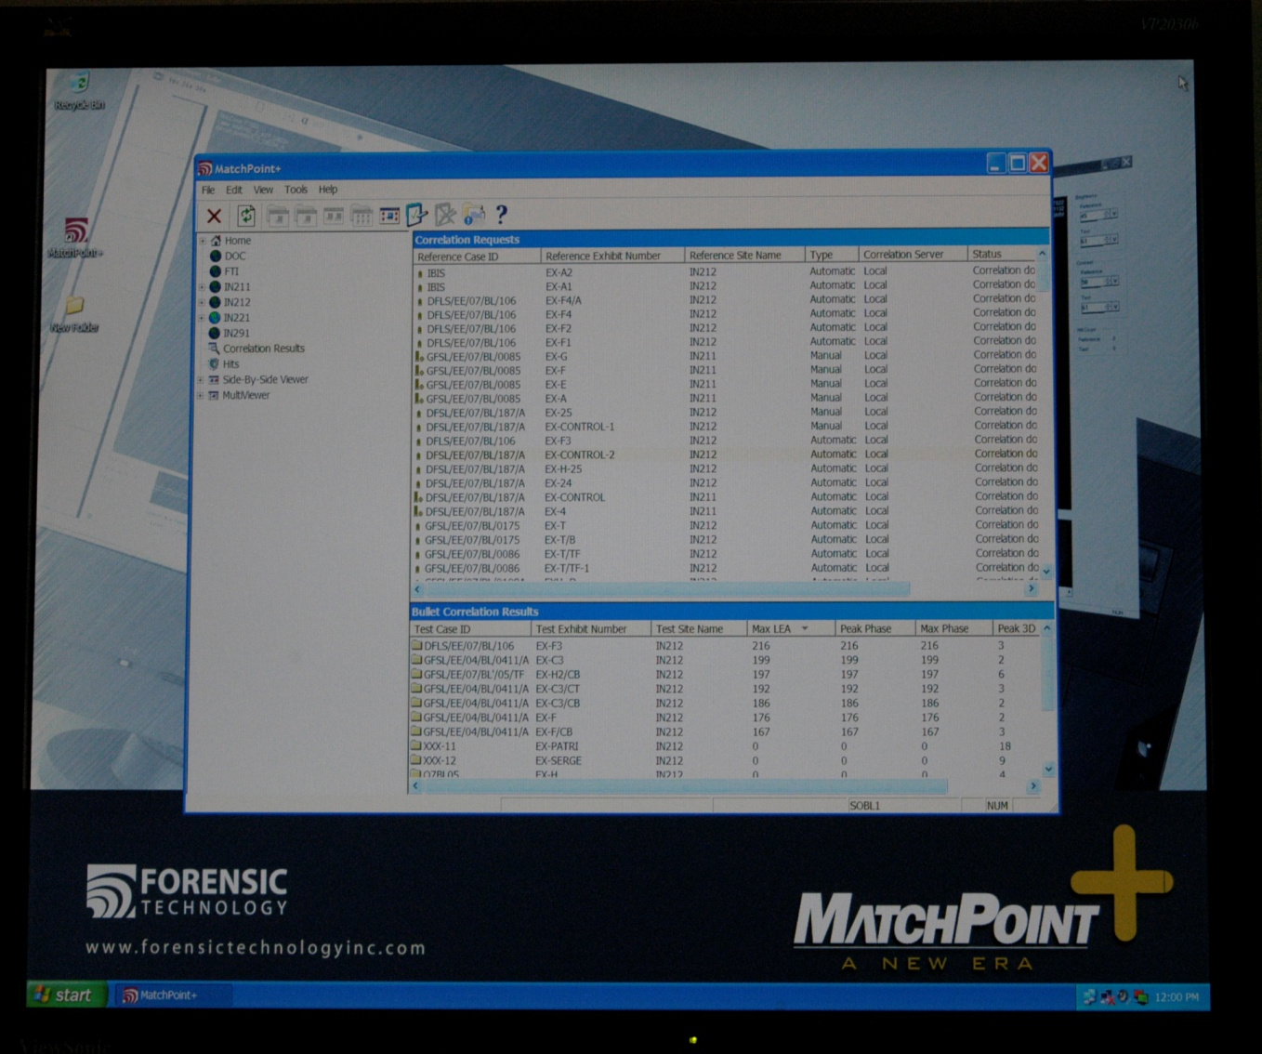
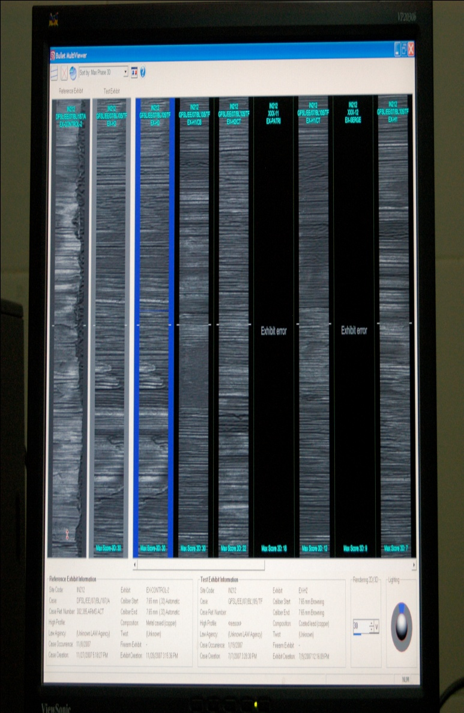
Correlation results & Comparison of multiple images

Slide 11
Cases solved by ibis
TWO CRIMES +TWO CITIES +TWO country made PISTOL
In February of 2008, a man was shot during a robbery attempt in the City of Bhavnagar in Gujarat State and later died of his wounds while hospitalized.
In March of 2008, a man was shot dead during a dispute which occurred in the City of Ahmedabad in Gujarat State.
In April of 2008, Dileep Joshi, a member of the “Shailesh Dhandhalia Gang” was arrested by police in Mehsana town for a violation of the Arms Act. He was in illegal possession of two country made pistols. The pistols were turned over to the DFS for detailed analysis on the new 3D IBIS system.
The two cases could be linked and thus solved.

