Slide 1
Action Mechanism of firearms
Ujaala Jain
Assistant Professor, SoFS

Slide 2
Action Mechanism
Automatic Action- Only one trigger press is needed and the entire process is done automatically.
Semi-automatic Action- The process is completed till unloading of the cartridge case and after that a new trigger press is required.
Manual- Everything has to be done manually by the operator.

Slide 3
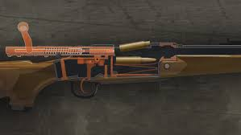
Loading and Unloading mechanism
Bolt Action
The mechanism combines the firing pin, a spring, and an extractor, all housed in a locking breechblock. The spring-loaded firing pin slide back and forth inside the bolt, which itself is the breechblock.

Slide 4
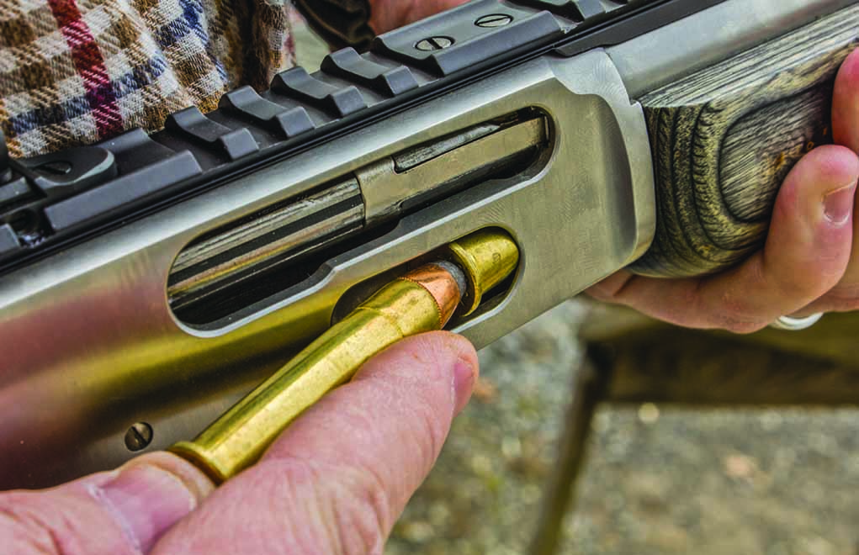
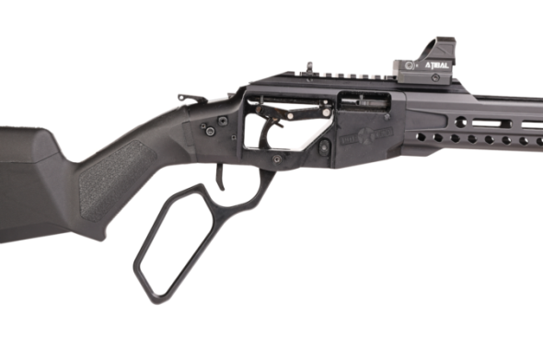
Loading and Unloading mechanism
Lever Action
It is a type of action for repeating firearms that uses a manually operated cocking handle located around the trigger guard area that pivots forward to move the slider via internal linkages, which will feed and extract cartridges into and out of the chamber, and cock the firing pin mechanism.

Slide 5
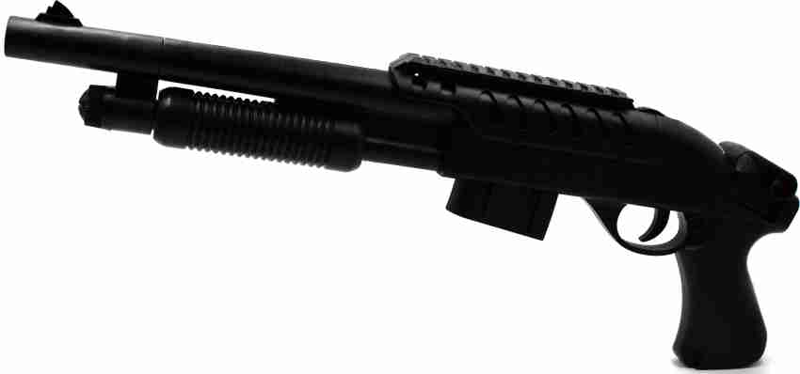
Loading and Unloading mechanism
Pump Action
Pump action is a type of manual firearm action that is operated by moving a sliding handguard on the gun's forestock. When shooting, the sliding forend is pulled rearward to eject any expended cartridge and typically to cock the hammer or striker, and then pushed forward to load a new cartridge into the chamber.

Slide 6
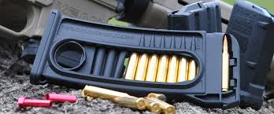
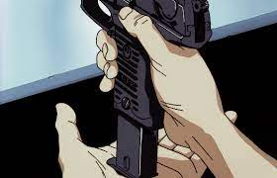
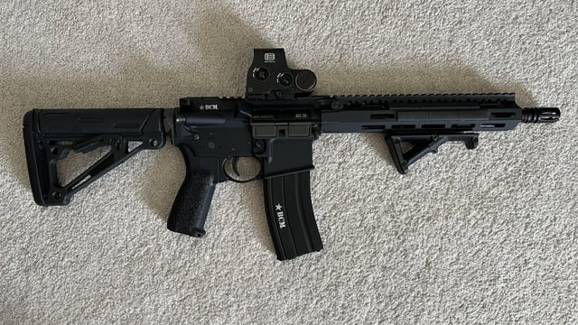
Loading in Chamber (Magazine- Simple)

Slide 7
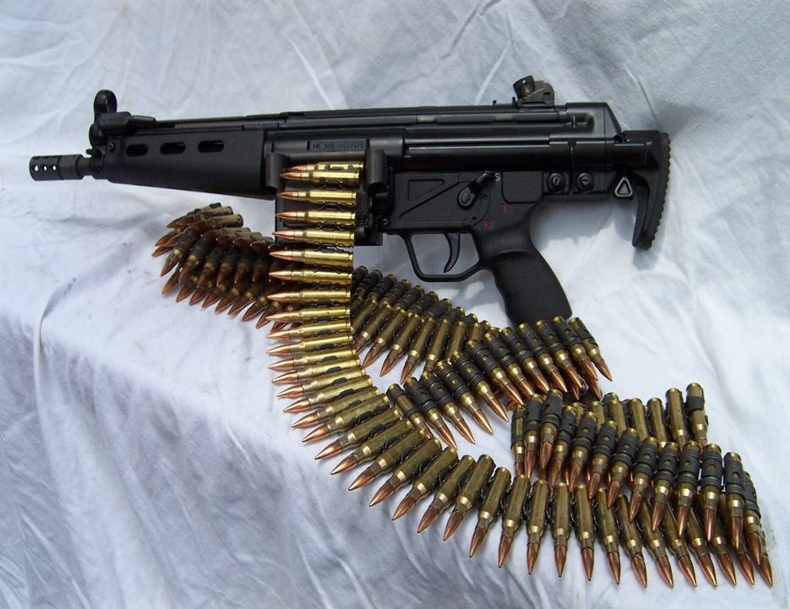
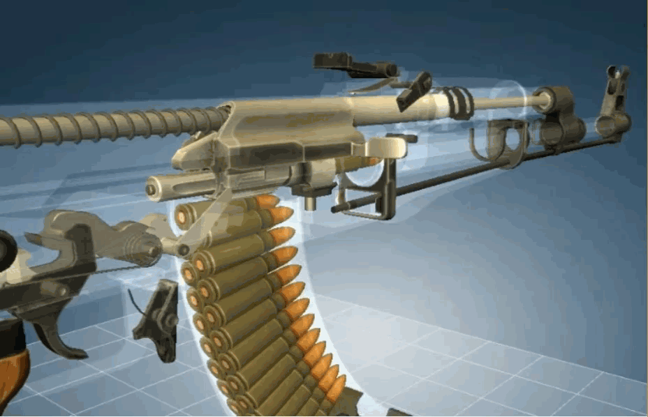
Loading in Chamber (Magazine-Rolled)

Slide 8
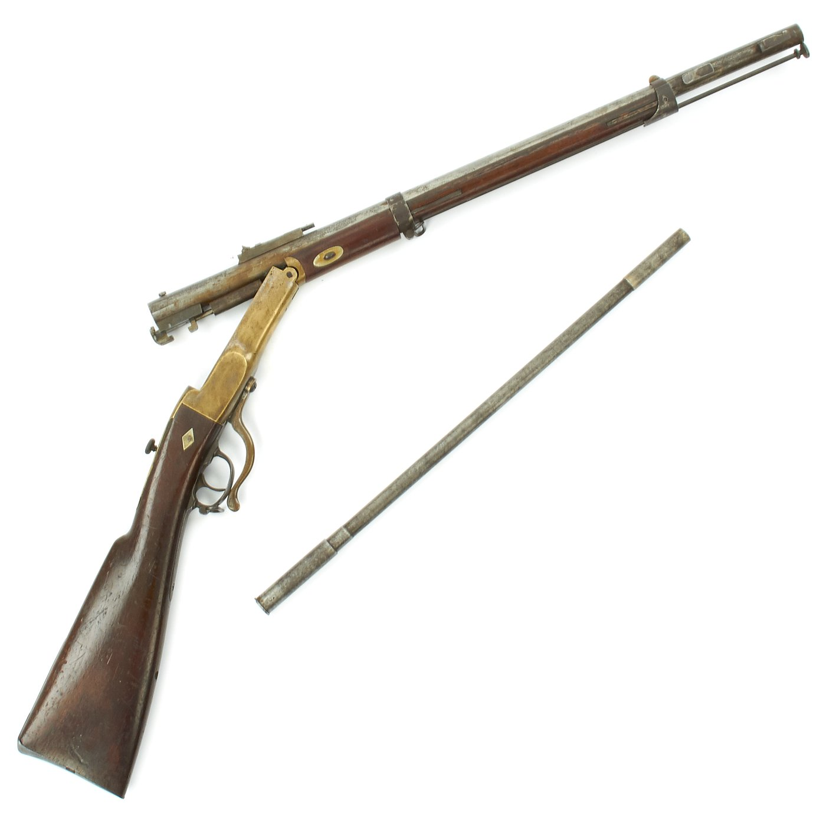
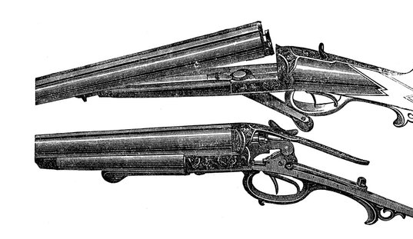
Loading in Chamber (Breech End)

Slide 9
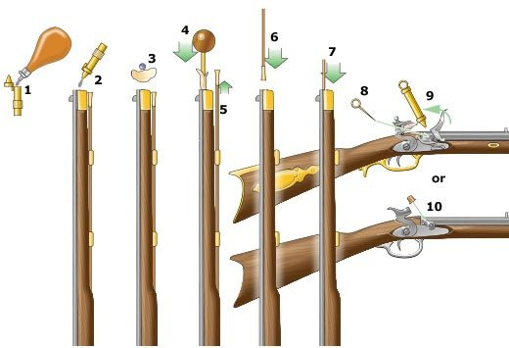
Loading in Chamber (Muzzle)

Slide 10
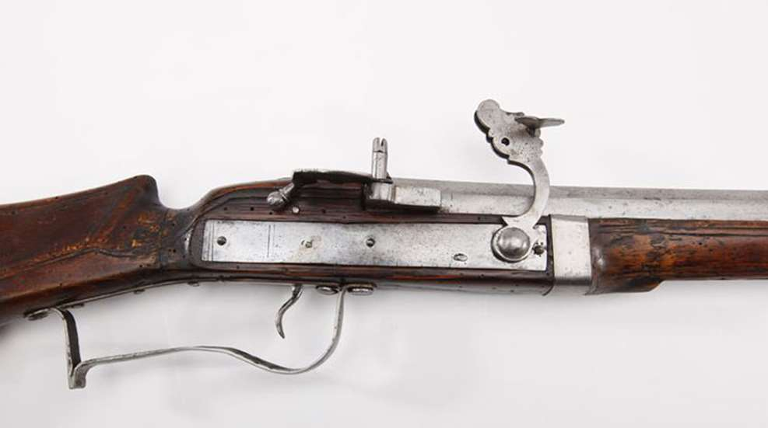
Loading in Chamber (Muzzle- Match Lock)

Slide 11
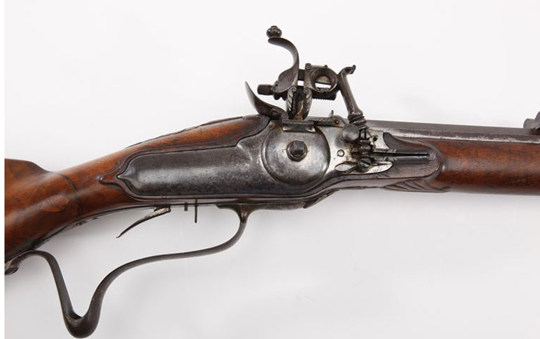
Loading in Chamber (Muzzle- Wheel Lock)

Slide 12
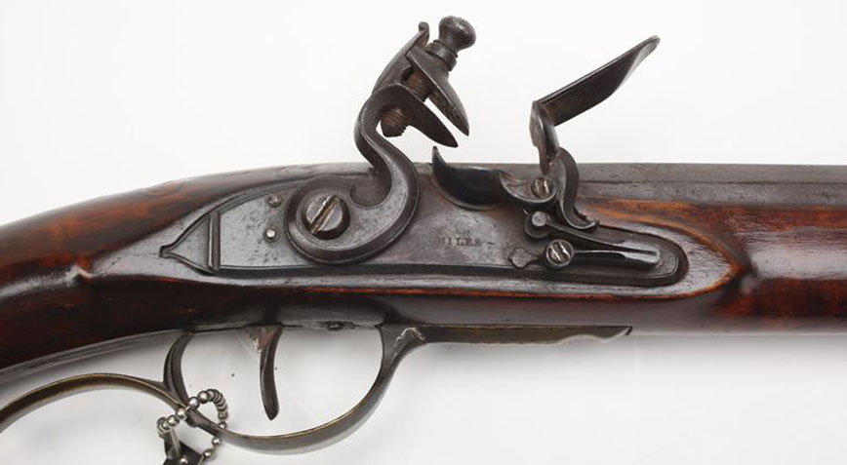
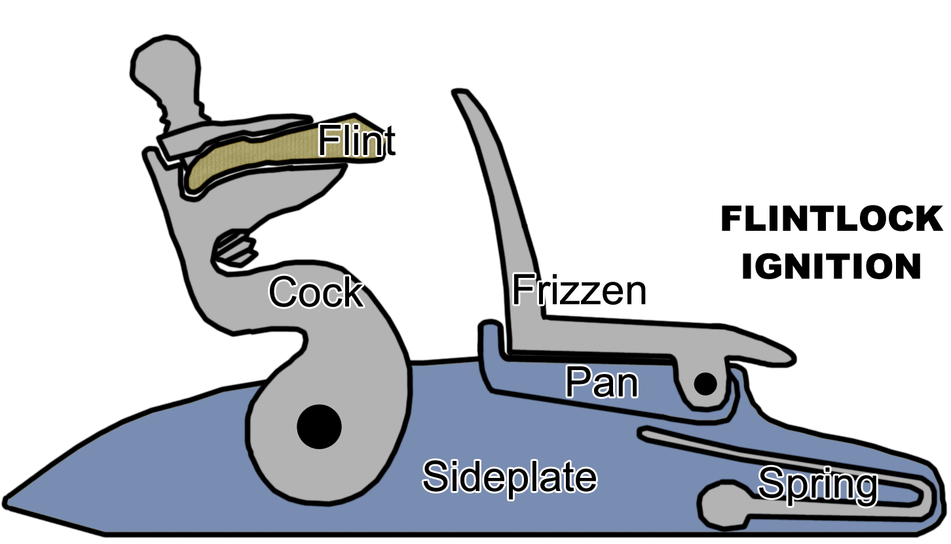
Loading in Chamber (Muzzle- Flint Lock)

