Slide 1
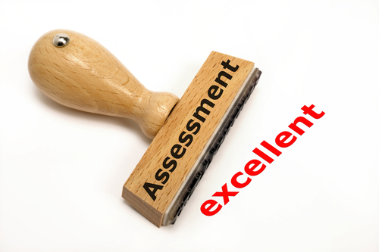
Managing Performance

Slide 2
Performance appraisal
Performance Appraisal is an objective assessment of an individual’s performance against well defined benchmarks.
It can be defined as evaluating an employees current and past performance relative to his /her performance standards.
A systematic and objective way of judging the relative worth or ability of an employee in performing his/her task.

Slide 3
Nature of performance appraisal
It may be understood as the assessment of an individual’s performance in a systematic way, the performance being measured against such factors as job knowledge, quality and quantity of output, initiative, leadership abilities, supervision, dependability, co-operation, judgement, versatility, health and the like.

Slide 4
Performance Management
A process that consolidates goal setting, performance appraisal, and development into a single common system, the aim of which is to ensure that the employee performance is supporting the companies strategic aims.

Slide 5
Objectives
To effect promotions based on competence and performance
To assess the training and development needs of employees
To let the employees know where they stand insofar as their performance is concerned as to assist them to constructive criticism and guidance for the purpose of their development
To improve communication
To confirm the services of probationary employees upon their completing the probationary period satisfactorily
It can be used to determine whether HR programmes such as selection, training, and transfers have been effective or not

Slide 6
Performance Appraisal System
Performance Management system
Focus is on performance evaluation and
generation of ratings.
Focus is on contributions
and improvements.
Emphasis is on Performance Planning,
analysis, review, development,
and improvements.
Emphasis is on ratings and evaluations.
Linked with rewards and recognition of
good performance and vice –versa.
Linked with defining and setting
performance standards.
Ownership is with line managers and
employees .HR Dept. facilitates its
implementation.
Ownership is mostly with the
HR department.
Annual exercise.
Continuous process with quarterly
performance review discussions.
Format driven.
Process driven with the format as an aid.

Slide 7
Main objectives of p a
General Applications | Specific Purpose
Developmental Uses | Identification of Individual needs Performance feedback Determining transfers and job assignments Identification of individual strengths and developmental needs
Administrative Uses/Decisions | Salary Promotion Retention or termination Recognition of individual performance Lay-offs Identification of poor performers

Slide 8
Organizational maintenance / objectives | HR Planning Determining organizational training needs Evaluation of organizational goal achievement Information for goal identification Evaluation of HR systems Reinforcement of organizational development needs
Documentation | Criteria for validation research Documentation of HR decision Helping to meet legal requirements

Slide 9
Performance Appraisal Methods.
Appraisal Methods
Type of Judgment.
The focus on Measure.
Trait
Absolute
Relative
Behavior
Results

Slide 10
Trait systems.
Trait systems ask evaluators to rate each employees traits or characteristics such as appearance, dependability, cooperation, initiative, judgment, leadership, decision making .
Graphic rating scale.

Slide 11
Comparison systems.
Comparison system evaluate a given employees performance against the performance of other employees. The different methods are,
Straight ranking method.
Paired comparison ranking method.
Forced distribution method.

Slide 12
Behavioral System.
Behavioral systems rate employees on the extent to which they display successful job performance behaviors.
The types of behavioral systems are,
Critical Incident Technique. (CIT)
Behavioral anchored rating scales (BARS).

Slide 13
Graphic rating scale
Graphic rating scales require an evaluator to indicate on a scale the degree to which an employee demonstrates a particular trait, behaviour, or performance result. Rating forms are composed of a number of scales, each relating to a certain job or performance-related dimension, such as job knowledge, responsibility, or quality of work. Each scale is a continuum of scale points, or anchors, which range from high to low, from good to poor, from most to least effective, and so forth. Scales typically have from five to seven points, though they can have more or less. Graphic rating scales may or may not define their scale points.

Slide 14
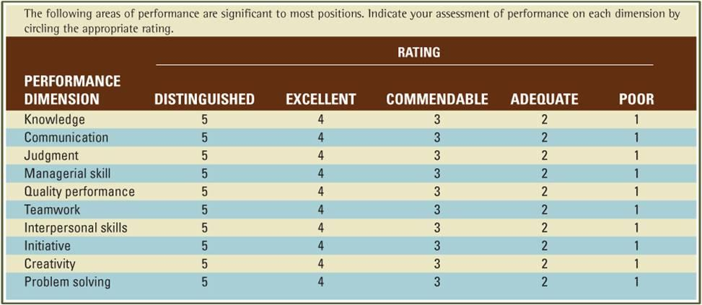

Slide 15
Ranking method
Ranking methods compare one employee to another, resulting in an ordering of employees in relation to one another. Rankings often result in overall assessments of employees, rather than in specific judgments about a number of job components. Straight ranking requires an evaluator to order a group of employees from best to worst overall or from most effective to least effective in terms of a certain criterion. Alternative ranking makes the same demand, but the ranking process must be done in a specified manner (for example, by first selecting the best employee in a group, then the worst, then the second-best, then the second-worst, etc.).

Slide 16
Paired comparison
In this method each employee is rated with another employee in the form of pairs. The number of comparisons may be calculated with the help of a formula

Slide 17
Forced distribution method
Here employees are clustered around a high point on a rating scale. Rater is compelled to distribute the employees on all points on the scale. It is assumed that the performance is conformed to normal distribution. Advantages – Eliminates Disadvantages – Assumption of normal distribution, unrealistic, errors of central tendency.

Slide 18
Critical incident technique
Under this method, the manager prepares lists of statements of very effective and ineffective behaviour of an employee. These critical incidents or events represent the outstanding or poor behaviour of employees on the job. The manager maintains logs on each employee, whereby he periodically records critical incidents of the workers behaviour. At the end of the rating period, these recorded critical incidents are used in the evaluation of the workers' performance

Slide 19
bars
It is also known as the behavioural expectations scale, this method represents the latest innovation in performance appraisal. It is a combination of the rating scale and critical incident techniques of employee performance evaluation. The critical incidents serve as anchor statements on a scale and the rating form usually contains six to eight specifically defined performance dimensions. The following chart represents an example of a sales trainee's competence and a behaviourally anchored rating scale.

Slide 20
bars
Performance | Points | Behavior
Extremely good | 7 | Can expect trainee to make valuable suggestions for increased sales and to have positive relationships with customers all over the country.
Good | 6 | Can expect to initiate creative ideas for improved sales.
Above average | 5 | Can expect to keep in touch with the customers throughout the year.
Average | 4 | Can manage, with difficulty, to deliver the goods in time.
Below average | 3 | Can expect to unload the trucks when asked by the supervisor.
Poor | 2 | Can expect to inform only a part of the customers.
Extremely poor | 1 | Can expect to take extended coffee breaks and roam around purposelessly.

Slide 21
360 degree appraisal
It is a system which an employee’s performance is rated by supervisors, peers, subordinates and clients.
In this method, besides assessing performance, other attributes of the assesse --- talents, behaviour, values, ethical standards, tempers and loyalty are evaluated by people who are the best placed to do it

Slide 22
Field review method
It is an appraisal by someone outside the assesse's own department, usually from corporate office or the HR department.
Observation method
Confidential records
Essay method
Cost accounting method
Comparative evaluation approach

Slide 23
Employee assessment may be based on a test of knowledge or skills which must be reliable and validated to be useful
Confidential records which the assessment is based on 14 items i.e attendance, self-expression(written or oral), ability to work with others, leadership, initiative, technical ability(job knowledge) ability to understand new material, ability to reason, originality and resourcefulness, areas of work that suits the persons best, judgement, integrity, responsibility, and indebtedness and memo served.
Essay method is extremely useful to filing information gaps about the employees that often occur in the better structured checklist method
Cost accounting method evaluates performance from the monetary returns the employee yields to his/her organization
Comparative evaluation approaches compare one worker’s performance with his/her co-workers

Slide 24
Physiological appraisal
It focus on future potential and not actual performance. Industry psychologists are employed for conducting the appraisal
This normally consists of in-depth interviews, psychological tests, discussions with supervisors and a review of other evaluations
The psychologist then writes an evaluation of the employee’s intellectual, emotional, motivational, and other related characteristics that suggest individual potential and may predict future performance.

Slide 25
Assessment centre
It is a central location where managers may come together to have their participation in job-related exercises evaluated by trainee observers. Mostly used for executive hiring, assessment centres are now being used for evaluating executive or supervisory potential.

Slide 26
Appraisal process

