Slide 1
RECRUITMENT & SELECTION

Slide 2
RECRUITMENT
It can be defined as generating of a pool of qualified candidates for a job
It involves attracting and obtaining as many applications as possible from eligible job-seekers
it can be understood as the process of searching for and obtaining applicants for jobs, from among whom the right people can be selected
It refers too the process of receipt of applications from job-seekers

Slide 3
Purposes and Importance
It determines the present and future requirements of the firm of potentially qualified job candidates
Increase the pool of job candidates at minimum cost
It helps the success rate of the selection process by reducing the number of visibly underqualified and overqualified job applicants
Meet the organization’s legal and social obligations regarding the composition of its work force
Increase organizational and individual effectiveness in the short term and long term

Slide 4
Recruitment Process
It comprises five interrelated stages:
Planning
Strategy Development
Searching
Screening
Evaluation & Control

Slide 5
Recruitment Planning
It involves the translation of likely job vacancies and information about the nature of these jobs into a set of objectives or targets that specify he NUMBER and the TYPE OF APPLICANTS TO BE CONTACTED
Each time a recruitment programme is contemplated, one task is to estimate the number of applicants necessary to fill all vacancies with qualified people

Slide 6
The Recruiting Yield Pyramid.
Stages of Recruiting process
Yield Ratio
New Hires/offers accepted.
20
3 : 2
Offers Made
30
4 : 3
Candidates Interviewed
40
5 : 1
Candidates Invited
200
10 : 1
Applicants
2000

Slide 7
Strategy Development
Once it is known how many type of recruits are required, serious consideration needs to be given to
Make or Buy Employees
Technological sophistication of recruitment & selection devices
Geographical distribution of labour markets comprising job seekers
Sources of recruitment
Sequencing the activities in the recruitment process

Slide 8
Searching & Screening
Once the plan is over , then the process starts with searching of good applications
Screening process is to remove the applicants who are visibly unqualified for the job

Slide 9
Evaluation & Control
It involves :
Salaries for recruiters
Management and professional time spent on preparing job description, job specification, advertisements, agency liaison etc
Cost of advertisements or other recruitment methods
Recruitment overheads and administrative expenses
Cost of producing supportive literature
Cost of overtime and outsourcing

Slide 10
Sources of Recruitment
Internal Sources
Present employees
Promotions and transfers among the present employees are the good source of recruitment
Promotions to higher positions have several advantages like good public relations, builds morale, encourages competent individuals, cheaper than going outside to recruit
Employee Referrals:
it can be a good source of recruitment when employees recommend successful referrals, they also paid monetary incentives which are called “ finder fees”

Slide 11
Former Employees :
Retired employees may be willing to come back on work for a part-time basis
They may recommend someone who would be interested in working for the company
People who have left the company for some reason might be come back and willing to work for higher emoluments
Previous Applications :
Those who have applied for jobs can be contacted by mail, a quick and inexpensive way to fill an unexpected opening

Slide 12
External Sources
Campus Recruitment
Professional & Trade Associations
Advertisements
Employment Exchanges
Walk-ins, Write-ins, Talk-ins
Consultants
Contractors
Displaced Persons
Radio & Television
Acquisition & Mergers
Competitors
E-Recruiting

Slide 13
Factors Affecting Recruitment
External Forces Internal Forces
Supply & Demand Recruitment Policy
Unemployment rate HRP
Labour Market Size of the Firm
Political-Legal Cost
Sons of soil Growth & Expansion
Image

Slide 14
SELECTION
It is the process of differentiating between applicants in order to identify and hire those with a greater likelihood of success in the job
Selection is the process of picking up individuals (out of the pool of job applicants) with requisite qualifications and competence to fill jobs in the organization

Slide 15
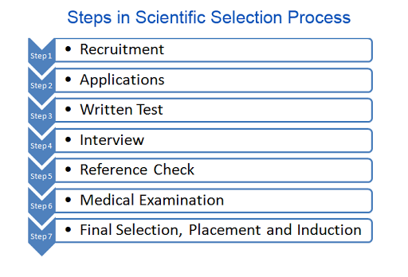

Slide 16
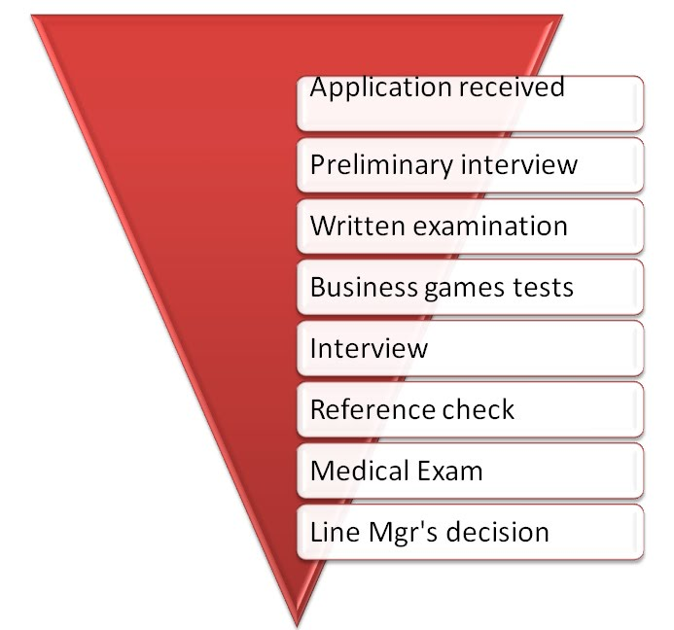

Slide 17
Interview
It is a formal, in-depth conversation conducted to evaluate the applicant’s acceptability.
It can be adapted to unskilled, skilled, managerial and professional employees
It allows a two-way exchange of information, the interviewers learn about the applicant, and the applicant learn about the interviewer

Slide 18
Interview can be
One to one (two participants)
Sequential ( one to one a step further a series of interviews, usually utilizing the strength and knowledge –base of each interviewer)
Panel ( 2-15 members)

Slide 19
Objectives of Interview
Helps obtain additional information from the applicant
Facilitates giving general information to the applicant such as company policies, job products manufactured and the like
Helps build the company’s image among the applicants

Slide 20
Interviews
Structured : Pre-set of Standardized Questions
Unstructured : Rarely questions
Mixed : combination of structured & unstructured
Behavioural : hypothetical situations ( reasoning and analytical skills)
Stressful : harsh, rapid fire questions

Slide 21
Halo Effect
It occurs when an interviewer judges an applicant’s performance on the basis of single trait, such as how the applicant dresses or talks

Slide 22
Reference checks
Criminal record checks
Previous employment checks
Educational records checks
Credit record checks
Civil records checks
Union affiliation checks
Character reference checks
Neighbourhood reference checks

