Slide 1
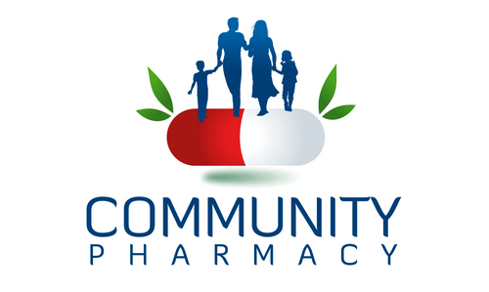
Presented by
Miss Diptimayee Jena
Asst. Prof .
Centurion University of Technology & Management, Bhubaneswar

Slide 2

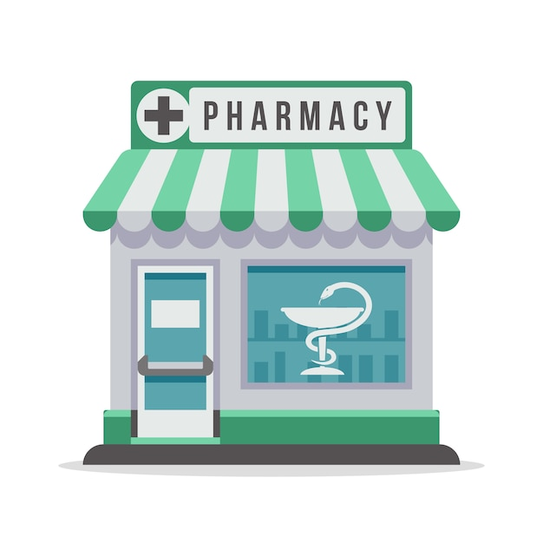
+

Slide 3
Definition:
Community pharmacy, also known as Retail Pharmacy, is the most common type of pharmacy that allows the public access to their medications and advice regarding their health.
Traditionally known as a Chemist, it is the healthcare facility that is responsible for the provision of pharmaceutical service to a specific community group or region.
The main responsibilities of a community pharmacy include compounding, counseling, and dispensing of drugs to the patients with care, accuracy, and legality along with the proper procurement, storage, dispensing and documentation of medicines.
The community pharmacist must be a qualified and pertinent with sound education, skills and competence to deliver the professional service to the community.

Slide 4
Community Pharmacy is defined broadly to include all those establishment that are privately owned and whose function, in varying degrees is to serve societies needs for both drug product and pharmaceutical service. It is the branch of pharmacy that deals with different aspects of patient care, dispensing of drugs and advising patient regarding the safe and accurate use of drugs.
Community Pharmacy practice means, any place under the direct supervision of a pharmacist where the practice of pharmacy occurs for the society.
OR
Community Pharmacy practice comprises the majority of licensed pharmacists, where pharmacists review the appropriateness of prescribed medications as part of the dispensing process for ambulatory patients (Out Patient, patients which are not admitted in hospital).

Slide 5
Have a sound background of pharmaceutical care, pharmacotherapy, and health promotion
Record and maintain his documents in order
Have good communication skills with patients and other healthcare providers
A Community Pharmacist should
Maintain a high degree of standard in products, services, and communication

Slide 6
History of Community Pharmacy:
Scotch M. Bathgate opened first chemist shop in Kolkata in 1811; the starting point of the pharmacy practice in India.
Pharmacy education under British ruled India had first begun in Madras Medical School in December 1860, two years course.
In 1932, pharmacy education was started at Banaras Hindu University, and introduced a Bachelor's of Pharmaceutical Chemistry and was first university to start a three year bachelors program in pharmacy. In 2008, Pharm.D (Doctor of Pharmacy), 6 year program has been introduced by PCI (Pharmacy Council of India).
The minimum qualification required to practice pharmacy is a Diploma in Pharmacy. A pharmacist's presence is legally required during the dispensing and selling of medicines. There is no pharmacist licensure pre-reg exam in India. Anyone who has the minimum qualification (D.Pharm) and above can apply for registration as a pharmacist.

Slide 7
Development of Community Pharmacy:
Good pharmacy Practice Compliance
Skill Development: Pharmacist Assistants
Quality pharmaceutical care

Slide 8
The problems faced by community pharmacies are,
Inadequate incentives and profit margin - Varies 12-20%.
Overcrowding of pharmacies in urban and semi urban areas - the overcrowding of community pharmacies in same locality is a reason for unhealthy competition and non-development of professional concepts in the practice area. Whereas in rural areas, the pharmacies are much lesser, or not there.
Anyone can open a pharmacy. It is not the exclusive domain of the pharmacist.
Professional fee - at present in India, there is no practice of charging professional fee for dispensing prescriptions.
Too many "me-too" brands in the market. India has many drugs and FDCs in the market, and more than 1,00,000 brands. Lack of implementation of drug laws -pharmacist is often not present when dispensing takes place, and prescription medicines are also available without a proper prescription.

Slide 9
Indian & International Scenario of Community Pharmacy:
Today, community pharmacists play an important role in any country as they take responsibility for patient’s medicine related needs for access to healthcare. However, in India only the supply of medicines remains the core activity of the community pharmacist. Most community pharmacists in the country still hardly offer patient-oriented service.
In India, consumers' (or patients) expectations from community pharmacists are that the medication should be effective, safe, and affordable. Other expectations from Indian pharmacists would be to dispense the drugs according to the rules with proper advice on how and when the medicines should be taken, and what to do in the case of adverse drug reactions as well as the provision of advice on common ailments.
The community (retail) pharmacy sector is the prime source of medicines for both ambulatory and hospitalized patients (minimum stock in many hospitals).

Slide 10

THANK YOU

