Slide 1
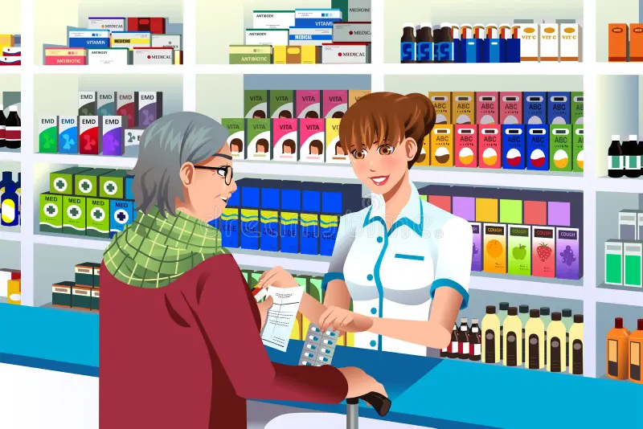
Role of a Community Pharmacist
Presented By:
Miss Diptimayee Jena
Assistant Professor

Slide 2


Chemists
Also known as
Experts in
Community Pharmacist
How to use drugs

Slide 3
They are well-respected professionals within their local community who use their expert knowledge of medicines to help patients get the best possible care and outcomes from their medicines.
By conducting customized patient monitoring and evaluations, they deliver patient-centered care.
WHO
Legally Qualified
Trained Healthcare
Link between patient & Prescriber
Defines Community Pharmacists as,

Slide 4


Patient
Community Pharmacist
Prescriber

Slide 5
Scope:
Population of the whole world is rising tremendously day by day, during the last few decades it has been realized that available health services and medical services are insufficient for the overall improvement of health status.
Now a days, community pharmacists are paying attention towards the health of the patient, environment of patient, and the state of patient general wellness.

Slide 6
Processing of the prescriptions
Dispensing
Storage
Consultation to General Practitioners
Responding to symptoms of Minor Ailments
Responsibilities
Patient Counselling
Health Screening Services
Drug information services
Health Promotion

Slide 7


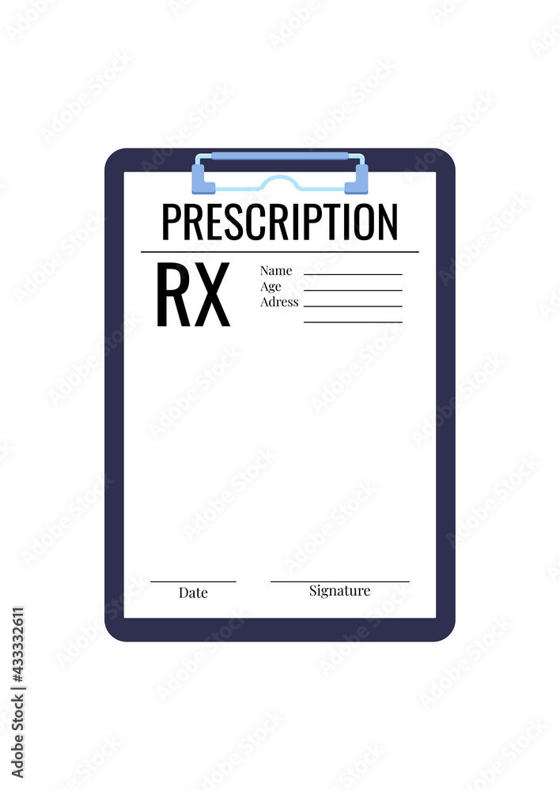
Processing of the Prescriptions:
&
Legality
Appropriateness
Potential Drug related problems
Regarding

Slide 8
Dispensing
Dispensing means, Make up & give out the medicines on the prescription.
In early days, Pharmacists has to compound and dispense the prescribed medication to patients, but now a days, prepackaged medicines are available.
Thus, dispensing activity became more easy.
The Pharmacist has to label each item prescribed:
Name of the Patient
Age, Gender
Name of the drug
Instructions for proper use of drugs
Name of the prescriber
Seal of Pharmacy

Slide 9

Patient Counselling

Slide 10
Majority of patients may not have proper idea regarding correct use of their drugs.
Due to busy schedules and over load, often prescribers give only brief information.
Research studies have supported the positive influence of counselling in disease management and improved medication adherence.
Thus improve the therapeutic outcome and quality of life.

Slide 11
Drug Information Services:
It is defined as, the systemic approach of reviewing various sources of published literature, evaluating the published information and provide the suitable answer for requester.
The pharmacist can use:
Primary Sources:
Peer reviewed journal, e.g., BMJ, LANCET
Secondary Sources:
Databases, e.g., Micromedex
Tertiary Sources:
Textbook

Slide 12





Smoking Cessation Programmes
Deworming & Balanced Diet

Slide 13


Slide 14


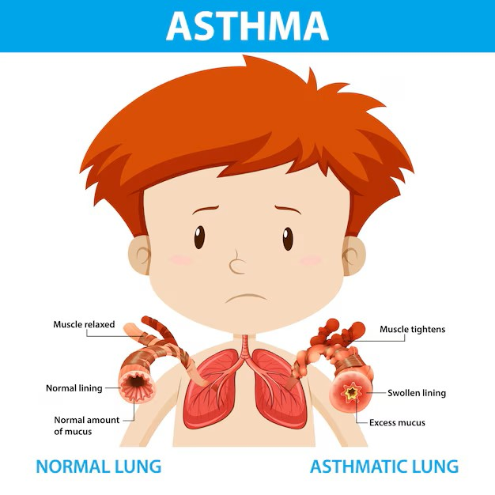
By offering the health screening services, community pharmacist can also involve in monitoring and managing the chronic disease like:

Slide 15
Responding to symptoms of Minor Ailments:
In cases of Minor diseases like common cold, diarrhea, sprains, simple body aches, Pharmacist will be able to give suitable medications.

Slide 16

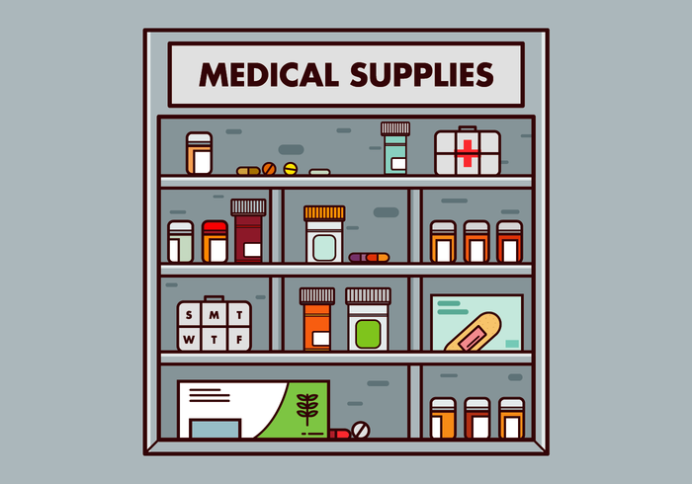
Consultation to General Practitioners:
Pharmacists by their professional liaison, they can guide patients to the general practitioners of management of medical condition.
If required pharmacist will provide:
Drug Information to Doctors
Emergency drugs to clinics and nursing homes

Slide 17


Slide 18
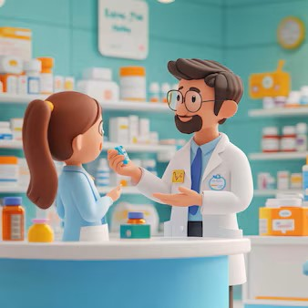
GPP
Defines
To provide
Pharmacist
Quality Pharmacy Service to every patients
It is the practice of pharmacy that responds to the needs of the people, who use the pharmacist’s services to provide optimal, evidence based care.

Slide 19
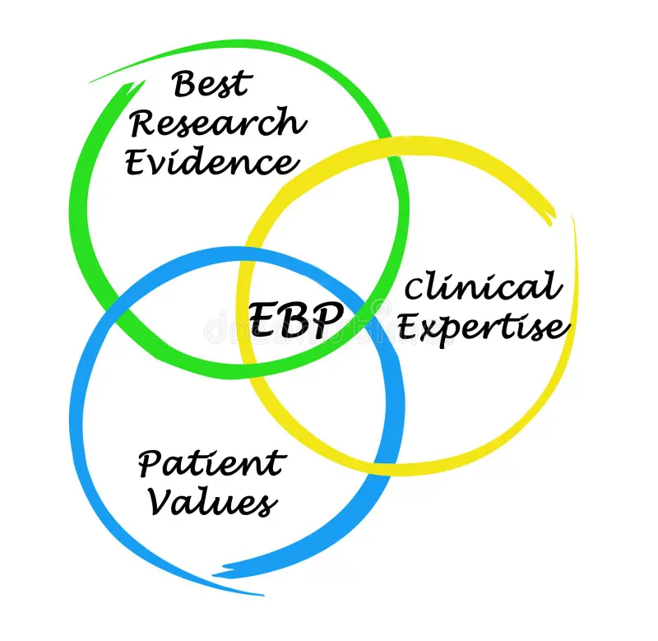

Slide 20
GPP
Organizes
Major roles of Pharmacist such as:
Prepare, obtain, store, secure, distribute, administer, dispense and dispose of medical products
Provide effective medication therapy management
Maintain and improve professional performance
Contribute to improve effectiveness of health care system and public health

Slide 21
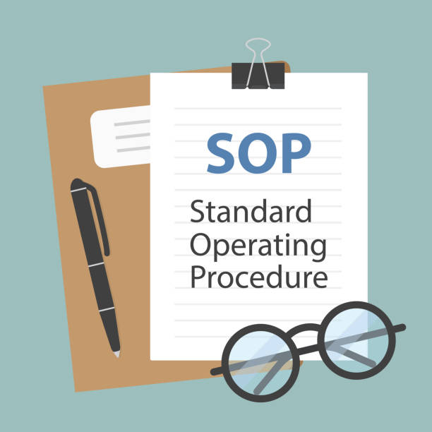

Slide 22




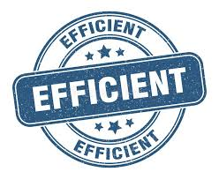

Provides
Needed to
Step by step instructions
&
Specific task
Efficiently
Consistently

Slide 23
Definition of SOP:
SOP is a set of written instructions that document a routine or repetitive activity followed by an organization.
Purpose of SOP:
The purpose of SOPs is essentially to be a go-to guide for solving problems, ensuring safety, & maintaining high performance across the company.

Slide 24
Contents of SOP:
Name & Address of the company
SOP number, and Date when the SOP was prepared/reviewed.
Aim & Objective of SOP
Scope of SOP
Process/Steps to be carried out, in sequential order
Whose responsibility is to carry out the SOP.
Any other useful information
Name & Signature of the person/s who made/reviewed the SOPs, along with date of review.

Slide 25
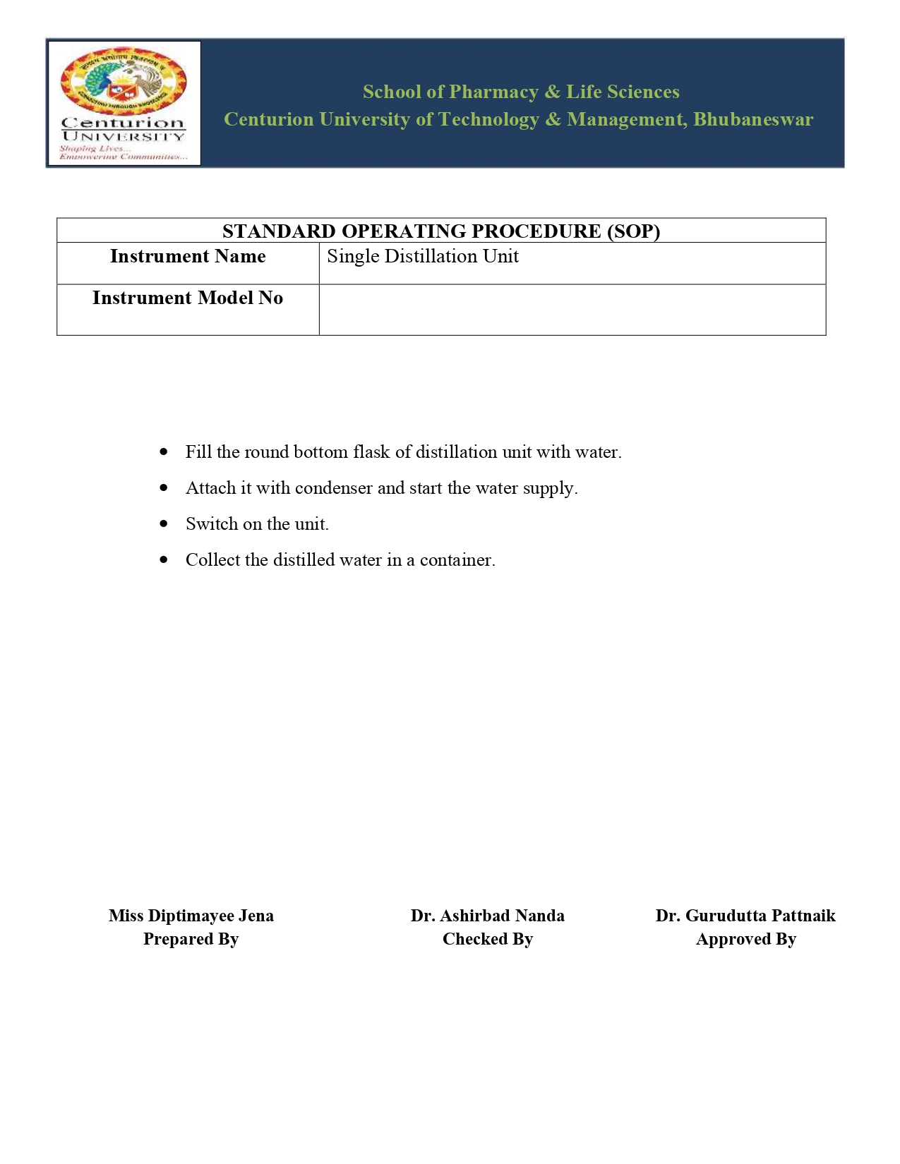

Slide 26


