Slide 1
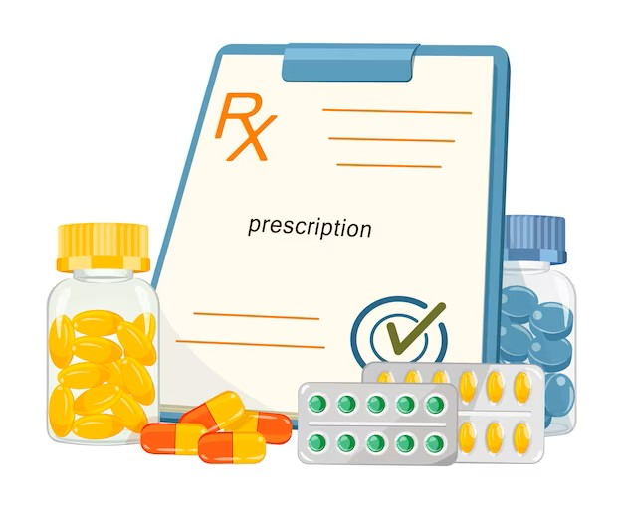
Prescription & Its Handling
Presented By:
Miss Diptimayee Jena
Assistant Professor

Slide 2

Praescriptus
(Latin Word)
Means
Before Writing
Gives rise to
Prescription
(English Word)

Slide 3
Prior to compounding and administering a medication, It is necessary to write a prescription.
Prescription is a set of written instructions of medicine from a physician or a registered medical practitioner.
It is a link between the physician and the pharmacist regarding prescribing.

Slide 4


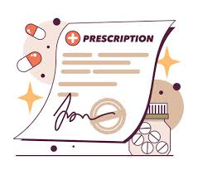
Link
Prescriber
Pharmacist

Slide 5
Parts of a Prescription:
Prescriber office information.
Date.
Patient data (Name, Age, Sex, and address of the patient)
Superscription (Symbol R_{X})
Inscription (Medication Prescribed)-Main part of a prescription
Subscription (Direction to pharmacist/dispenser)
Signatura or Transcription (Direction for Patients)
Renewal instructions
Prescriber’s signatura and registration number

Slide 6

Parts of a Prescription
1. Date
2. Name……..
Age………
Weight……
3. Superscription
Paracetamol – 500mg
4. Inscription
tab Pacaretamol 10
5. Subscription
BID for 5 days
6. Signatura
7. Signature
8. Reg No. & Seal

Slide 7
1. Prescribers office address:
When a patient becomes ill, having information on their physician is vital to being able to reach them in an urgent situation.
The prescription contains the following information:
Name of the Doctor or Office
Address with phone number and e-mail
Prescription No; (required when calling the pharmacy for a refill)

Slide 8
2. Date:
The top of the prescription, the date should be mentioned.
As a result, a pharmacist can quickly determine the date of the prescription.
If the prescription is being refilled, knowing when the last time drug was dispensed, It may be helpful.
The date protects the patients from abusing a medication that is habit forming.

Slide 9
3. Patient Details:
This section should contain the patient’s name, age, weight, gender, and address.
This is a very necessary feature since it is used to identify the person.
Identifying information such as the patient’s name and address is required.
Child patients must provide their age, weight, and gender in order to determine the necessary dose.

Slide 10
4. Superscription:
This is the section of the prescription that contains the sign , which stands for “Take Thou”.
It’s a Latin Term, and it’s a good one.
You Take is a common expression in English.
In the past, the sign was thought to have come from the Jupiter sign. God of healing Jupiter is a Greek deity. The patient’s fast recovery was requested by using this sign.

Slide 11
5. Inscription:
It is the most important portion of the prescription.
It contains information regarding drug’s composition and dose.
The medication may be either an official or non-official formulation.

Slide 12
Official Preparation
i.e., from pharmacopoeia
Non-official Preparation
The name of the preparation is the only thing written.
E.g., Piperazine Citrate Elixir IP.
Each ingredient’s quantity and type will be specified

Slide 13
6. Subscription:
The subscription contains, instructions for the pharmacist on how to produce a dose.
This section of prescription specifies, the number of dosage units and the amount to be administered.
E.g., 10 tabs of Paracetamol, for instance (that means, 10 pieces paracetamol tablet)

Slide 14
7. Signatura:
To be printed on the label. “Signature” is the most common way to refer it.
t.i.d (three times a day), b.i.d (two times a day), and o.d (one day) are used in the signatura.
Signed and stamped prescriptions are issued by a licensed medical professional.

Slide 15
Computerized Physician Order Entry (CPOE)
Electronic entry of physician instructions – hospitalized patients under his/her care.
Communicated over a computer network.
Advantages:
Easy communication
Decreases delay in order completion
Reduces errors related to handwriting
Provides error checking for duplicate or incorrect doses or tests

Slide 16
Who can prescribe?

Slide 17






Prescriber
Veterinarians
Dentists
Podiatrists
Pharmacist
Optometrist
Nursing Practitioners

Slide 18
Refill Information:
Additional labelling instructions,
Warnings such as:
“May cause drowsiness”
“do not drink alcohol”
Schedule II drug no fill
Schedule III & IV drug not to exceed 5 refills or 6 months after the issue date.
Schedule V drug-No restriction.

Slide 19
Strength of Drug:
Decimal Points
Avoid trailing Zeros
Ex: 5mg vs. 5.0mg; can be mistaken for 50mg
Always use leading zeros
Ex: 0.8ml vs. .8ml; can be mistaken for 8ml.

Slide 20
Quantity of Drug:
Only necessary quantity.
Calculate quantity: frequency per day * treatment days

Slide 21
Directions for Use:
Full English or use Latin abbreviations:
Latin Abbreviations:
More convenient
More potential for mistakes
Avoid dangerous abbreviations
Clear & specific directions

Slide 22
Schedules of Controlled Drugs
Schedule I:
No accepted medical use & have a high abuse potential.
Ex: Heroin, Marijuana
Schedule II:
High abuse potential-Severe psychic.
Ex: Stimulants, Opium, Morphine

Slide 23
Schedule III:
Abuse potential is less than those in Schedules I & II
Ex: Other drugs, such as: Barbiturates
Schedule IV:
Abuse potential is less than those in Schedule III
Ex: Phenobarbital, Oxazepam
Schedule V:
Abuse potential is less than those in Schedule IV
Ex: Narcotic analgesic drugs used for antitussive

Slide 24
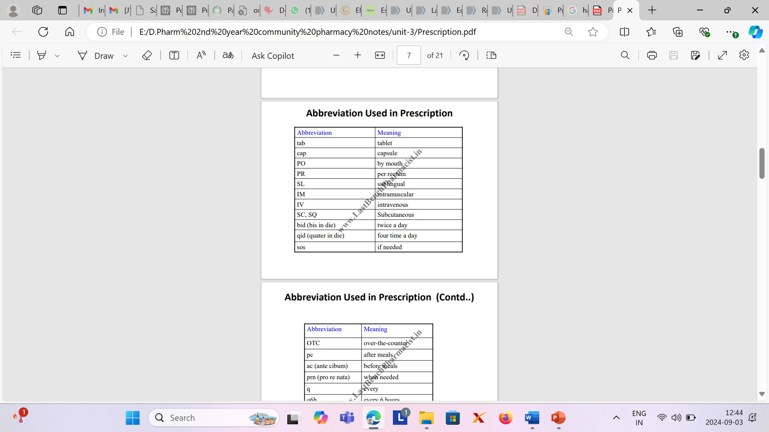

Slide 25
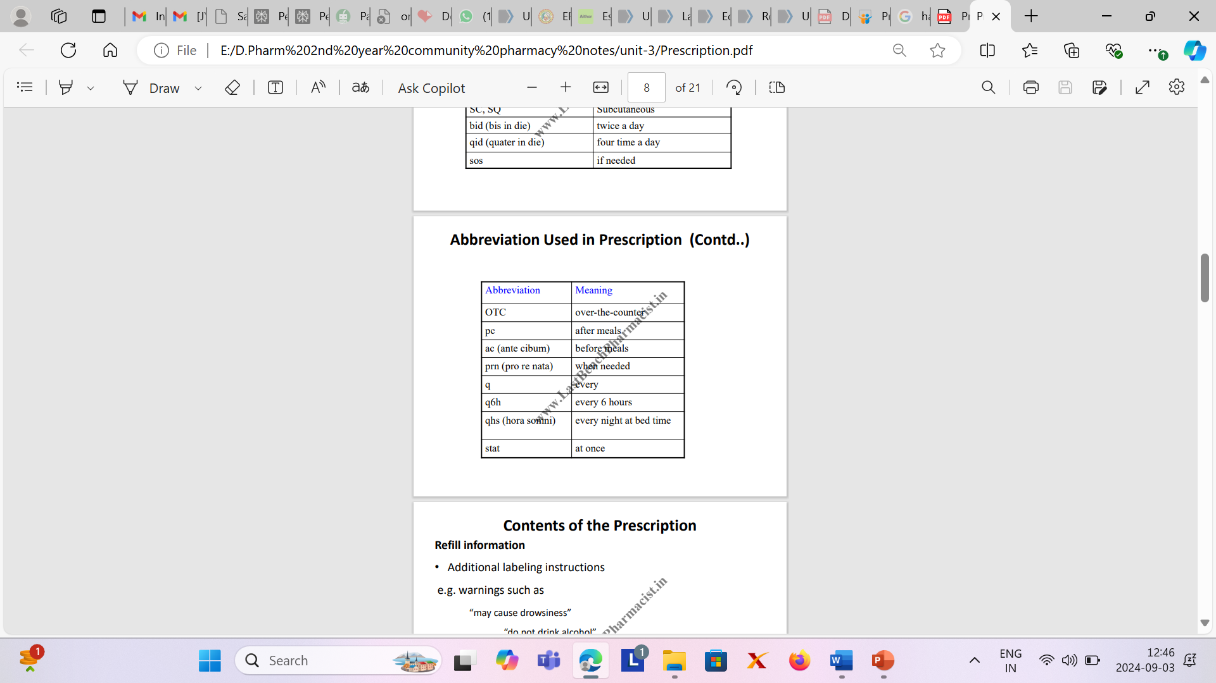

Slide 26

Legality of Prescription

Slide 27
For a pharmacist to dispense a controlled substance, the prescription must include specific information to be considered as valid:
Date of issue
Patient’s name & Address
Patient’s date of birth
Clinician name, address, DEA number
Drug name
Drug strength
Dosage form
Quantity prescribed
Directions for use
Number of refills
Signature of prescriber

Slide 28
There are legal limits on the number of refills & number of dispensed that a prescription may have.

Slide 29
Medication related Problems:
Inappropriate prescribing
Unnecessary regimen
Dispensing error (Incorrect or Inappropriate labelling)
Inappropriate behaviour by the patient

Slide 30
Drug related Problems:
Drug for untreated indication
Wrong drug being taken
Too little dose of the prescribed drug
Too high dose of the prescribed drug
Adverse drug reaction present
Drug-drug/food/lab interaction
Not receiving the prescribed drug
Drug used without valid indication

Slide 31
Drug Interactions:
Effects of one drug are altered by the co-administration of
Another drug
Herbal Medicine
Food
Drink or other environmental chemical agents

Slide 32
Net effect-manifests as,
Additive or enhanced effect of one or more drugs
Antagonism of the effect of one or more drugs or
Any other alteration in the effect of one or more drugs.

Slide 33
Examples of Drugs with High Risk of Interaction
Digoxin
Lithium
Aminoglycosides
Cytotoxic Agents
Warfarin
Levodopa
Theophylline

Slide 34
Types of Drug Interactions
Pharmacokinetic Interactions: affect the processes by which drugs are absorbed, distributed, metabolized or excreted.
Changes in gastro intestinal pH
Adsorption, Chelation & other complexing mechanisms
Effects on gastro intestinal motility

Slide 35
Malabsorption
Drug distribution
Drug Metabolism
Ellimination interactions
Changes in urinary pH
Changes in active tubule excretion
Changes in renal blood flow

Slide 36
Pharmacodynamic Interactions: Effects of one drug may get changed by the presence of another drug at its site of action.
Antagonistic Interactions
Additive or Synergistic Interactions
Drug-food Interaction

Slide 37
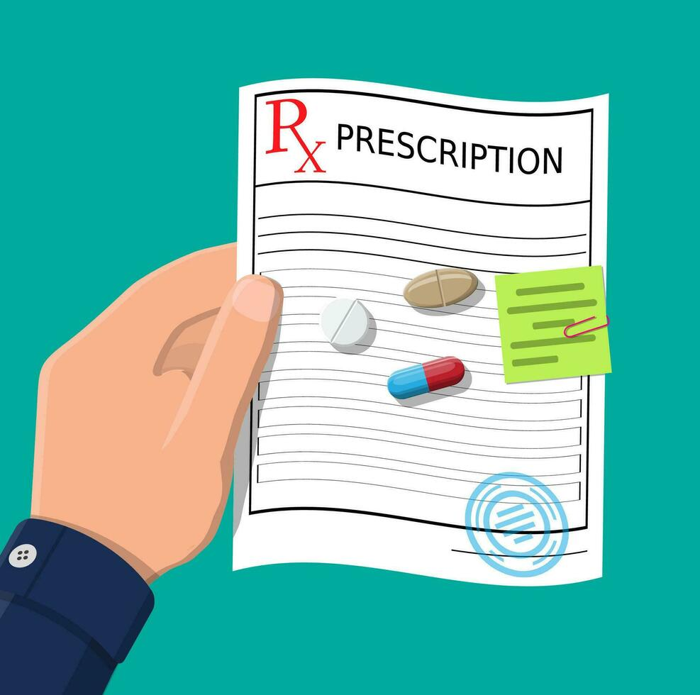
Handling of Prescription

Slide 38
Receiving
Reading & Checking
Collecting & Weighing the material
Compounding, Labeling & Packing

Slide 39

The Prescription must be received by the pharmacist himself
Receiving
While receiving, he should not change his facial expression
Because, it may cause anxiety to the patient

Slide 40
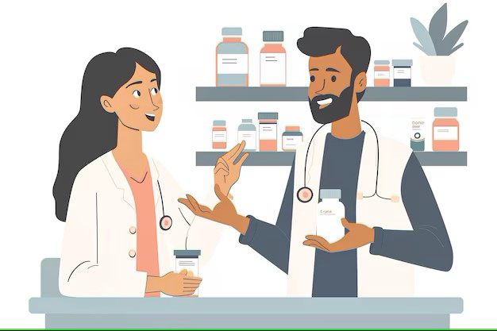
The pharmacist should check whether it is in paper format
Reading
Any doubt, in case of prescribed drugs, he should discuss it with another pharmacist
Because, some drugs have almost same effect. Ex: Digoxin- Digitoxin

Slide 41

Errors in dosage form
Checking
Wrong dose/dosage form
Contraindicated Drugs
Drug Interactions

Slide 42
Before Compounding, All the materials are collected
Collecting & Weighing the material
In the left side of the balance
After weighing materials, shifted the right side of the balance
While compounding, label of the stock bottle, read carefully to avoid any error

Slide 43
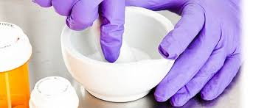
Carried out in neat place
Equipment should cleaned and dried thoroughly
Only one compound should be compounded at a time
Compounding

Slide 44

Filled in a suitable container
Container should tightly closed, free from microorganisms and moisture

Slide 45

Size of label a container
Directions to the patients
Mode of administration, direction for use and storage
Labelling

Slide 46
Labelling of Dispensed Medications

Slide 47
Labelling of Dispensed Medications:
Labels for dispensed medicines are important for communicating medicine-related information to consumers and ensuring effective medicine use.
The dispensed medicine label must include the essential information the consumer needs to take their medicines safely and effectively.

Slide 48
Types of Dispensing Labels:
Main Label
Ancillary Label
Pictograms

Slide 49
Main Label:
Main label indicates a brand name or brand logo of the company that sources and sells drugs. Brand labels play a big role for customers as because, customer only know the brand name.
A brand level is associated with the product quality, stability and feeling good .

Slide 50
Ancillary Label:
It is a level added on a dispensed medication package by a pharmacist in addition to the usual prescriptions label.
The ancillary information can include the route of medication, what to avoid, how to take it, etc.
A list of common example includes:
Take medication with a full glass of water
Do not take alcohol
Do not chew or crush

Slide 51
Pictograms:
These are the images representing proper way to take or store medications, precautions, and other important information regarding a medication that a health care provider should provide to his/her patient.
Pictograms are graphic images that immediately show the use of hazardous products, what type of hazard is present with a big glance. For example, The product is flammable.

Slide 52
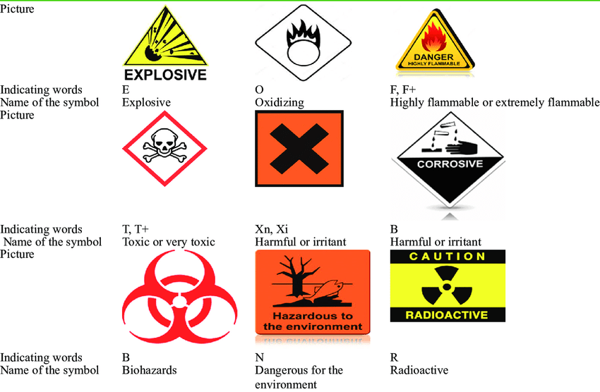
Most pictograms have a distinct Red “Square set on one of its points” border.

Slide 53
Brief instructions regarding Usage of Medications :
Information given on label should be :
Accurate
Legible
Intelligible
Adequate and relevant

Slide 54
Importance of Label:
To provide consumers information regarding the product
To ensure the appropriate and safe use of approved products
To distinguish the product from that of competitors established a brand
A legal requirement

Slide 55
Different parts of a Label
Active Ingredients (A)
Purpose (B)
Uses (C)
Warnings (D)
Directions (E)
Other Information (F)
Inactive Ingredients (G)

Slide 56


