Slide 1
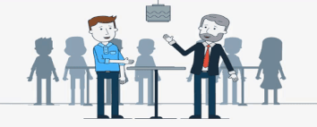
Communication Skills
Presented By:
Miss Diptimayee Jena
Assistant Professor

Slide 2

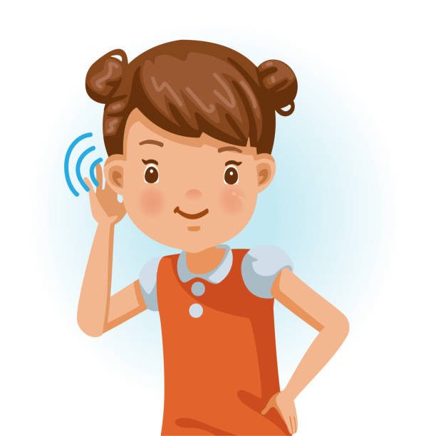
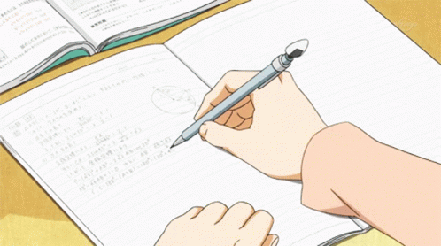
Definition:
Communication
Act of
Giving & Receiving & sharing information
Talking
Writing
Listening

Slide 3
Good communicators listen carefully, speak or write clearly, and respect different opinions.
Communication Skill:
Communication skills are the abilities you use when giving and receiving different kind of information.
Some examples include, communicating new ideas, feelings or even an update on your project.
Communication skills involve listening, speaking, observing and empathizing.
Communication skills are those skills which are needed to speak and write properly. A person who is able to speak appropriately and maintaining eye contact with the audience, uses different vocabulary and articulate speech to suit the need of the audience is generally said to be an effective speaker.

Slide 4
Verbal Communication skill
Visual Communication skill
Non-Verbal Communication skill
Types of Communication skills
Listening skill
Written Communication skill

Slide 5
Verbal Communication skill:
Verbal communication occurs when we engage in speaking with others.
It can be face-to-face, over the telephone, via Skype or zoom,etc.
Some verbal engagements are informal, such as chatting with a friend over coffee or in the office kitchen, while others are more formal such as a scheduled meeting.
It is not just about the words.
We string those words together to create an dominating message as well as the intonation (Pitch, tone, cadence)

Slide 6
Non-Verbal Communication skill:
What we do while we speak often says more than the actual words.
Non-verbal communication includes facial expressions, posture, eye contact, hand movements and touch.
In non-verbal Communication, avoiding eye contact, sighing, scrunched up face, etc. indicate something different/wrong.

Slide 7
Written Communication skill:
Whether it is an email, a memo, a report, a facebook post, a tweet, a contract, etc. all forms of written communication have the same goal to disseminate information in a clear and concise manner.
In fact, poor writing skills often lead to confusion and embarrassment, and even potential legal jeopardy (danger, loss or harm).

Slide 8
Listening skill:
The act of listening does not often make its way onto the list of types of communication.
Active listening, however, is perhaps one of the most important types of communication because if we can not listen to the person sitting across from us, we can not effectively engage with them.

Slide 9

Visual Communication skill:
We are a visual society.
Think about from a personal perspective-the images we post on social media are meant to convey meaning- to communicate a message.

Slide 10
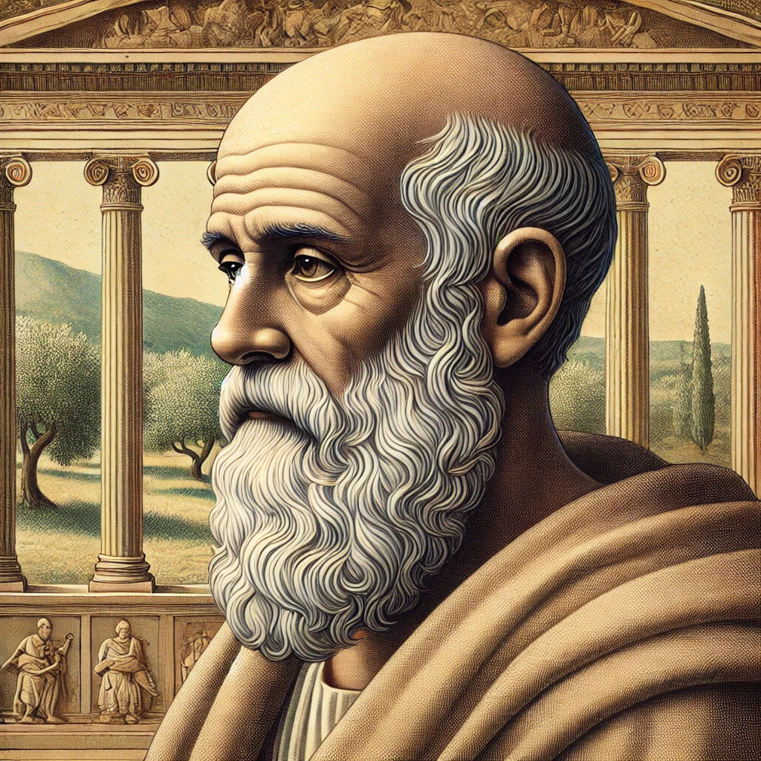
Healing arts has three components.
A disease
A patient
A physician
Says
The physician is the servant of healing arts.
The patient must face to the disease together with the physician.
Hippocrates

Slide 11
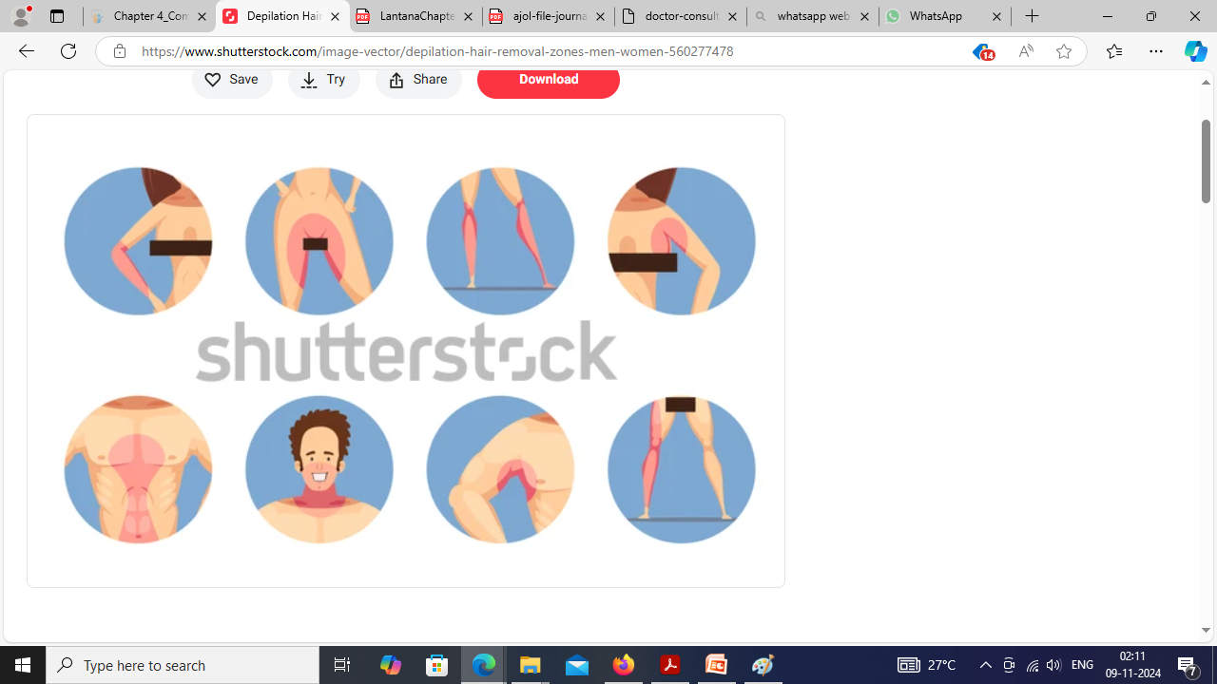
To communicate in healthcare means,
To communicate and obtain information on which patient’s health depended.
In healthcare, the normal communication boundaries move along
Baring of intimate body parts.

Slide 12
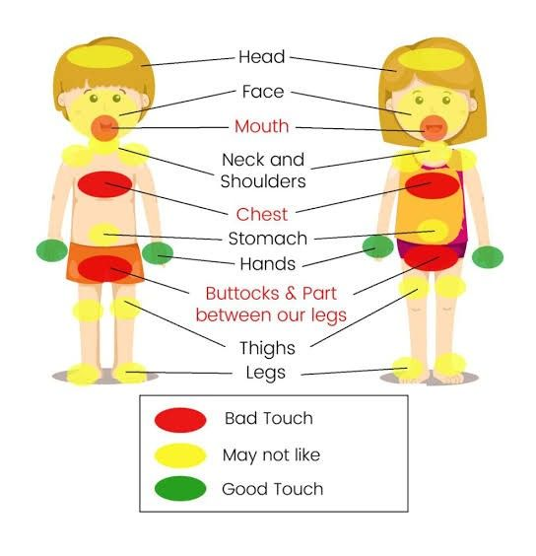
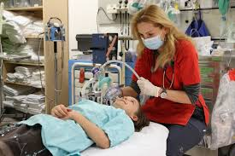
Touching of different parts of the body
Implementation of painful procedures

Slide 13
Explanations of diagnosis, investigation and treatment.
Patient involvement in decision making.
Communication with other Health professionals
Communication skills in health care include:
Communication with relatives
Providing advice on lifestyle, health, or risk factors.
Searching for the informed consent, obtaining consent for post-mortem

Slide 14
Verbal Communication Skills (One-to-one, Over the telephone)
Communication is about passing information from one person to another.
This means that both the sending and the receiving of the message are equally important.
Verbal communication therefore requires both a speaker (or writer) to transmit the message, and a listener (or reader) to make sense of the message.
Basic Verbal Communication Skills: Effective Speaking and Listening

Slide 15
Effective speaking involves three main areas: the words you choose, how you say them, and how you reinforce them with other non-verbal communications.
All these affect the transmission of your message, and how it is received and understood by your audience.
It is worth considering your choice of words carefully. You will probably need to use different words in different situations, even when discussing the same subject. For example, what you say to a close colleague will be very different from how you present a subject at a major conference.

Slide 16
Active listening is an important skill. However, when we communicate, we tend to spend far more energy considering what we are going to say than listening to the other person
Effective listening is vital for good verbal communication. There are a number of ways that you can ensure that you listen more effectively.

Slide 17
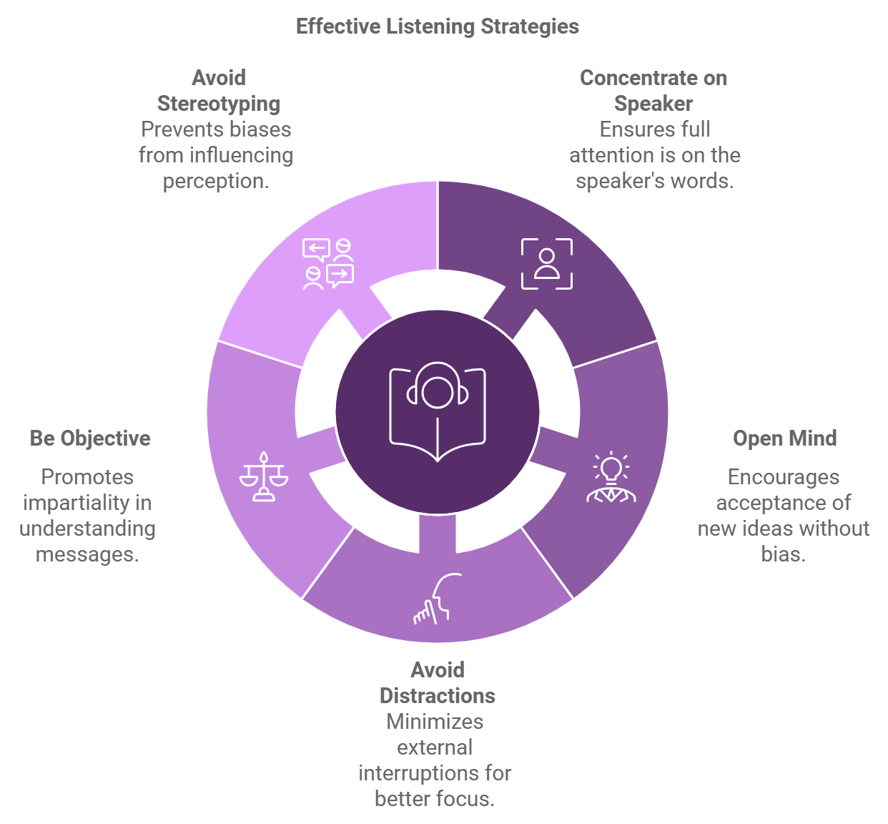

Slide 18
These include:
Be prepared to listen. Concentrate on the speaker, and not on how you are going to reply.
Keep an open mind and avoid making judgements about the speaker.
Concentrate on the main direction of the speaker’s message. Try to understand broadly what they are trying to say overall, as well as the detail of the words that they are using.

Slide 19
Avoid distractions if at all possible. For example, if there is a lot of background noise, you might suggest that you go somewhere else to talk.
Be objective.
Do not be trying to think of your next question while the other person is giving information.
Do not dwell on one or two points at the expense of others. Try to use the overall picture and all the information that you have.
Do not stereotype the speaker. Try not to let prejudices associated with, for example, gender, ethnicity, accent, social class, appearance or dress interfere with what is being said

Slide 20
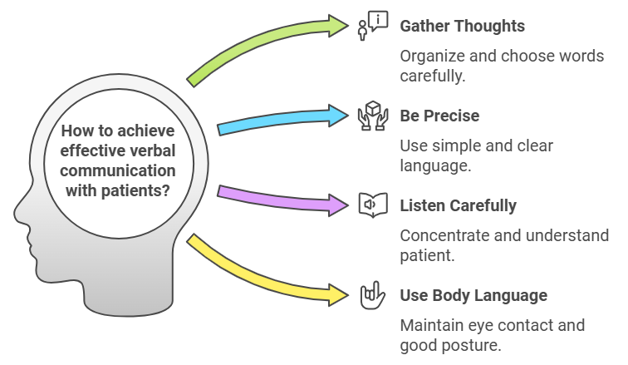

Slide 21
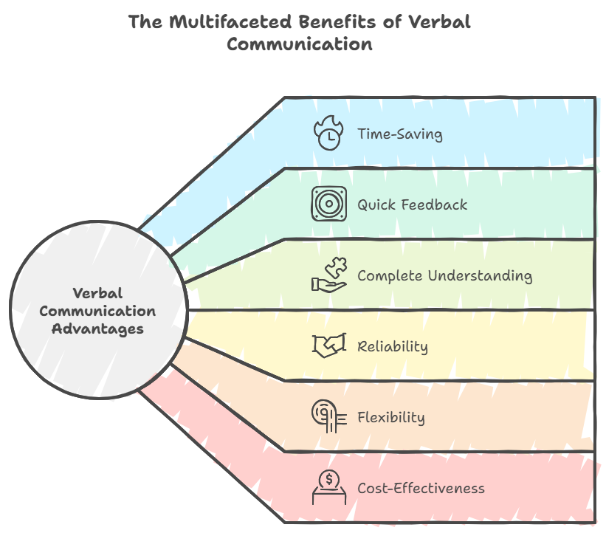

Slide 22
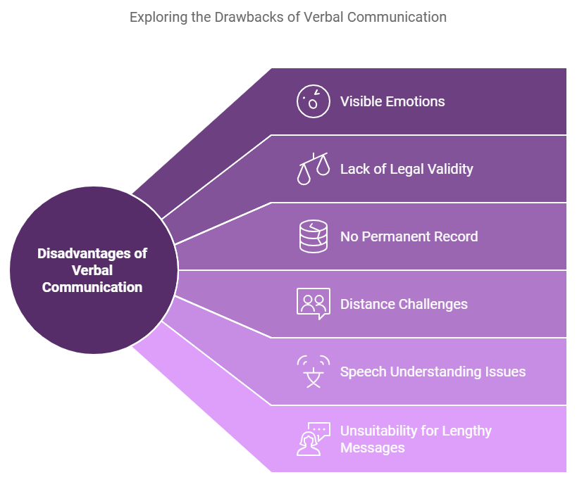

Slide 23
Written Communication Skills:
Written communications skills are those skills that use written words for conveying of a message to other persons.
Types of written communication include:
A. Formal written communication
Emails
Letters
Contracts
Briefs
Memos
Meeting agendas
Bulletins
B. Informal written communication
Examples: Personal letter

Slide 24
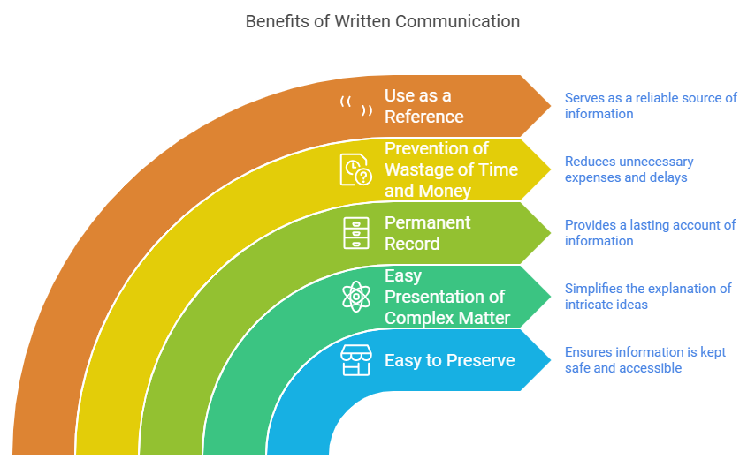

Slide 25
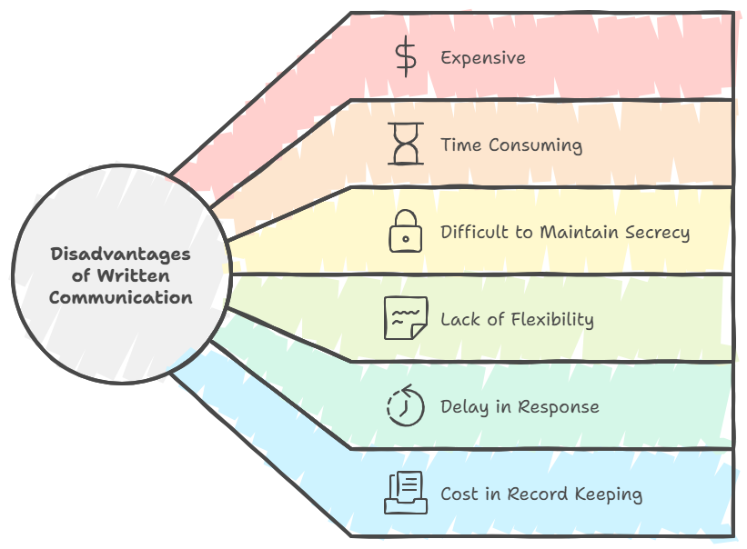

Slide 26
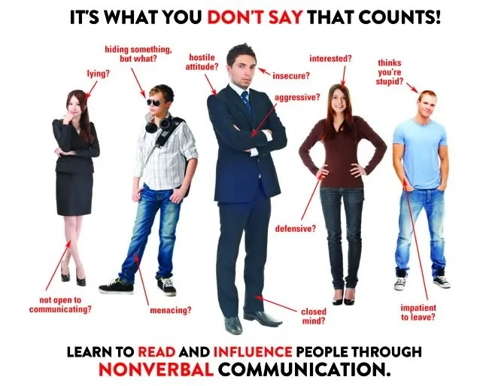
Body Language

Slide 27
Body language is a type of communication in which physical behaviours, as opposed to words, are used to express or convey information.
Such behaviour includes facial expressions, body posture, gestures, eye movement, touch and the use of space.
Face Expression: An important indicator of emotional state.
Body posture: Message can be conveyed through body posture.
Closed body posture: person sitting with his legs and arms crossed in front of their body. This prevents or hinders the free flow of information.
Open body posture: A relaxed stance with uncrossed legs and arms. It tends to ease communication
Eye Contact: It indicates confidence, attention and honesty.
Tone of Voice: Soften voice etc can also influence the communication.
Proximity/Closeness Of Position: The pharmacist and patient must maintain a minimum distance of 45cm

Slide 28
Interactions with Professionals:
Be prepared with specific questions or facts and recommendations when initiating a patient care- related conversation with physicians.
Interactions with Patients (Patient interview techniques):
Medication history interview are required for making decisions.
The following information is recorded:

Slide 29
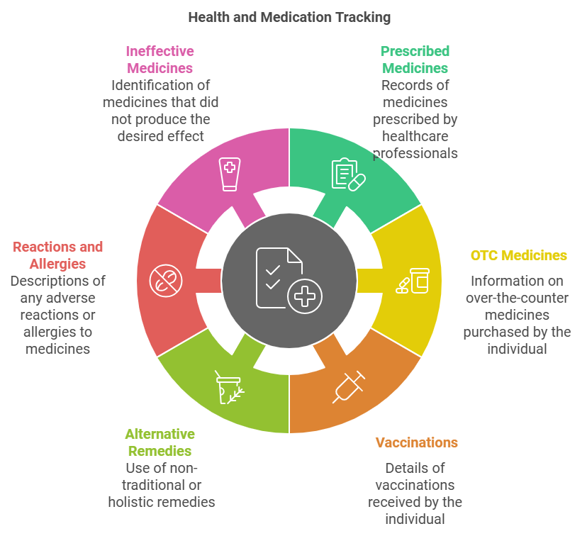

Slide 30


