Slide 1

Patient Counselling
Presented By:
Miss Diptimayee Jena
Assistant Professor

Slide 2

Definition:
Patient Counselling
Providing medication information
Defined as
Orally
Or Written form
to
Patient or their representative

Slide 3
Regarding,
Direction of use
Advice on side effects
Precautions
Storage
Diet
Life style modifications

Slide 4
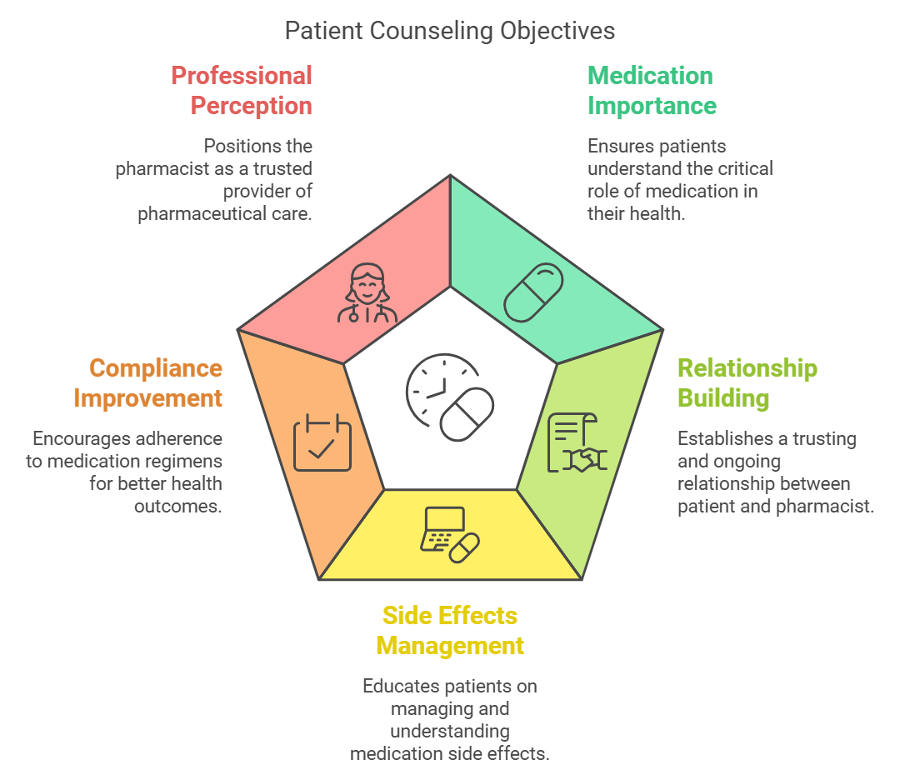

Slide 5
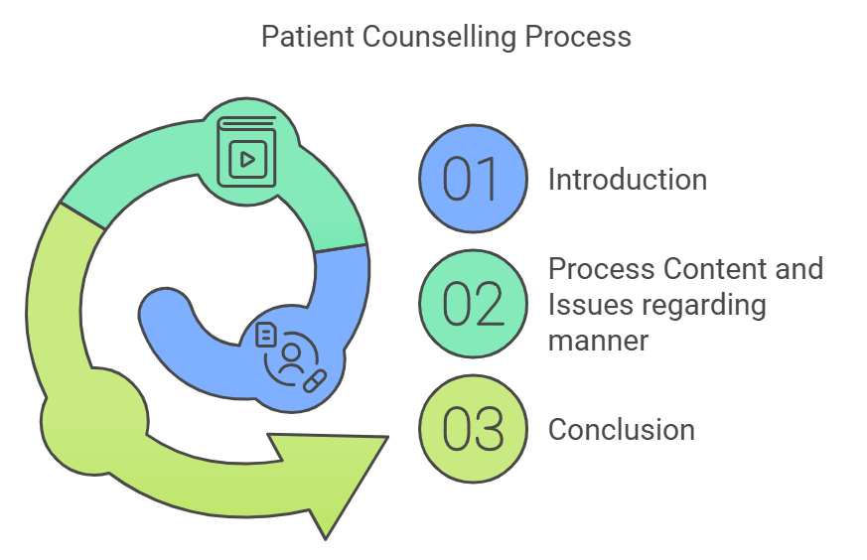

Slide 6
Steps during Patient Counselling:
Preparing for the session
Opening of the session
Counselling content
Closing the session

Slide 7
Opening the session
Review the patient’s Record
Introduce yourself and identify the patient
Explain purpose of counselling
Obtain drug related information such as allergies, use of herbals
Assess the patients understanding of the reasons for therapy
Assess any actual and/or potential concerns or problems of importance to the patient

Slide 8
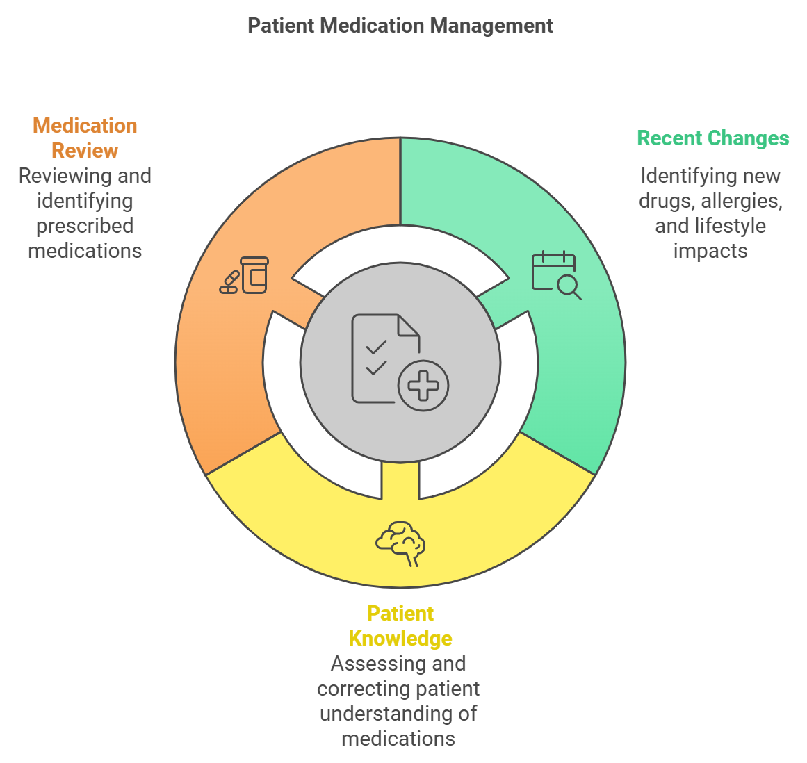

Slide 9
Issues regarding manner:
Use language that the patient understands
Use appropriate counselling aids
Present facts and concepts in simple words and in logic order
Use open ended questions.

Slide 10
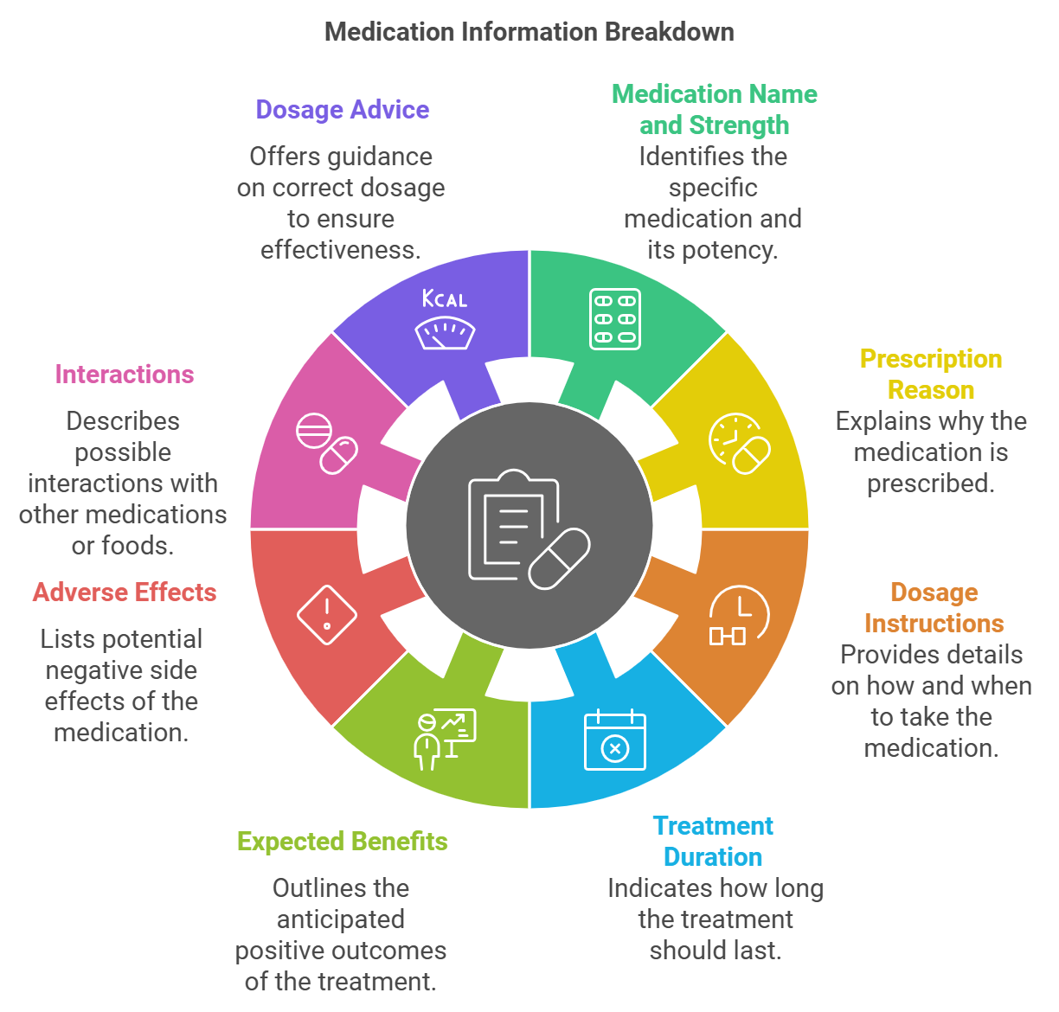
Counselling Contents

Slide 11
Conclusion/Closing session:
Verify the patient’s understanding by means of feedback
Summarize by emphasizing keypoints
Give an opportunity to the patient to put forward any concerns.
Help the patient to plain follow-up

Slide 12
Priorities for patient Counselling:
Chronic Disease Conditions
Special Populations
Multiple drug therapy
Co morbidities
New Prescription

Slide 13
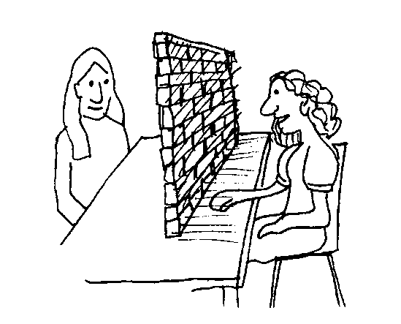
Barriers in Effective Patient Counselling

Slide 14
Pharmacist-Related Barriers
System Related Barriers
Patient-Related Barriers
  Lack of Knowledge about patient
  Lack of Knowledge about patient’s disease condition
  Lack of Confidence
  Lack of Skill
  Age Differences
  Difference Gender
  Inappropriate Communication
  Language differences
  Lack of Listening
  Lack of Time
  Lack of Preparation
  Lack of Privacy
  Lack of Pharmacist in Pharmacy
  Lack of Time
  Heavy Patient Flow for prescription filling
  Lack of Trust
  Poor Listening
  Lack of Time
  Physical or mental condition
  Gender Differences
  Language Differences
  Misunderstanding of Information
  Lack of Literacy
  Lack of Expression
  Poor Communication

Slide 15
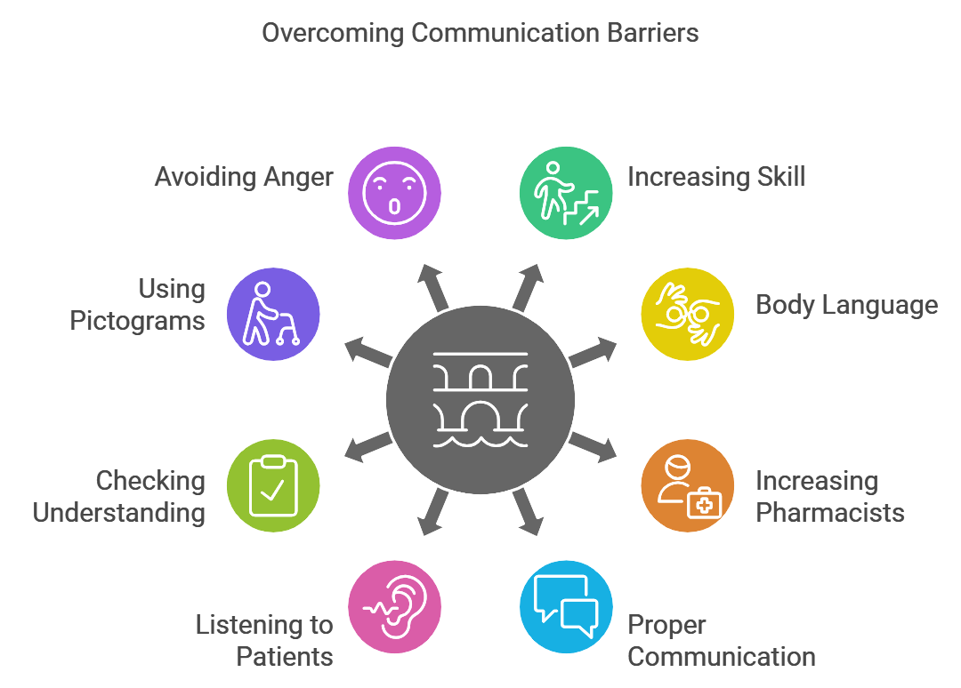

Slide 16
Patient Counselling Points for Chronic Disease/Disorders:

Slide 17
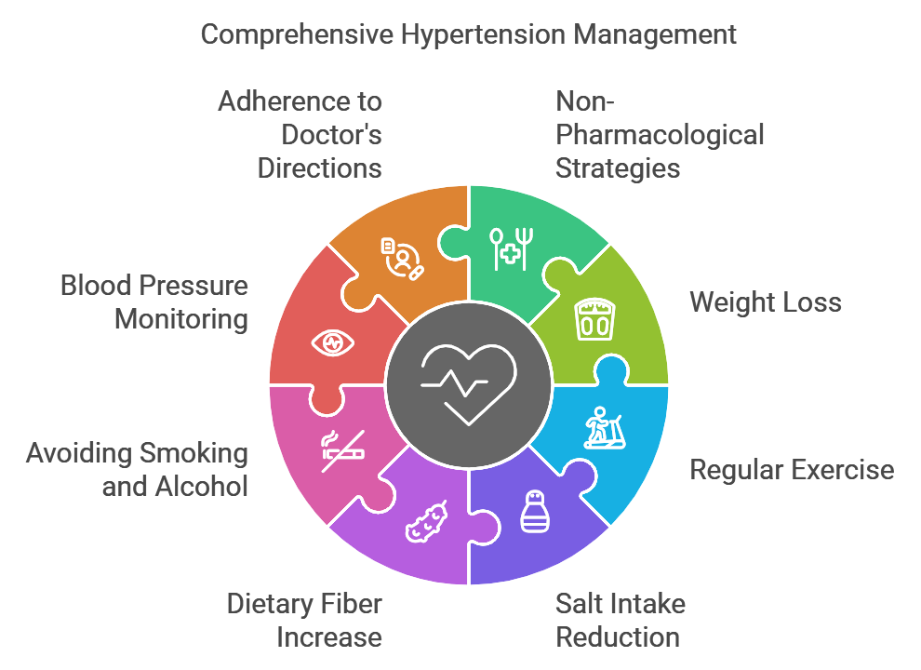

Slide 18
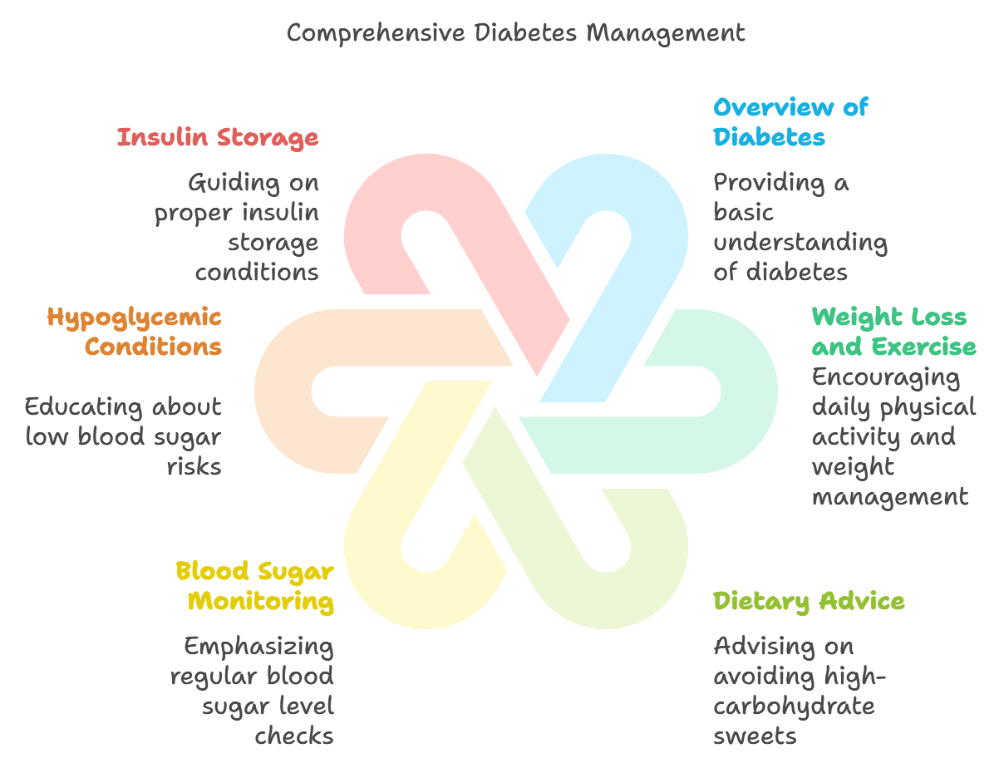

Slide 19
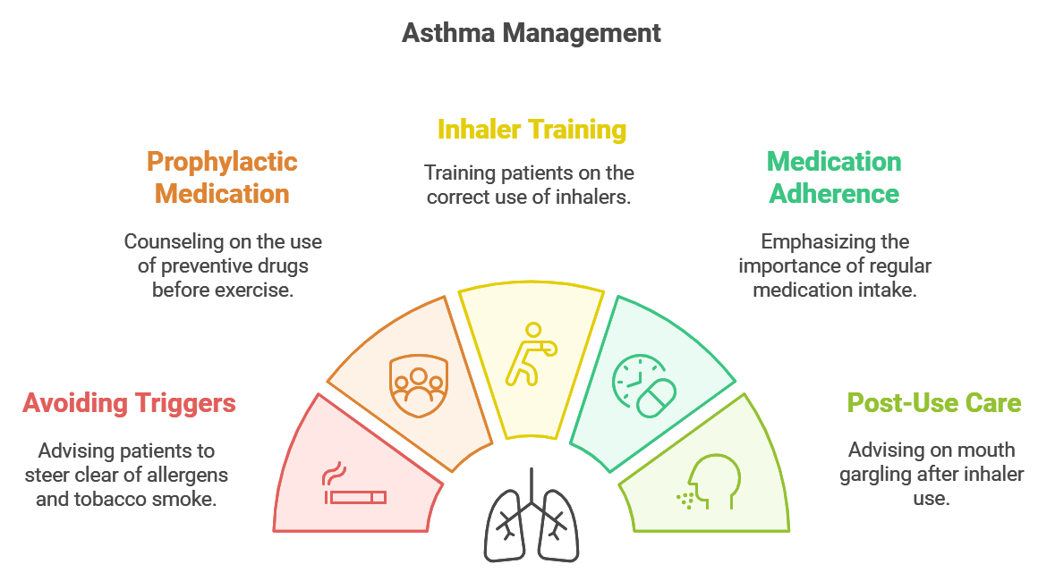

Slide 20
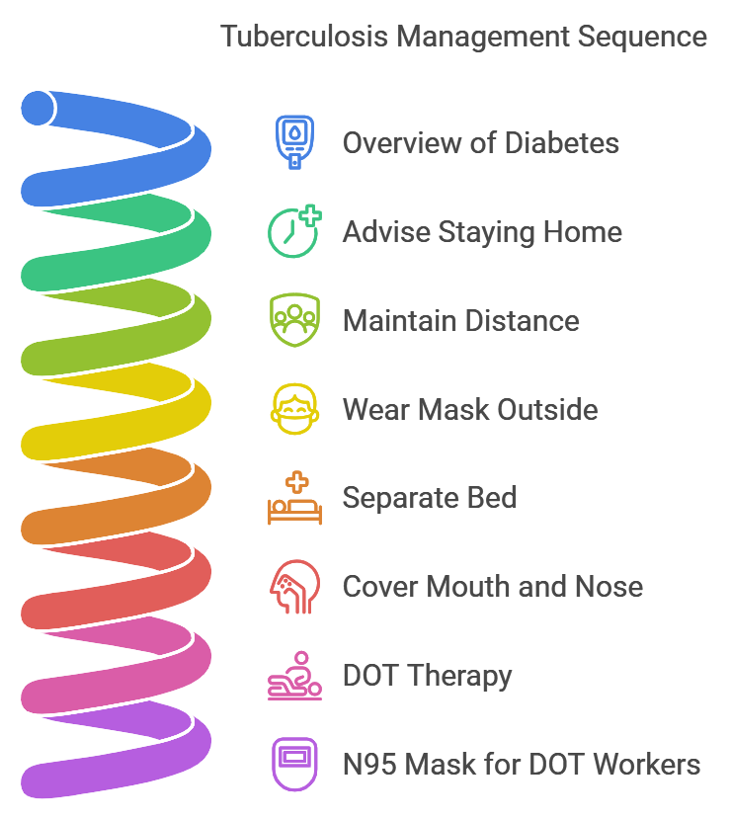

Slide 21
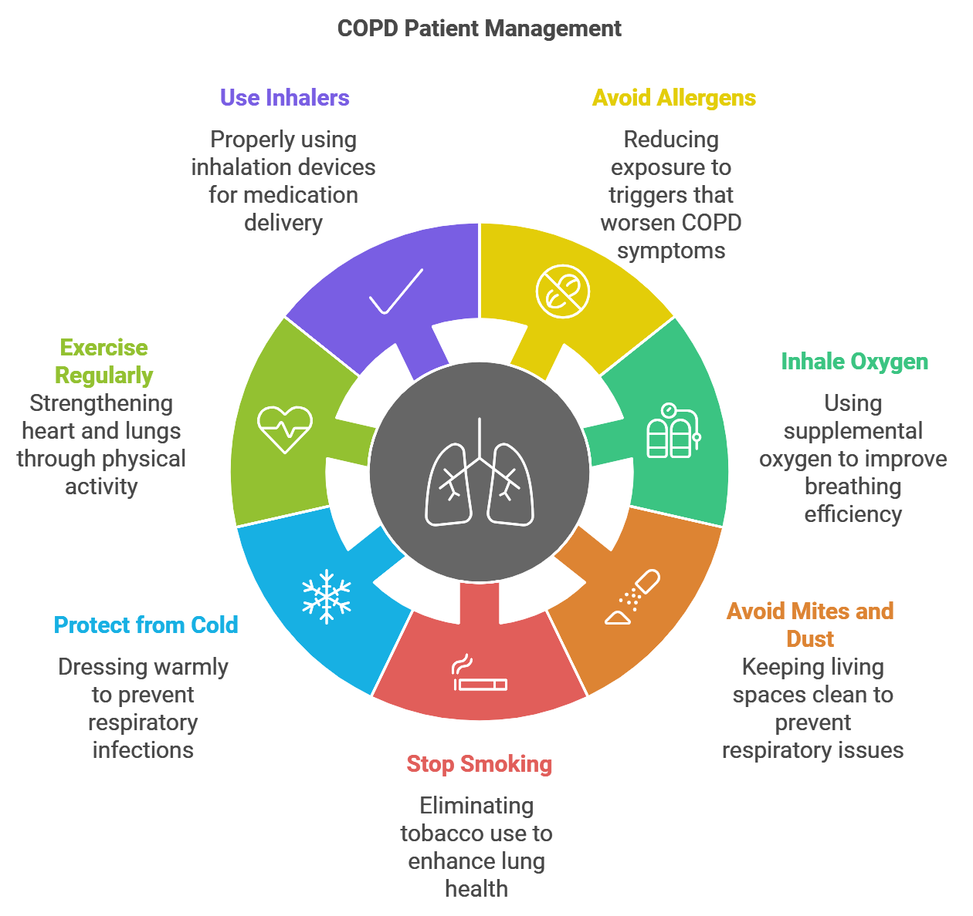

Slide 22
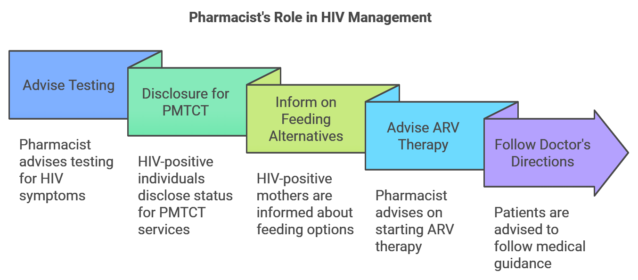

Slide 23
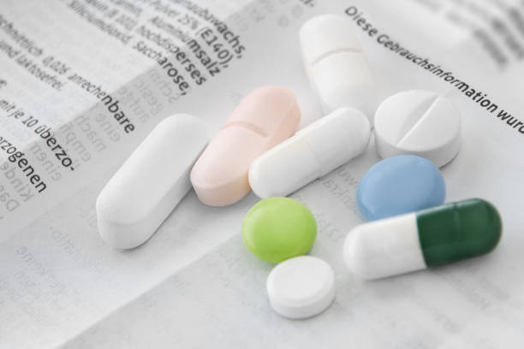
Patient Package Inserts

Slide 24
Patient Package Insert (PPI) or medication guide is a document provide along with a prescription medication to provide additional information about that drug.
It’s a document approved by administrative licensing authority, which is provided with package of a drug.
A package insert, primarily directed at the prescribers, is intended to provide information for the safe and effective use of the respective drug. It is also known as Prescription drug label, Prescribing information.

Slide 25
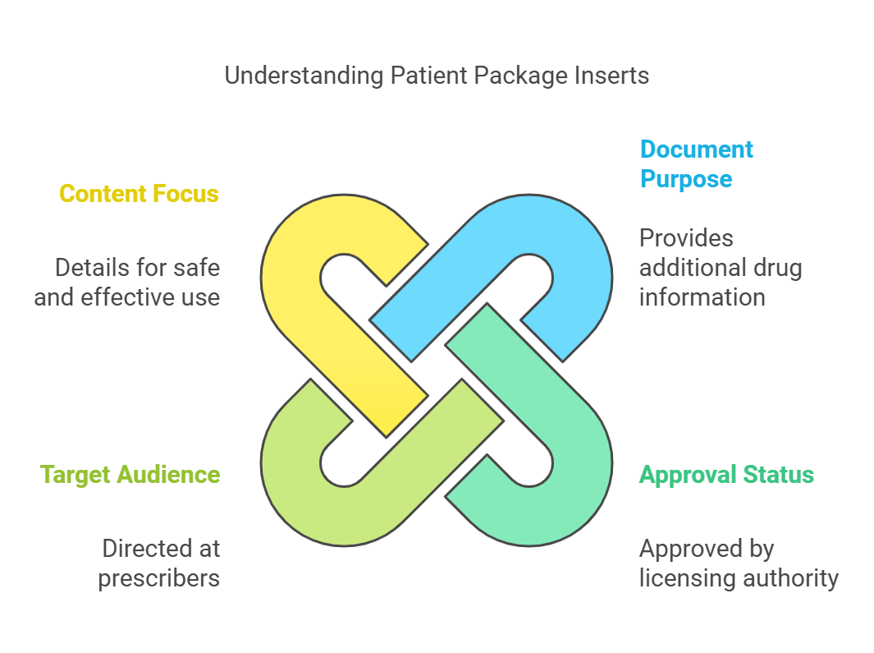

Slide 26
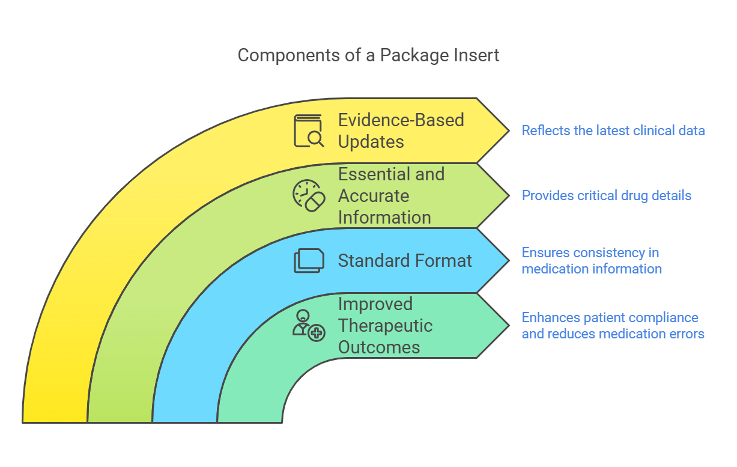
Importance of PPI:

Slide 27
Scenario of PPI use in India:
In India, the concept of PI is governed by the Drugs and Cosmetics Act (1940) and Rules (1945)
The section 6 of schedule D (II) of the rules lists the headings according to which information should be provided in the package inserts.

Slide 28
The section 6.2 mandates that the package insert must be in “English” and provides information on:
Therapeutic Indication
Posology (Dose calculation for children)
Methods of Administration
Contraindication
Special Warnings & Precautions
Drug Interactions
Contraindications in pregnancy and lactation
Undesirable effects
Antidote for overdosing

Slide 29
The section 6.3 mandates pharmaceutical information on:
List of excipients
Incompatibilities
Shelf life as packaged after dilution or reconstitution, or after first opening the container.
Special precautions for storage
Nature & specification of container
Instruction for use/handling

Slide 30
In India, the regulatory authority is Ministry of Health and Family Welfare, Government of India.
The pharmaceutical companies submit the full prescribing information as a part of the new drug application for marketing.
This information should be according to the section 6.2 and 6.3 of Schedule D, 1940 Act.
Once the application is approved by the regulatory authorities, the information is accompanied with the drug in the package. regulatory authority

Slide 31
According to US FDA, the first thing listed is usually the brand name and generic name of the product. Other sections are:
Clinical Pharmacology (Describes how the medicine works in the body)
How it is absorbed and eliminated
What its effects are likely to be at various concentrations
May also contain results of various clinical trials or studies
Explanation of the medication’s effect on various populations (Children, Women)

Slide 32
Indications & usage: Uses indications for which the drug has been FDA approved (e.g. migraines, seizures, high blood pressure)
Contraindications: Lists situations in which the medication should not be used, for example, in patients having other medical conditions such as kidney problems or allergies
Warnings: Covers possible serious side effects that may occur
Precautions: Explains how to use the medication safely including physical impairments and drug interactions, such as; “do not drink alcohol while taking this medication” or “Do not take the medication with any MAIO inhibitors”

Slide 33
Adverse Reactions: Lists all side effects observed in all studies of the drug (as opposed to just the dangerous side effects which are separately listed in “Warnings” section)
Overdosage: Provides the results of an overdose and provides recommended action in such cases.
Dosage & Administrations: Provides recommended dosage may list more than one for different conditions or different patients (e.g. lower dosages for children)
How supplied: Explains in detail the physical characteristics of the medication including colour, shape, markings, and storage information.

Slide 34
Patient Information Leaflets

Slide 35
Patient Information Leaflets (PILs) are leaflets containing specific information regarding medical conditions, doses, side effects that packed with medicine to give the user information regarding the product.
PIL is the European version of the package insert.
The PIL is written by the manufacturing pharmaceutical company.
All licensed medicines need to carry such a leaflet. But to minimize the cost, manufacturers avoid inserting a PIL.

Slide 36
Contents of the PILs:
The purpose of PILs is to inform patients regarding the administration, precautions and potential side effects of their prescribed medication.
Identification of the medication: The name, the active substances, the pharmaceutical form, strength of the product should be stated.

Slide 37
2. Therapeutic Indications: The conditions for which the medicine is authorized must be listed.
3. Information Necessary before taking the medicine: Situations where the medicine should not be used, any precautions, warnings, interactions with other medicines or foods, information for special groups of patients (Pregnant or nursing mothers), and any effects the medicine may have on the patient’s ability to drive.

Slide 38
4. Dosage:
How to take or use the medicine including both the route and method of administration.
How often it should be given
How long the course of treatment will be last.
What to do, if a dose is missed and if relevant what to do in an event of overdose and the risk of withdrawal effects.

Slide 39
5. Description of Side effects:
All the effects which may occur under normal use of the medicine and what action the patient should take if any of these occur.
These should be listed by seriousness and then by frequency.

Slide 40
6. Additional Informations:
This covers information on excipient details.
A description of product
Registered pack sizes
Storage conditions
Name & address of the manufacturer

Slide 41
Uses of PILs:
PILs improve patient’s knowledge regarding how to take their medicines correctly, to get better health.
PIL improves the patient’s awareness of potential side effects
These are designed to educate patients and help them to be more active in decision making regarding their treatment.

Slide 42
PIL give information about maintaining good health, along with screening programs.
Mostly, patients who receive leaflets are more satisfied than those who do not.

Slide 43


