Slide 1

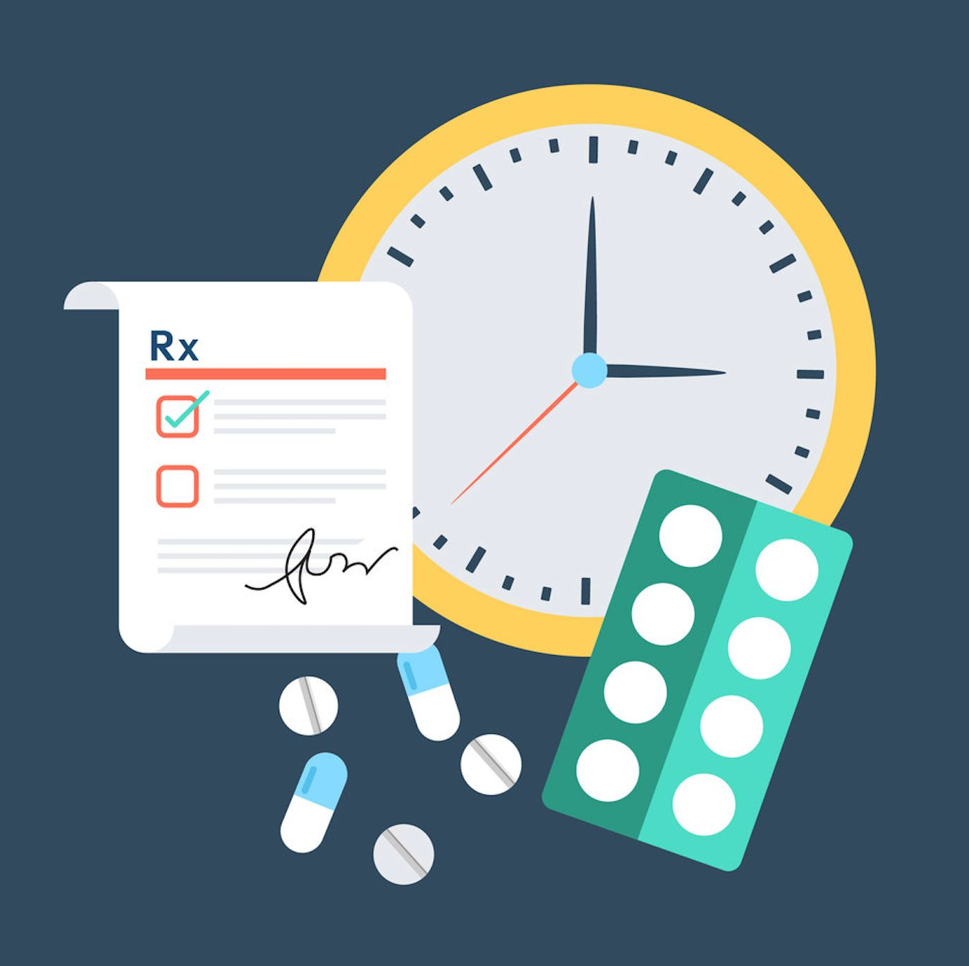
MEDICATION ADHERANCE
Presented By:
Miss Diptimayee Jena
Assistant Professor
SoPLS, CUTM, Bhubaneswar

Slide 2
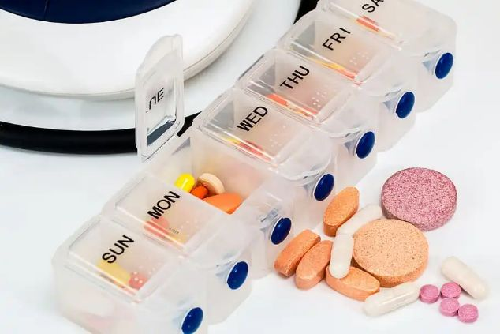
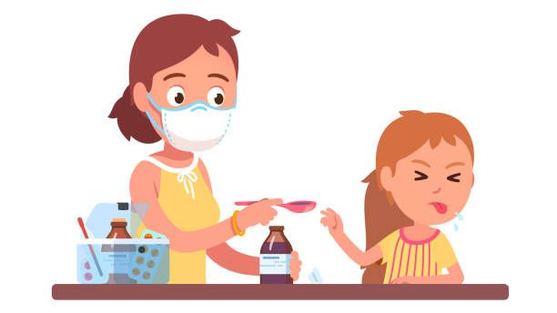
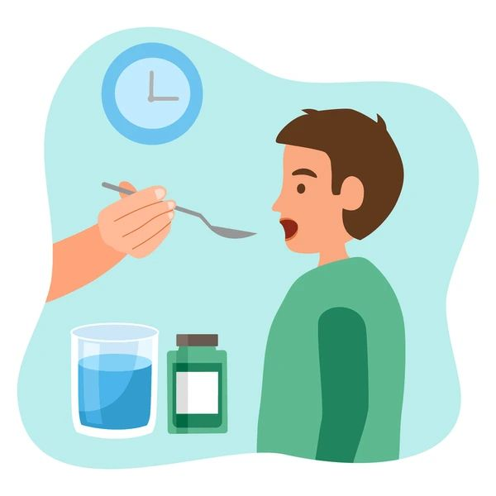

The extent to which a person's behaviour corresponds with taking a medicine
Defined as
Medication Adherence

Slide 3
Medication adherence can be defined as the extent to which a person's behaviour corresponds with taking a medicine optimally.
Medication adherence is defined by the World Health Organization as “the degree to which the person’s behaviour corresponds with the agreed recommendations from a health care provider”

Slide 4
Enhances Patient Safety
Decrease Health Care Costs
Benefits
Good Investment for tackling chronic conditions
Improves Long term Therapies & outcomes

Slide 5


Extent to which

Slide 6
Compliance:
Compliance (Disfavour) is the extent to which a patient’s behaviour matches the prescriber’s advice.
Compliance implies patient obedience to the physician’s authority, whereas adherence signifies that the patient and physician collaborate to improve the patient’s health by integrating the physician’s medical opinion and the patient’s lifestyle, values and preferences for care.
Adherence, on other hand, requires the person’s agreement to the recommendations for therapy

Slide 7
Related to,
Knowledge & beliefs about illness
Motivation to get better.
Confidence in ability to help oneself get better.
Adherence
Compliance

Slide 8
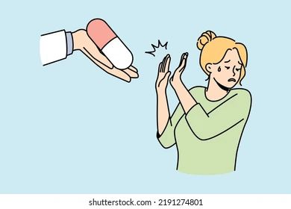
Non-Adherence referred as, when patients don't take their medications as prescribed manner.

Slide 9
Fail to maintain the doses as prescribed.
Using devices improperly like inhalers.
Skipping doses.
Taking expired medication.
Medication Non Adherence includes
Stopping the medication too soon.
Taking medication with foods, drinks or other medications, it should not be used with.
Taking the doses at wrong time.
Storing medication in a wrong place.

Slide 10

To Taking Medication
Unseen the benefits of medication
Side Effects
Busy Schedule/Life Style

Slide 11
Dimensions of Non-adherence:
Patient Related Factors
Socio Economic factors
Health System Factors
Medication Non-Adherence
Condition related Factors
Therapy related Factors

Slide 12
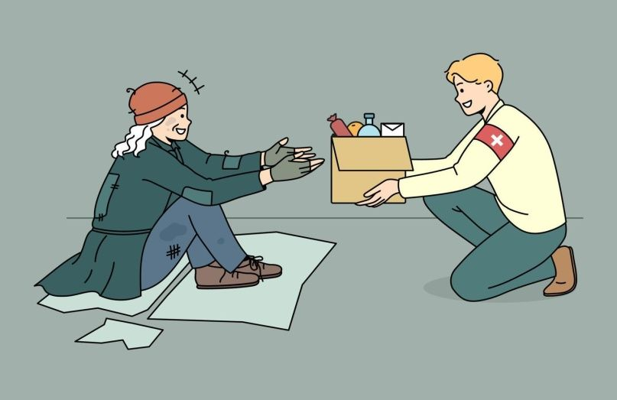


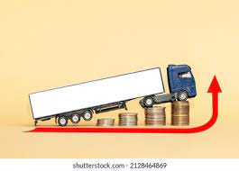

Socio Economic Factors:
Poverty

Slide 13



Condition Related Factors:
Available Effective Treatment
Emphasis on Adherence
Progression/Severity of the disease

Slide 14
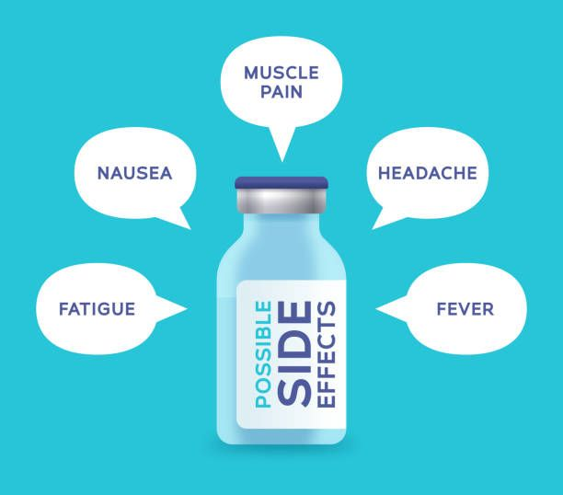



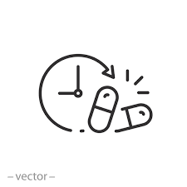
Therapy Related Factors:
Available Medical Support
Complex Medical Regimen
Previous Treatment Failure
Duration of Medication

Slide 15


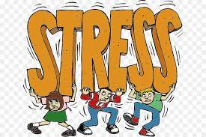

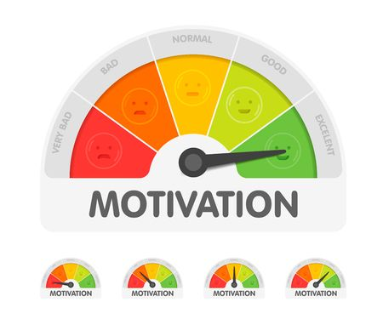
Patient Related Factors:
Forget Fullness
Low Attendance Follow-ups
Low Motivation

Slide 16



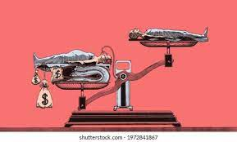
Health System Factors:
Inadequate Training for Health Care Providers
Short Consultations
Overworked Health care Providers
Interventions for improving it
Poor Health Services

Slide 17


Slide 18
Strategies to improve Medication Adherence:
Simplify the regimen
Impart Knowledge
Modify Patient beliefs & behavior
Provide communication & trust Leave the bias
Evaluate adherence

Slide 19

Simplify the Regimen:

Slide 20
Encourage use of adherence aids
Investigate customized packaging for patients.
Adjust timing, frequency, amount & dosage.
Match regimen to patient’s activities of daily living
Consider changing the situation vs. changing the patient.
Avoid prescribing medications with special requirements.

Slide 21

Impart Knowledge

Slide 22
Advice regarding cost effectiveness.
Focus on patient decision making
Involve patient’s family or care giver if appropriate.
Keep the team informed (Physician, Nurses, Pharmacist).
Provide all the prescription instructions clearly in writing and verbally.
Reinforce all discussions often, especially for low-literacy patients

Slide 23

Modify Patient beliefs & Behaviour

Slide 24
Address fears and concerns.
Provide reward for adherence
Empower patients to self-manage their condition.
Discuss with patients regarding the consequences of not taking their medications.
Council patients regarding the benefits of taking the medications.

Slide 25

Provide communication & Trust

Slide 26
Use plain language
Practice active listening
Provide emotional support
Improve Interviewing skills

Slide 27

Leave the Bias:

Slide 28
Develop patient centric communication style
Acknowledge biases in medical decision making.
Understand health literacy and how it effects outcomes.

Slide 29
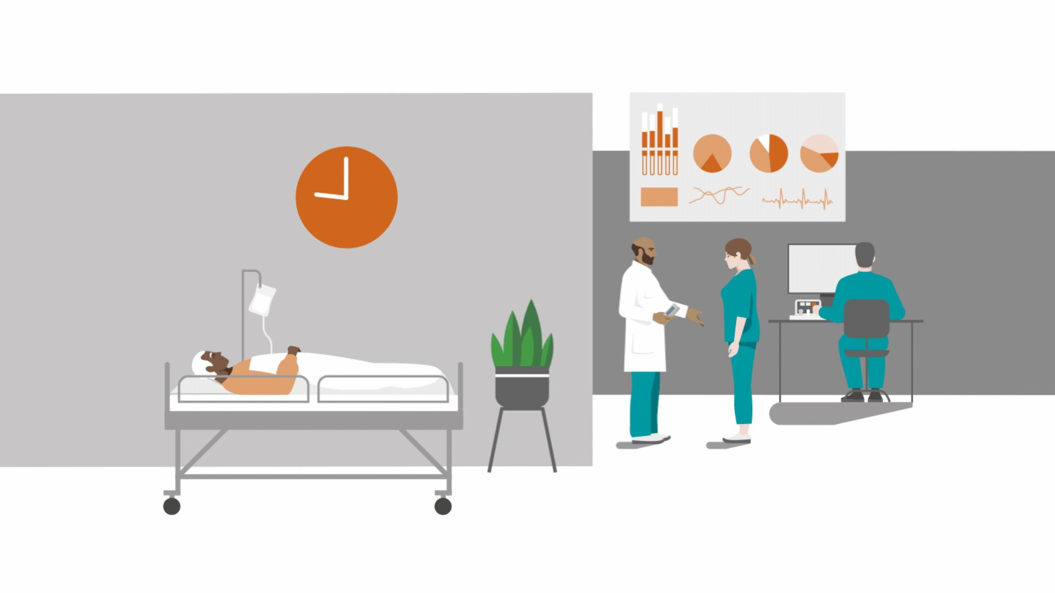
Evaluating adherence

Slide 30
Self-Report
Ask about adherence behaviour at each visit
Periodically review patient’s medication containers.
Use biochemical tests: Measure serum or urine levels as needed.
Use medication adherence scales:
Morisky-8 (MMAS 8)
Medication Possession Ratio

Slide 31
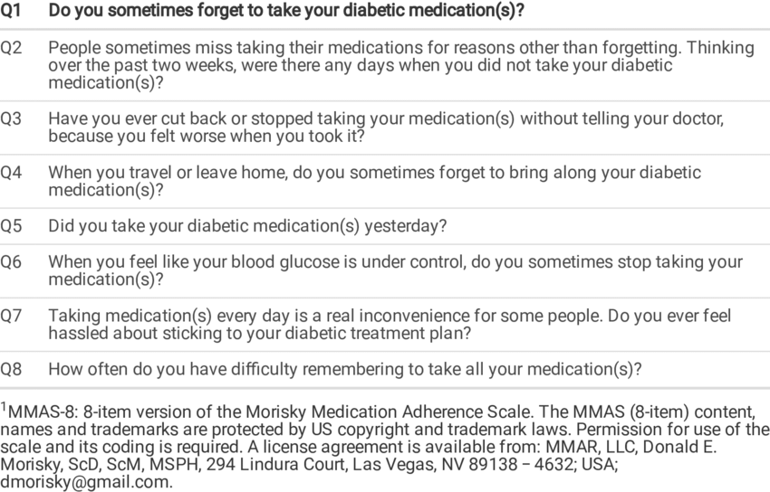
Morisky’s Medication Adherence Scales for Diabetic Patients:

Slide 32
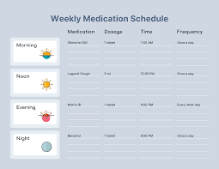
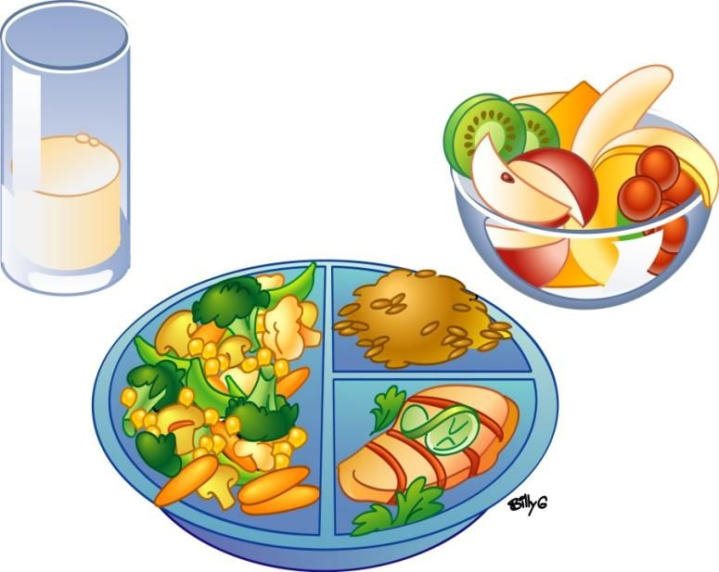


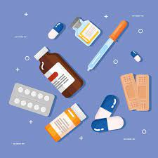

What Patients can do to improve your adherence:
Put them in a place that’s easy to remember
Healthy Diet
Make a Schedule
Current list of Medications
Shower
Brush your teeth
Set Alarm

Slide 33

Choose One Pharmacy in stead of Multiple Pharmacies

Slide 34
Things you should know about your medications:
Name of the medication and why it is being used.
How long the medication is to be taken
Remember the frequency of administration
Avoidance of any food or diet during the medication.
Look for the side effects and What to do if they happen…..
Where to store the medication

Slide 35
Role of Pharmacist:
Inform the patient regarding the medication. Such as,
What is the use of the medication?
What are the expected outcomes after administration of the drug? Such as,
When will it start to work?
Will you notice any changes?
Side Effects to watch out for
Answer any of the doubts regarding the medication

Slide 36
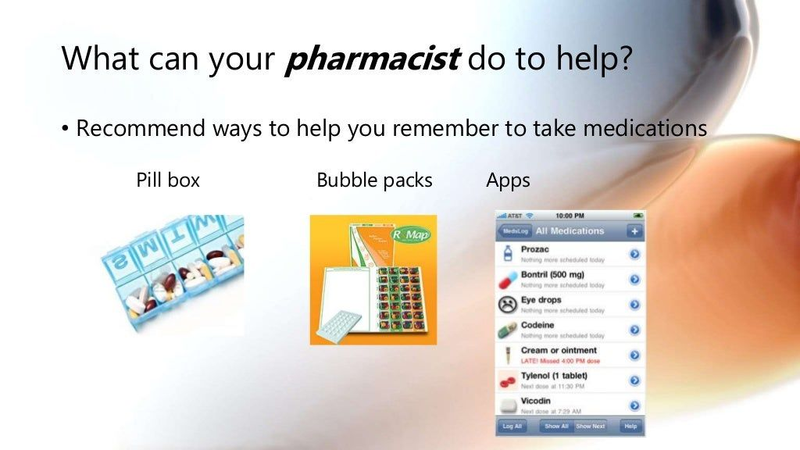
Recommended ways for the Pharmacist:

Slide 37
A Pharmacist can,
Fit medications into your schedule:
Come up with a schedule, using your daily routines
Consider a medication that may work for a longer period of time
Recommend storage options for medications when travelling.

Slide 38
Cost:
Cost savings/discount programmes
Look for a similar medication that may cost less

Slide 39
Medication Therapy Management (MTM):
Appointment with the Pharmacist
Bring all medications and Over the counter products (Vitamins/herbals)
Pharmacist reviews all of your medications,
Interactions
Side effects
Cost savings
Adherence and compliance
Increase your knowledge of your medications
Answer questions

Slide 40


