Slide 1

Presented BY:
Miss Diptimayee Jena
Assistant Professor
Dispensing Process

Slide 2

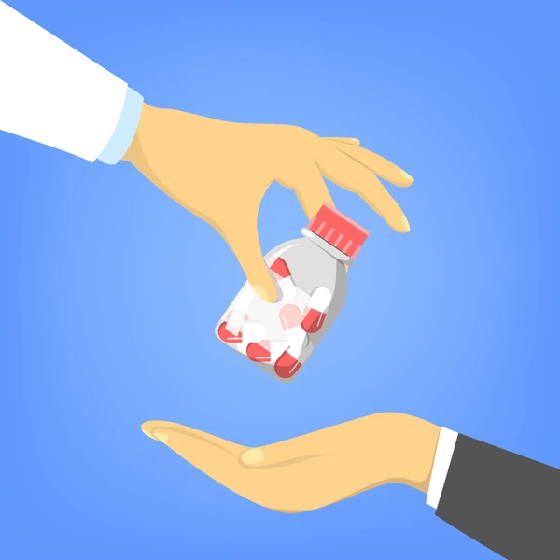

Dispensing
Process
&
Preparing
Providing
to
Prescribed Medications
Patient

Slide 3



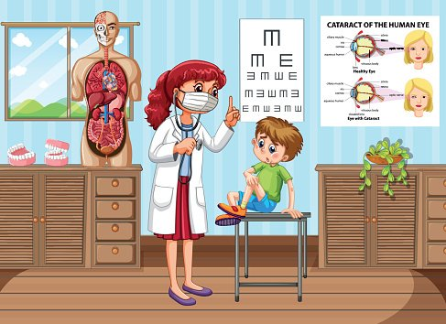
It can occur in various healthcare systems such as;

Slide 4
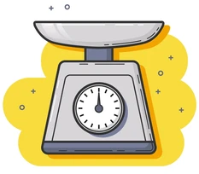
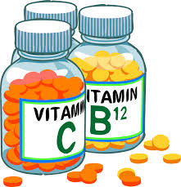
It involves;
Accurately Weighing & Packaging the Prescribed medications
According to the Healthcare provider’s instructions & the specific dosage requirement
Patient

Slide 5
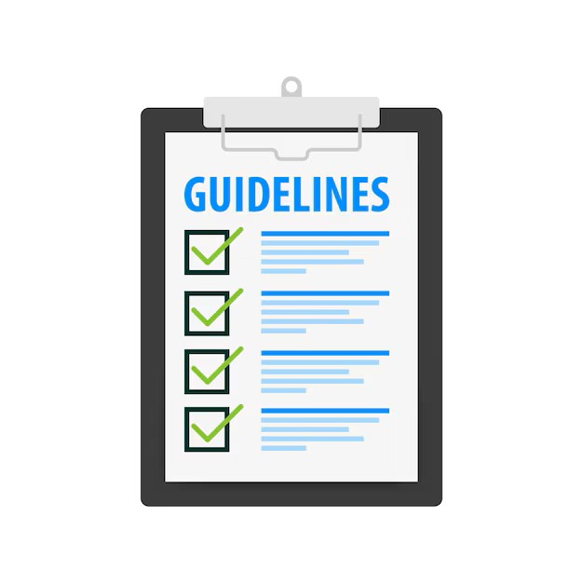
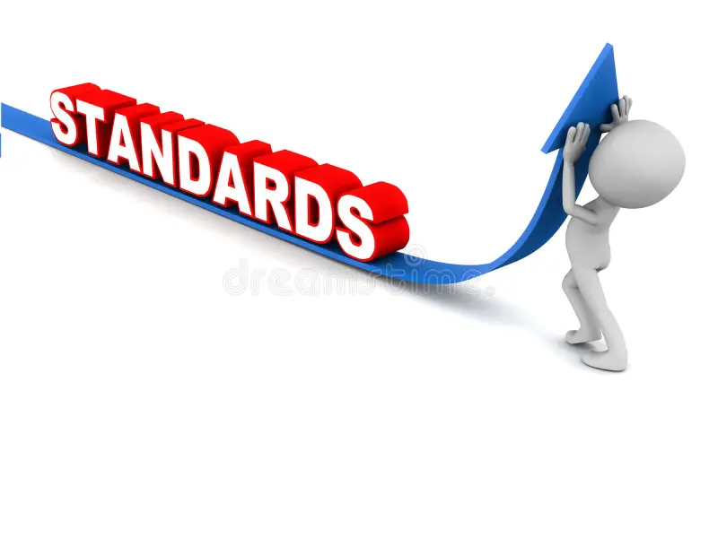

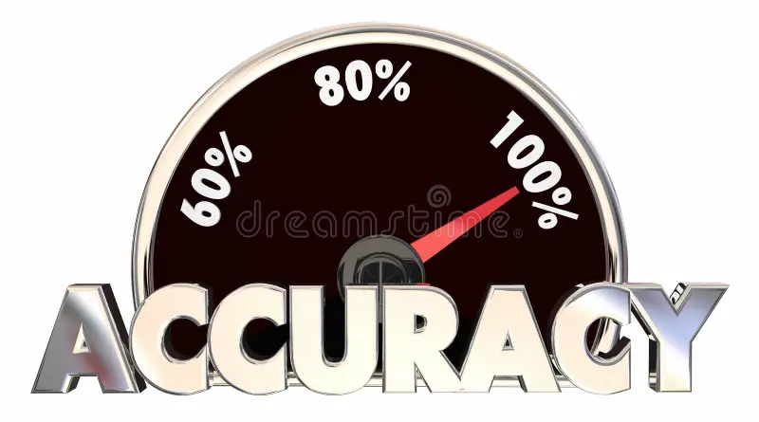

GDP
Refers to
Set of guidelines & Standards designed to ensure,

Slide 6



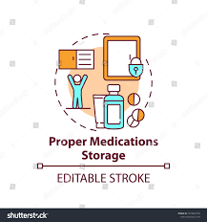
Key elements of GDP are;
Accurate Prescription Handling
Patient Counselling

Slide 7

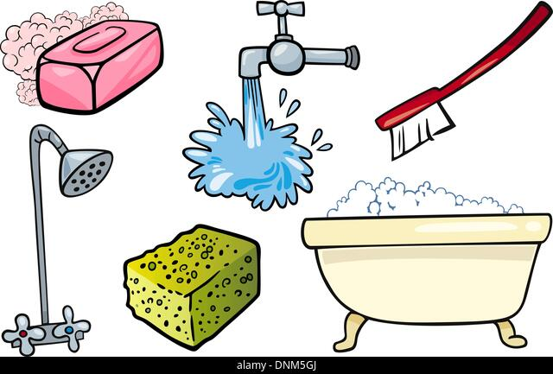
Cont.…..
Safe Handling of Controlled Substances
Hygiene & Cleanliness

Slide 8
Various Activities involved in Dispensing are;
Receiving & Confirming order
Checking Prescription & Interpretation
Verifying & Consulting, if required
Removing medicines for issue and assembling
Billing & Counter checking
Issuing medicines to the client with clear instructions and counselling

Slide 9
Dispensing Modules are;
Prescription Counter
Waiting Area
Requirement of a good dispensing environment
Barriers, Noise and distractions that can affect dispensing.

Slide 10

Dispensing Area:
Prescription Counter

Slide 11
Accessible to the patient
Preferably be separate and in a quite location
Ideally, Prescription counter should be
Feedback Mechanism
Be clean, orderly attractive, and with an identifying sign or symbol

Slide 12

Waiting Area

Slide 13



Posters or Public related Pamphlets
Healthcare related Magazine

Slide 14




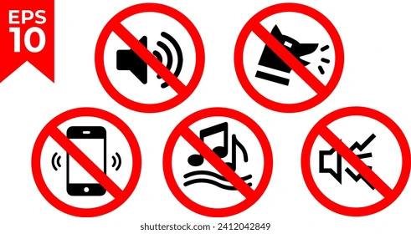
Requirement of A Good Dispensing Environment:
Be clean and organized space
Proper Lighting
Temperature & Humidity controlled
No loud music playing, talking or television
Barcode scanning & Verification
Medication stock rotation
Placement of medicines in an organized way

Slide 15
Significance of GDP:
Patient Safety:
The primary reason for adhering to GDP is to ensure patient safety.
Accurate dispensing reduces the risk of medication errors, which can lead to harmful consequences for patients, including adverse reactions, ineffective treatment, or even life-threatening situations.
Preventing Medication Errors:
It helps in minimizing the occurrence of medication errors caused by factors such as, illegible prescriptions, incorrect dosing, drug interactions, or misunderstanding patient instructions.

Slide 16
Effective Treatment:
For desired or effective outcomes, Properly dispensed medications are required.
Incorrect dosages, substitutions or interactions can comprise the efficacy of treatment, affecting patient recovery and well-being.
Professional Reputation:
Healthcare institutions and professionals are judged based on their commitment to patient safety and quality of care.
Minimizing Adverse Events:
Accurate dispensing minimizes the occurrence of adverse drug reactions, allergic responses, and other unexpected effects that can arise from incorrect medications or dosages.

Slide 17
Healthcare costs:
Medication errors and related adverse events can lead to increased healthcare costs due to hospitalizations, additional treatments, and prolonged patient care.
Patient Adherence:
Clear instructions and patient counselling during the dispensing process improve patients’ understanding of their medications, leading to better adherence to prescribed regimen.
Ethical Responsibility:
Healthcare professionals have an ethical duty to provide safe and effective care to patients. Good dispensing practices reflect their commitment to patient well being.

Slide 18


