Slide 1






PILOT PLANT SCALE- UP TECHNIQUE
Gnyana Ranjan Parida
Assistant Professor
SPLS, CUTM

Slide 2


I am the pilot

Slide 3
Fundamental Definitions
Plant:- It is a place where the 5 M’s like money, material, man, method and machine are brought together for the manufacturing of the products.
Pilot Plant:- Pilot means “ experimental” or “test” that guides the destination. It is the part of the pharmaceutical industry where a lab scale formula is transformed in to a viable product by development of liable and practical procedures of manufacturing .
Scale-up:- The art for designing of prototype using the data obtained from the pilot plant model. It is a process of increasing the batch size. Scale up is a general term used for the “transfer of knowledge” and “transfer of technology”. (Application of same procedures for achieving different volumes of output).
Model: A geometrical similar replica of complete prototype on a small scale with equal scale ratios in all direction is termed as a model. Its function is to exhibit the effects of change in shape or operating conditions of a existing plant.
Prototype: A large scale apparatus or full size plant is called prototype.
Pilot Program:- The scale up operation conducted after developing a product( or a process) in the laboratory and prior to its acceptance for full scale commercial manufacturing.
3

Slide 4



Pilot Scale and Scale-Up
R & D
Pilot Scale
Large Scale Production
Scale-Up
4

Slide 5
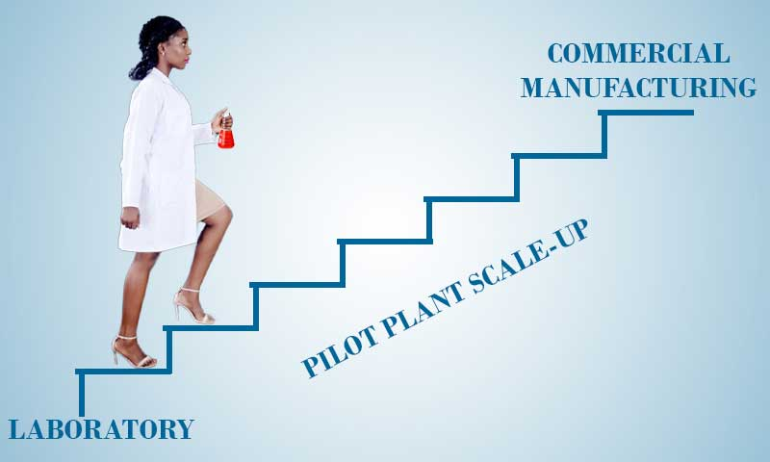

Slide 6




What Do Pilot Scale and Scale-Up Mean ?
PILOT SCALE SCALE-UP
INTERMEDIATE
BATCH SCALE
NEXT TO
PILOT SCALE
MANUFACTURES DRUG PRODUCT BY A PROCEDURE
FULLY REPRESRNTATIVE OF AND SIMULATORY TO THAT OF MANUFACTURING SCALE
PROCESS OF INCREASING THE BATCH SIZE (MIXING) / PROCEDURE FOR APPLYING THE SAME PROCESS TO
DIFFERENT OUTPUT VOLUMES (TABLETTING)
6

Slide 7
Why one should conduct pilot plant studies?
A pilot plant allows investigation of a product and process on an intermediate scale before large amounts of money are committed to full-scale production.
It is usually not possible to predict the effects of a many-fold increase in
scale.
It is not possible to design a large scale processing plant from laboratory data
alone with any degree of success.
7

Slide 8
Objective of Pilot Plant
“ Find mistakes on small scale and make profit on large scale”
To produce physically and chemically stable therapeutic dosage forms.
Review of the processing equipment
Guidelines for the productions and process control.
Evaluation and validation for process and equipments.
To identify the critical features of the process.
To provide master manufacturing formula
To try the process on a model of proposed plant before committing large sum of money on a product unit.
Examination of the formula to determine its ability to withstand Batch- scale and process modification.
To avoid the scale-up problem.

Slide 9
Importance of Pilot Plant Studies
Examination of formulae.
Review of range of relevant processing equipments.
Production rate adjustment.
Idea about physical space required.
Appropriate records and reports to support GMP.
Identification of critical features to maintain quality.

Slide 10
Uses / Functions of Pilot Plant
Evaluating the results of laboratory studies and making product and process corrections and improvements.
Producing small quantities for sensory , microbial evaluations, chemical , limited market testing or furnishing samples to potential customers, shelf-life and storage stability studies.
Determining possible salable by-products or waste stream requiring treatment before discharge.
To ensure the lab scale formulation proves to be efficient, economical and consistently reproducible ( technology evaluation) , scale up is attempted to the production( technology transfer ).
To evaluate the changes in drug-excipients due to alternative supplies.
To recommend for the purchase of new piece of equipments required for large scale manufacture or optimum utilization of existing equipments.
To validate the dosage forms of new drugs and drugs in the market.

Slide 11
Advantages of Pilot Plant
Pilot plant scale is convenient. In fact, products can be produced in a short time.
Cost of the manufacture becomes low.
Pilot plant scale up becomes economical and consumes less production time.
Maintenance of equipments becomes low and the life of equipments is extended.
Pilot plant validation simplifies the production scale validation, because it sets product specifications , in-process controls and process variable control-limits.
Reworking and revalidation at pilot plant will prove to be valuable during production operations.
Disadvantages of Pilot Plant
Pilot plant does not guarantee a smooth transition.
A well defined process at laboratory scale may fail in pilot scale or full production scale.
The unit operation conducted on an equipment of specific size on hand may not reflect the same in the final equipment.
Initially working on high potency drugs need to be avoided , because high costs involved and the materials are usually discarded after testing even at pilot plant level.

Slide 12
SCALE OF BATCHES –PRODUCT DEVELOPMENT
The batch size increases continuously from drug product development to the production level.
In case of generic product application( ANDA), the batch size is small.
After the product is approved , the batch size increases , in order to meet the demand of market.
3 types of batches
# Laboratory batch
#Pilot batch
#Production batch

Slide 13
Laboratory Batch
Laboratory batch is a (1 x) process intended to develop a suitable formulation, based on certain design criteria and specification.
These are attempted at the early stage of development.
Products including packaging aspects are evaluated and supplied for preclinical studies.
The size of (1 x ) laboratory batch usually as follows for dosage forms
Solid, semisolid dosage forms: 3-10kg
Tablets or capsules:3000-10,000 units
Liquid dosage forms: 3-10 liters
Stability study criteria: kept at 45 degree temp for 1month or 40-48 degree Celsius for 3month at 80% RH
The physical and chemical stability of the product are assured.
Laboratory batches are performed in the product development laboratory under the supervision of formulation development pharmacist.
The formulation is now set for the next step , pilot plant.

Slide 14
B. Pilot Batch
Pilot batch is a (10 x) scale up process for assuring stable product, meant for documentation, evaluation of clinical testing including bioequivalence studies .
The 10 x batch represents the first replication of the designated formula.
The size of the pilot batch is
Solid, semisolid dosage forms: 3-10kg
Tablets or capsules:3000-10,000 units
Liquid dosage forms: 3-10 liters
During this stage, the production facilities must be CGMP approved.
The batches are prepared in pilot level equipment.
The equipment must be cost effective, easy to clean and capable of producing high yield of products which consistently meet the established specifications.
These are also known as exhibit batches in order to prepare relevant documents for submitting to the FDA.
Process demonstration or process capability studies are usually started at this stage.

Slide 15
The capability studies consists of process characterization, process ranging and process optimization. This is a prerequisite for validation.
The no. and actual size of the pilot batches may vary in response to one or more of the following factors :
Equipments availability
Availability of API
Cost of raw material

Slide 16
. Production Batch
Production batch is to scale the production and process by another magnitude (100 x ), meant for marketing the products.
The size of 100 x batch is usually as follows.
Solid, semisolid dosage forms: 3-10kg
Tablets or capsules:3000-10,000 units
Liquid dosage forms: 3-10 liters
The actual size (100 x ) may vary due to availability of equipment and raw materials.
Usually three successfully completed production batches are required for validation purpose.
Production represents the full production batch in standard production equipments.
The size can be increased to any level, depending on the in the market.
If the batch size changes significantly , additional validation studies are required.
The permission for marketing is granted based on exhibit batches, production batches, are thoroughly evaluated by the supervising authority.

Slide 17
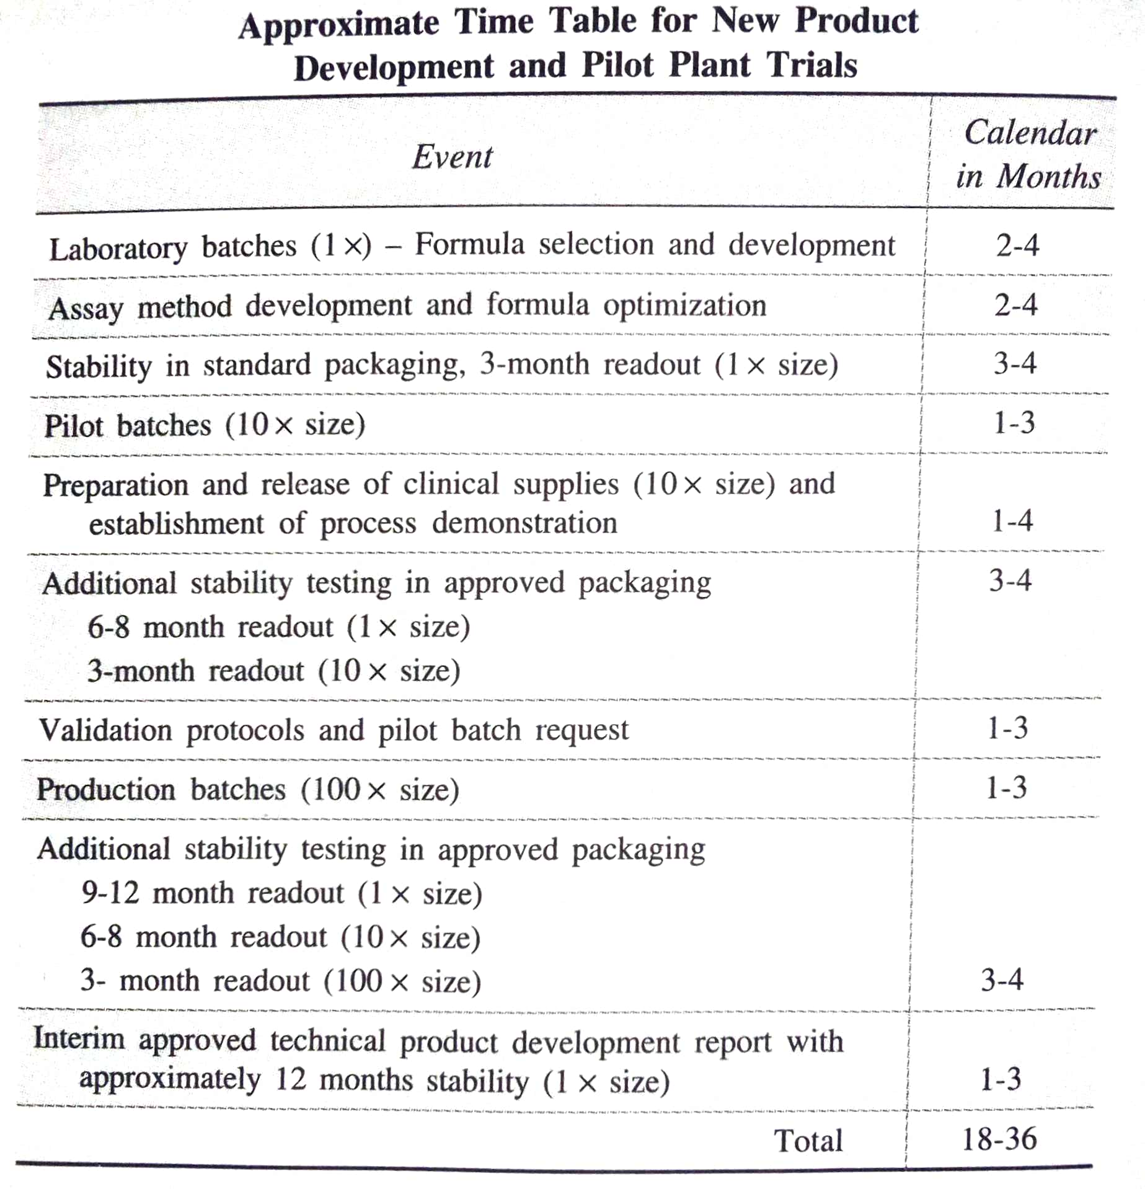

Slide 18
STEPS IN SCALE UP

Slide 19
Define product economics based on projected market size and competitive selling and provide guidance for allowable manufacturing costs
Conduct laboratory studies and scale-up planning at the same time
Define key rate-controlling steps in the proposed process
Conduct preliminary larger-than-laboratory studies with equipment to be used in rate-controlling step to aid in plant design

Slide 20
Design and construct a pilot plant including provisions for process and environmental controls, cleaning and sanitizing systems, packaging and waste handling systems, and meeting regulatory agency requirements
Evaluate pilot plant results (product and process) including process Economics to make any corrections and a decision on whether or not to proceed with a full scale plant development

Slide 21









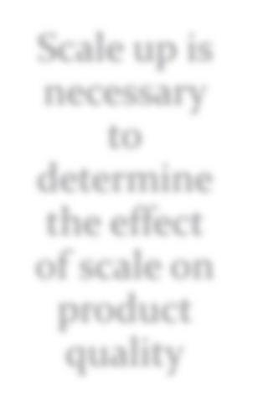
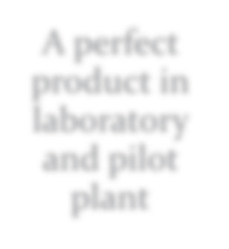
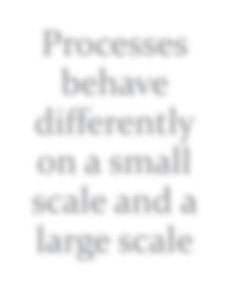

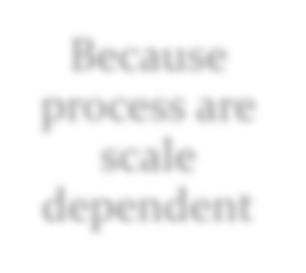

Why Scale-Up needed……
Scale up is necessary to determine the effect of scale on product quality
A perfect product in laboratory and pilot plant
Processes behave differently on a small scale and a large scale
A well defined process
Because process are scale dependent
But May fail in QA Tests

Slide 22










OBJECTIVES OF SCALE UP….
To produce physically and chemically stable products
Review of the processing equipment Guidelines for production and process control Evaluation and Validation
To identify the critical features of the process
To provide master manufacturing formula

Slide 23
Advantages of Scale Up
Members of the production and quality control division can readily observe scale up runs.
Supplies of excipients and drugs , cleared by the QC division , can be drawn from the more spacious area to the production division.
Access to engineering department personnel is provided for installation , maintenance and repair.
Disadvantages of Scale up
The frequency of direct interaction of the formulator with the production personnel in the manufacturing area will be reduced which may arise communication gap.
Any problem in manufacturing will be directed towards its own pilot plant personnel’s.

Slide 24
Requirements/ considerations for pilot plant and Scale-Up….
Reporting Responsibility
Personnel Requirements
Space Requirements
Administration and Information Process Physical Testing Area
Standard Pilot-plant Equipment Floor Space
Storage Area
Review of Formula
Raw materials
Equipment
Production rates
Process Evaluation
Preparation of Master Manufacturing Procedures
Product Stability and Uniformity
GMP Considerations

Slide 25
General considerations
1. Reporting Responsibility
The formulator who developed the
R & with staffing
D group
separate
product can take into the production
and can provide support even after
been
transition into production has completed

Slide 26
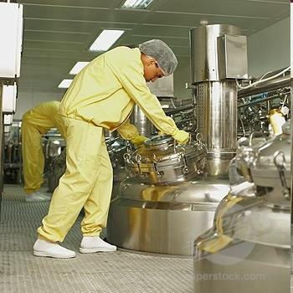
General considerations (contd.)
2. Personnel Requirement
Scientists with experience in pilot plant operations as well as
in actual production area are the most preferable.
As they have to understand the intent of the formulator as well as understand the perspective of the production personnel.
The group
should have some with engineering
personnel
knowledge as well as scale up also
involves engineering principles along with knowledge of computers and electronics.

Slide 27
General considerations (contd.)
3. Space Requirements
Administration and information processing
Standard equipment floor space
Storage area
Physical testing area

Slide 28

General considerations (contd.)
3.1. Administration and information process:
Adequate office and desk space should be provided for both scientist and technicians.
The space should be adjacent to the working area.
Adequate space for computer works should be available.

Slide 29
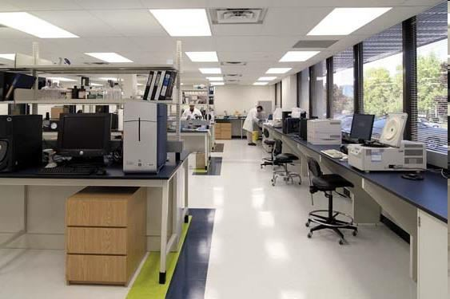
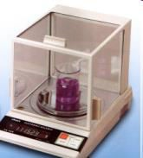
General considerations (contd.)
3.2. Physical testing area:
There should be adequate working area where the analysis and physical testing of samples can be performed (in-process control analysis) which helps in early identification of production error.
This area should provide permanent bench top space for routinely used physical- testing equipment like balances, pH meter, viscometer etc.

Slide 30
General considerations (contd.)
3.3. Standard pilot-plant equipment floor space:
Discreet pilot plant space, where the equipment needed for manufacturing all types of dosage form is located.
Intermediate – sized and full scale production equipment is essential in evaluating the effects of scale-up of research formulations and processes.
Equipments used should be made portable where ever possible. So that after use it can be stored in the small store room.
Space for cleaning of the equipment should be also provided.

Slide 31
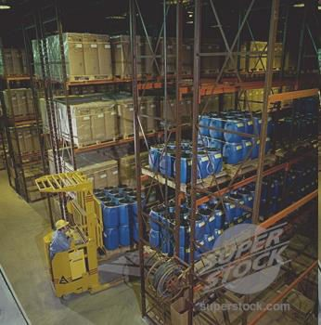
General considerations (contd.)
3.4. Storage Area
It should have two areas divided as approved and unapproved area for active ingredient as well as excipient. Different areas should provided for
the storage
of the in-process bulk products & materials
scale-up
materials, finished
from the pilot-plant from the
experimental
batches made in the production.
Storage area for the packing material should also be provided.
Controlled environment space should be allocated for storage of stability samples

Slide 32
General considerations (contd.)
4. Review of the formula:
A thorough review of the each aspect of formulation is important.
The purpose of each ingredient and it’s contribution to the final product manufactured on the small-scale laboratory equipment should be understood.
Then the effect of scale-up using equipment that may subject the product to stresses of different types and degrees can more readily be predicted, or recognized.

Slide 33
General considerations (contd.)
5. Raw materials:-
One purpose/responsibility of the pilot-plant is the
active ingredient &
approval & validation of the
excipients raw materials.
Why?
Raw materials used in the small scale production cannot necessarily be the representative for the large scale production.
However, ingredients with change in particle size, shape or morphology may result differences in bulk density, static charges, rate of solubility, flow properties, color, etc.

Slide 34
General considerations (contd.)
6. Equipment:-
The most economical and the simplest & efficient equipment which are capable of producing product within the proposed specifications are used.
The size of the equipment should be such that the experimental trials run should be relevant to the production sized batches.
If the equipment is too small the process developed will not scale up,
Whereas if equipment is too big then the wastage of the expensive active
ingredients.
Ease of cleaning , time of cleaning

Slide 35
General considerations (contd.)
7. Production Rates:-
The immediate as well as the future market trends/requirements are considered while determining the production rates.
Equipment and the process should be chosen on the basis of frequency of production of a batch and that takes following in to consideration:
Product loss in the equipment during manufacturing
The time required to clean the equipments between batches
The number of batches that need to be tested for release.

Slide 36
General considerations (contd.)
8. Process Evaluation:-
Order of mixing of components
Drying temp.
And drying time
Mixing speed
Screen size (solids)
PARAMETERS
Mixing time
Filters size
(liquids)
Rate of addition of
granulating agents, solvents,
solutions of drug etc.
Heating and cooling Rates

Slide 37

Why to carry out process evaluation????
The knowledge of the effects of various process parameters as few mentioned above form the basis for process optimization and validation.
The purpose of process validation is to confirm that the selected manufacturing procedures assure the quality of the product at various critical stages in the process and finished form.

Slide 38
9. Master Manufacturing Procedures:-
General considerations (contd.)
The three important aspects
Processing directions
Manufacturing procedure
Weight sheet

Slide 39
The weight sheet should clearly identify the chemicals required in a batch, their quantities, order of mixing etc. To prevent confusion name and identifying no. for the ingredients should be used on batch records.
The process direction should be precise and explicit which includes addition rates, mixing times, mixing speed , heating and cooling rates and temp., storing of finished product samples should be specified on batch record.
Manufacturing procedure shold be written by the actual operator.

Slide 40
10. Product stability and uniformity:-
General considerations (contd.)
The primary objective of the pilot plant is the physical as well as chemical stability of the products.
Hence each pilot batch representing the final formulation and manufacturing procedure should be studied for stability.
Stability studies should be carried out in finished packages as well.

Slide 41
11. GMP consideration
Equipment qualification
Process validation
Regularly schedule preventative maintenance
Regularly process review & revalidation
Relevant written standard operating procedures
The use of competent technically qualified personnel
Adequate provision for training of personnel
A well-defined technology transfer system
Validated cleaning procedures.
An orderly arrangement of equipment so as to ease material flow & prevent cross- contamination

