Slide 1

UNIT-III DISINFECTANT RASMITA JENA ASSISTANT PROFESSOR SoPLS, CUTM, BBSR

Slide 2
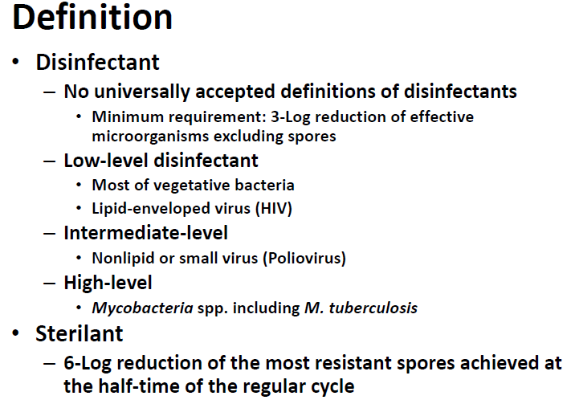
Classification and mode of action of disinfectants

Slide 3
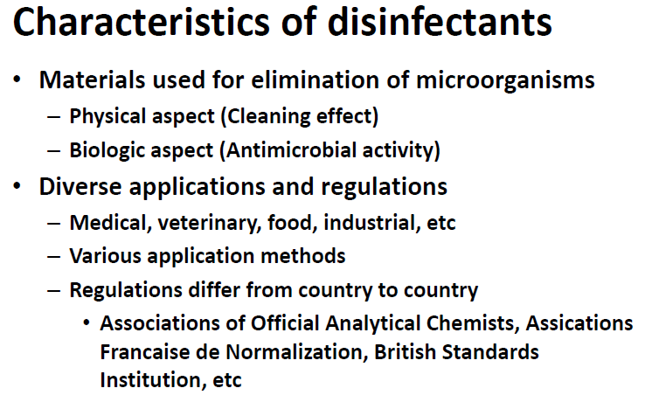

Slide 4
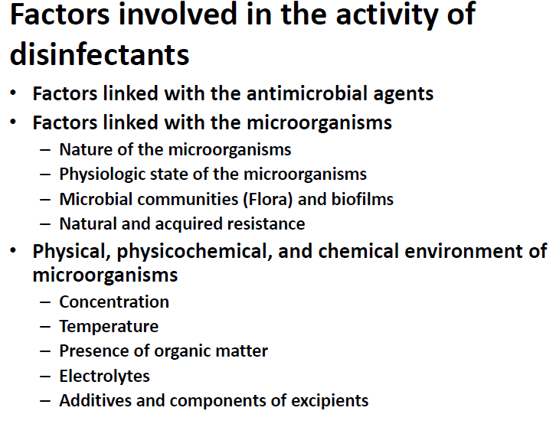

Slide 5
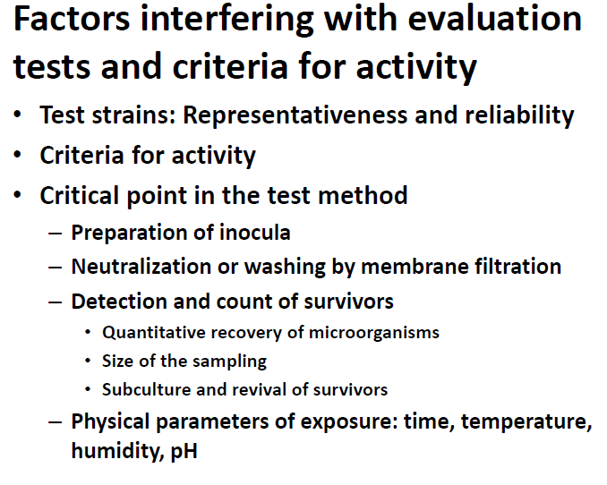

Slide 6
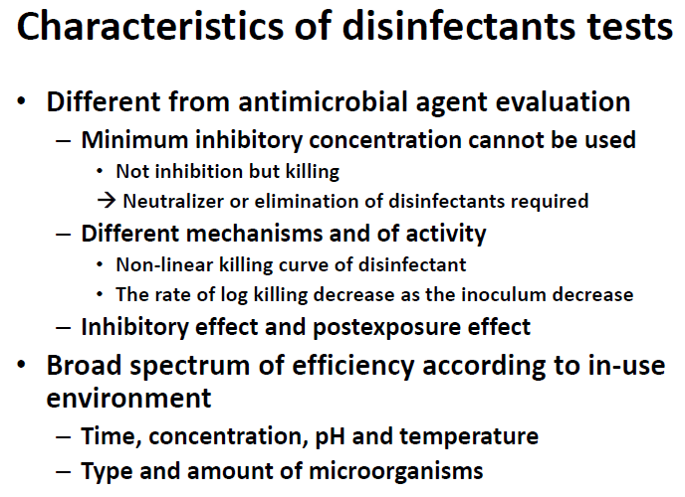

Slide 7
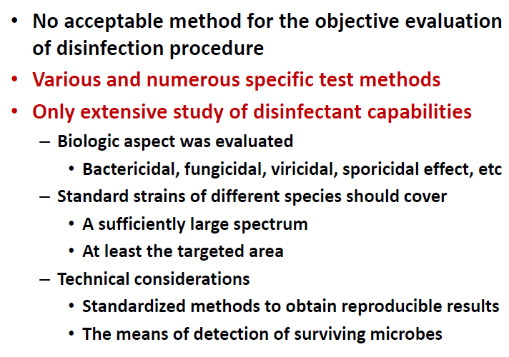

Slide 8
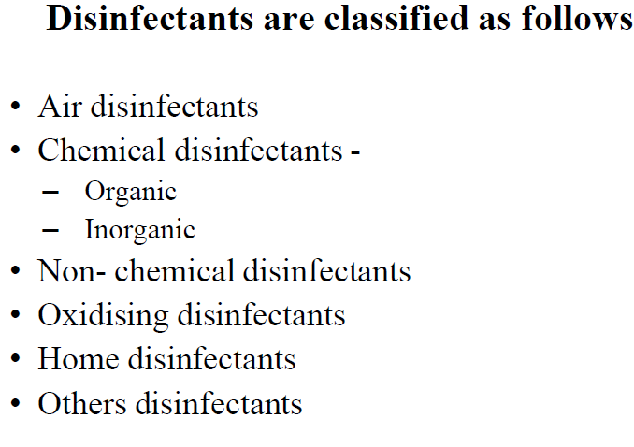

Slide 9
Air disinfectants
They are typically chemical substances capable of disinfecting microorganisms suspended in the air.
An air disinfectant must be dispersed either as an aerosol or vapour at a sufficient concentration in the air to reduce the number of viable infectious microorganisms to be significantly reduced.
Various glycols, principally propylene glycol and triethylene glycol, are ideal air disinfectants because they have both high lethality to microorganisms and low mammalian toxicity to inactive of diverse bacteria, influenza virus, and Penicillium chrysogenum (previously P. notatum) mold fungus

Slide 10
Chemical disinfectants
Organic disinfectant –
Alcohols : are most effective when combined with distilled water (concentration of 60% to 70% v/v) to facilitate diffusion through the cell membrane & have fairly rapid bactericidal action against vegetative bacteria. Ethanol 60 to 70% v/v and isopropanol 50 to 60% v/v are used as skin disinfectants while methanol vapour has been used as fungicide. Additionally, high-concentration mixtures (such as 80% ethanol + 5% isopropanol) are required to effectively inactivate lipid-enveloped viruses (such as HIV, hepatitis B, and hepatitis C. The higher alcohols ( propyl, butyl, amyl etc) are more germicidal than ethyl alcohol. Alcohols are used as preservatives in some vaccines.

Slide 11
Aldehyde : Formaldehyde (HCHO) is the main aldehyde used for disinfection, have a wide microbiocidal activity and are sporicidal and fungicidal. Formaldehyde in solution is useful for sterilization of certain instruments. Sometimes, ortho-phthalaldehyde is also used.
Phenol and its derivatives : Phenol is the chief products obtained by the distillation of the coal tar. Phenol 1% has bactericidal action. Many derivatives of phenol are more effective and less costly. Phenolics are active ingredients in some household disinfectants. They are also found in some mouth washes and in disinfectant soap and hand washes. Phenols are toxic to cats and newborn humans. o-Phenyl phenol is often used instead of phenol, since it is somewhat less corrosive

Slide 12
Inorganic disinfectants –
• Acids and bases : Sodium hydroxide, Potassium hydroxide, Calcium hydroxide, Magnesium hydroxide, Sulfurous acid, Sulfur dioxide
• Metals
• Iodine : Iodophors are prepared by mixing iodine with the solubilizing agent; Diluted iodophor is often used by brewers and wine makers to sanitize equipment and bottles; Its major advantage over other sanitizers is that when used in proper proportions, it does not require rinsing.

Slide 13
Chlorine : This group comprises aqueous solution of chlorine, hypochlorite, or hypochlorous acid. Occasionally, chlorine-releasing compounds and their salts are included in this group. Frequently, a concentration of < 1 ppm of available chlorine is sufficient to kill bacteria and viruses, spores and mycobacteria requiring higher concentrations. Chlorine has been used for applications, such as the deactivation of pathogens in drinking water, swimming pool water and wastewater, for the disinfection of household areas and for textile bleaching.

Slide 14
Non-chemical disinfectants
Ultraviolet germicidal irradiation is the use of high-intensity shortwave ultraviolet light for disinfecting smooth surfaces such as dental tools, but not porous materials that are opaque to the light such as wood or foam.
Ultraviolet light is also used for municipal water treatment. Ultraviolet light fixtures are often present in microbiology labs, and are activated only when there are no occupants in a room(e.g., at night).

Slide 15
The phrase "sunlight is the best disinfectant" was popularized in 1913 by United States. As sunlight's ultraviolet rays can act as a disinfectant, the Earth's ozone layer blocks the rays' most effective wave lengths. Therefore, ultraviolet light-emitting machines, such as those used to disinfect some hospital rooms, make for better disinfectants than sunlight.
Heat treatment can be used for disinfection and sterilization.

Slide 16
Oxidising disinfectants
Oxidizing agents act by oxidizing the cell membrane of microorganisms, which results in a loss of structure and leads to cell lysis and death. Chlorine and oxygen are strong oxidizers, so their large number of disinfectants operate in this way are as follows:
Electrolyzed water or "Anolyte" is an oxidizing, acidic hypochlorite solution made by electro lysis of sodium chloride into sodium hypochlorite ; hypochlorous acid is the predominant oxychlorine species.

Slide 17
Hydrogen peroxide is used in hospitals to disinfect surfaces and it is used in solution alone or in combination with other chemicals as a high level disinfectant.
Hydrogen peroxide is sometimes mixed with colloidal silver. It is often preferred because it causes far fewer allergic reactions than alternative disinfectants. Also used in the food packaging industry to disinfect foil containers.
A 3% solution is also used as an antiseptic.

Slide 18
Ozone is a gas used for disinfecting water, laundry, foods, air, and surfaces. It is chemically aggressive and destroys many organic compounds, resulting in rapid decolorization and deodorization in addition to disinfection. Regardless, ozone has a very wide range of applications from municipal to industrial water treatment due to its powerful reactivity.
Potassium permanganate (KMnO4) is a purplish-black crystalline powder that colours everything it touches, through a strong oxidising action. It is used to disinfect aquariums and is used in some community swimming pools as a foot disinfectant before entering the pool.

Slide 19
Home disinfectants
The most cost-effective home disinfectant is chlorine bleach (typically a >10% solution of sodium hypochlorite which is effective against most common pathogens, including disinfectant-resistant organisms such as tuberculosis (mycobacterium tuberculosis), hepatitis B and C, fungi, and antibiotic-resistant strains of staphylococcus and enterococcus.
It has disinfectant action against some parasitic organisms.

Slide 20
The benefits of chlorine bleach include its inexpensive and fast acting nature. However it is harmful to mucous membranes and skin upon contact, has a strong odour ; and combination with other cleaning products such as ammonia and vinegar can generate noxious gases like chlorine.

Slide 21
Mode of action of disinfectants
The exact mechanism of action of a disinfectant is not easy to elucidate. The notion of 'target' in the bacterial cell, frequently evoked for the antibiotics, is not clear for disinfectants (except for some, e.g. chlorhexidine).
In understanding the mode of action of a disinfectant, it can be difficult to distinguish the primary stage (characteristic of the mode of action) and the secondary stage (consequence of the action).

Slide 22
The actions of disinfectants on the external membrane, cytoplasmic membrane and energy metabolism of cells; these actions include rupture of the membrane, loss of permeability and coagulation of the cytoplasm.
Disinfectants and biocides are a chemically diverse group of agents which are generally considered to exhibit poor selective toxicity.
This should not be mistaken for poor target specificity, however, and much is now known concerning the damaging interactions which may arise between bacterial cell and disinfectant agent.

Slide 23
Critical governing features of these interactions are the physicochemical characteristics of the chemical agent, cell morphology, and the physiological status of the microorganism.
Antibacterial events include membrane disruption, macromolecule dysfunction, and metabolic inhibition; the consequential effect is determined by the relative contribution(s) of the target(s) to microbial cell survival and the possible initiation of self-destructive processes.
Disinfection kinetics offer a measure to differentiate between physiochemical and chemical interactions.

Slide 24
Antiseptics and their evaluation
What is an Antiseptic?
Antiseptics can be defined as antimicrobial agents which can be applied on the body of living organisms to inhibit the action of microbes.
They are not injected into the body like the antibiotics, rather they are applied on the surface of the skin to heal the living tissues in case of wounds and cuts.
Dettol is the most commonly used antiseptic. It is a mixture of chloroxylenol and terpineol.
Iodoform is also used as an antiseptic for wounds.

Slide 25
Types of Antiseptics
Some antiseptics are germicidal in nature, implying that they have the ability to completely destroy microbes. These types of antiseptics are referred to as bacteriocidal antiseptics.
Other antiseptics only inhibit the growth of microbes (or prevent the growth of microbes altogether). Such substances are commonly referred to as bacteriostatic antiseptics.

Slide 26
The Difference between Disinfectants and Antiseptics
Disinfectants and antiseptics are both used for killing the microbes but still, there is a difference between them.
An antiseptic is used for killing the microbes on the living tissues whereas a disinfectant is applied on a non-living object.
Secondly, the concentration of both differ. We can use the same chemical as a disinfectant and an antiseptic by varying its concentration.
For example, phenol can be used as an antiseptic if its concentration is 0.2 % but to use it as a disinfectant the concentration should be 1%.
We can broadly conclude that the cleaning products contain disinfectants and the healing products (for curing the living tissues) contain antiseptics.
Both are similar in nature but vary in their concentration. Lysol is a disinfectant whereas Dettol is an antiseptic.

